Slide 1
Loving and Learning How to Study God’s Word
Why do you think it’s important to Study God’s Word?
How do you go about Studying the Bible?
What benefits and or challenges have you experienced from the Study of the Bible?

Slide 2
As we examine the material in this seminar, I want you to know that there are lots of approaches to studying the Bible. We will touch on three of them and focus on one in particular.
The way I do it may not be how you do it, which is fine.
The most important thing to remember is that as we explore the truth of God’s Word, the Holy Spirit’s involvement is crucial.
Without His leading we will miss the mark. As our helper, the Holy Spirit opens our hearts to the truth.
The Lord promised that His Holy Spirit would lead us into all truth.

Slide 3
Loving and Learning How to Study God’s Word
My Two Favorite Verses:
2 Timothy 2:15
¹⁵ Be diligent to ^{(A)}present yourself approved to God as a worker who ^{[a]}does not need to be ashamed, accurately handling ^{(B)}the word of truth. NASB

Slide 4
Acts 17: 10-11
After being released by the authorities in Thessalonica the brothers spirited them off to Berea.
¹⁰ And the brethren immediately sent away Paul and Silas by night unto Berea: who coming thither went into the synagogue of the Jews.
¹¹ These were more noble than those in Thessalonica,
in that they received the word with all readiness of mind, and searched the scriptures daily, whether those things were so. KJV-

Slide 5
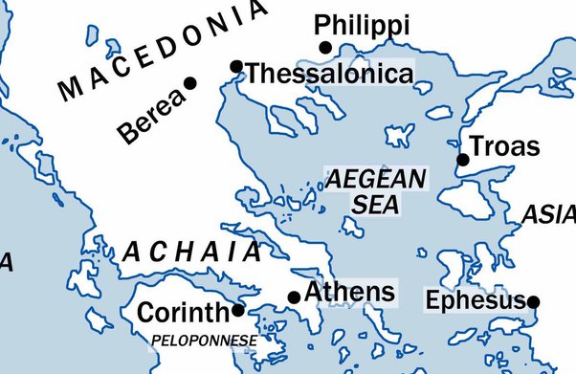

Slide 6
Study Objectives
These sessions are intended to provide help in studying the Word of God.
Our Objectives:
To learn to accurately handle the Word of God.
To teach you the process of “expository” (“word for word", "verse by verse”) study of God’s Word, in “context” according the revealed truth of the Bible.
To give you some tools to use to help you in your study.

Slide 7
Guidelines and Things to Consider
Please understand that, while this process will help you in your personal quiet time, this seminar focuses on understanding what the Bible says and what it means by using the tools that are available in order to understand the revealed truth of the Bible.
Use the information as a guide and adapt it to your particular style as you have time. It will be well worth whatever time you spend in learning and applying the Lord’s message.

Slide 8
Guidelines and Things to Consider
Studying and understanding God’s Word is a journey, not a destination. It involves praying, reading, meditating on the text, and waiting on the Leading of the Holy Spirit.
The treasure and majesty of His Word is found “in how the Holy Spirit illuminates it and gives us perfect insight to the Mind of Christ.”
Practice makes perfect.

Slide 9
Our Bible
Has 31,000 verses
1189 Chapters
  929 chapters in the Old Testament or 78%
  260 chapters in the New Testament 22%
The best commentary on the Bible is the Bible, and God engineered it all.
When we study God’s Word, we should let it tell us what it says and what it means.
In studying a passage especially one that we don’t understand, Let’s allow the weight of the whole of Scripture(31,000 verses) influence the verse or the passage. Overall themes will become apparent, and will help in the interpretation of specific passages.

Slide 10
Four Common Methods of Studying the Bible
Source: Got questions.org
Inductive Bible Study: Uses three basic steps that move from a focus on specific details to a more general, universal principle. It is defined as the attempt to use information about a specific situation to draw a conclusion.
The steps are observation (what does it say?), interpretation (what does it mean?), and application (what does it mean for my life?).
Inductive Bible study is a valuable tool in understanding and applying the principles of God’s Word.
It can be done on many different levels. The shorter version is good for a brief devotional. The more extensive study is wonderful for digging deeper into the mind and heart of God.
Inductive study starts with the evidence at hand and draws conclusions based on the evidence found in the Word. (like a jury hearing testimony in a trial).

Slide 11
Four Common Methods of Studying the Bible
Source: Got questions.org
2. Deductive Bible Study: is simply taking a general statement and then going to Scripture to find details that support (or disprove) it.
An example of deductive Bible study might be to start with the general statement, “Sin leads to death.”
The student of the Bible must then go to Scripture to find passages that support that statement. He might cite Romans 5:12, Romans 6:23, Ezekiel 18:20, and Jeremiah 31:30. If he finds that Scripture does indeed support his premise that sin leads to death, he can then make a more specific application: we are all in danger of death, because we are all sinners (Romans 3:23).
A weakness of the deductive method is if we start with a false premise, then we will not arrive at a proper conclusion.
For example, we might start with the general statement, “All angels have wings.” We might even find a passage or two in Scripture that mentions angels’ wings, such as Isaiah 6:2. But if our conclusion is “Michael has wings, because Michael is an angel,” then we are on shaky ground.

Slide 12
Four Common Methods of Studying the Bible
Source: Got questions.org
Topical Study, is similar to a deductive Bible study in that it begins with a general topic like marriage and then finds specific scriptures to find out what the Bible teaches about marriage and to draw conclusions from them. In this form, the passage provides support material for the topic.
4. Expository Bible Study- from “to expose”. This is the method I prefer as it starts with a passage of Scripture and then studies the grammar, the context, both “near and far” and the historical setting of that passage in order to understand the author's intent.
In other words, the expositor is one who analyzes the text carefully and objectively understands the meaning of the passage, and applies it.
Our seminar will focus on this method.

Slide 13
Fast Facts about our Bible
1. How many books are in the Bible?
The Bible contains 66 books, divided among the Old and New Testaments.
2. How many books are in the Old Testament?
There are 39 books in the Old Testament.
3. How many books are in the New Testament?
There are 27 books in the New Testament.

Slide 14
4. What does “testament” mean?
Testament means “covenant” or “contract.”
5. Who wrote the Bible?
The Bible was written under the inspiration of the Holy Spirit by over 40 different authors from all walks of life:
shepherds, farmers, tent-makers, physicians, fishermen, priests, philosophers and kings.
Despite these differences in occupation and the span of years it took to write it, the Bible is an extremely cohesive and unified book.

Slide 15
6. Which single author contributed the most books to the Old Testament?
Moses. He wrote the first five books of the Bible, referred to as the Pentateuch; the foundation of the Bible.
7. Which single author contributed the most books to the New Testament?
The Apostle Paul, who wrote 14 books (over half) of the New Testament.
8. When was the Bible written?
It was written over a period of some 1,500 years, from around 1450 B.C. (the time of Moses) to about 100 A.D. (following the death and resurrection of Jesus Christ).

Slide 16
9. What is the oldest book in the Old Testament?
Many scholars agree that Job is the oldest book in the Bible, written by an unknown Israelite about 1500 B.C.
Others hold that the Pentateuch (the first five books of the Bible) are the oldest books in the Bible, written between 1446 and 1406 B.C.
10. What is the youngest book in the Old Testament?
The book of Malachi, written about 400 B.C.

Slide 17
11. What is the oldest book of the New Testament?
Probably the book of James, written as early as A.D. 45.
12. What is the youngest book in the New Testament?
The Book of Revelation is the youngest book of the New Testament, written about 95 A.D.
13. What languages was the Bible written in?
The Bible was written in three languages: Hebrew (O.T., Aramaic*, Daniel and parts of Ezra) and Koine Greek (N.T.).
*Aramaic was the language of the Babalonians. and was spoken in Israel during the time of Jesus. Greek - Alexander the Great- during the Intertestamental Period – N.T was written in common/Koine Greek(source: Gotquestions.org)

Slide 18
What Happens When We Study God’s Word
We see how all the puzzle pieces of life fit into the tapestry of eternity.
We learn that now even though we see through the mirror darkly, Christ’s promise is that one day we will see face to face, knowing fully as we have been fully known.
1Corinthians 13:9-10

Slide 19
My Story

Slide 20
Objective 1
To Learn to accurately handle the Word of God:

Slide 21
Expository Bible Study:
Discovery
Background Investigation
In order to understand the Bible one must first know the Author. An unsaved person can not understand God’s Word on its face as it is spiritually discerned. Ask the Lord to show you in prayer and He will give you discernment. 1Cor.2:14-16
Are you a believer in Christ for your salvation?
If not take care of that first. Here is a very clear article to help you if you have questions: https://www.gotquestions.org/know-sure-Heaven.htmlnotebook

Slide 22
Assemble your tools: A good study Bible that you can mark in, and a notebook in which to journal and make notes;
Start by praying and asking the Holy Spirit to empower you, to feed you as you read, study, meditate and imbed His Word into the very fabric of your life …so that you can be transformed by it.
Psalm 119: ¹⁸ Open my eyes, that I may behold wonderful things from Your Law.
Jeremiah 15:16: ¹⁶ Your words were found and I ^{(A)}ate (gk. Devoured) them,
And Your ^{(B)}words became a joy to me and the delight of my heart;
For I have been ^{(C)}called by Your name, Lord God of armies.

Slide 23
As you begin, read the book or the passage several times with a notebook. Make notes for each chapter, writing down your observations of the passages within the chapter.
  Take your time as this is not a race but an exploration.
  Break it down into bite size pieces.
  Acts as an example has 28 chapters, so look at an outline in your study Bible and break it down into divisions.
  Next meditate on what you have learned.
  Write down some applications of what the Lord is teaching you from the content.

Slide 24
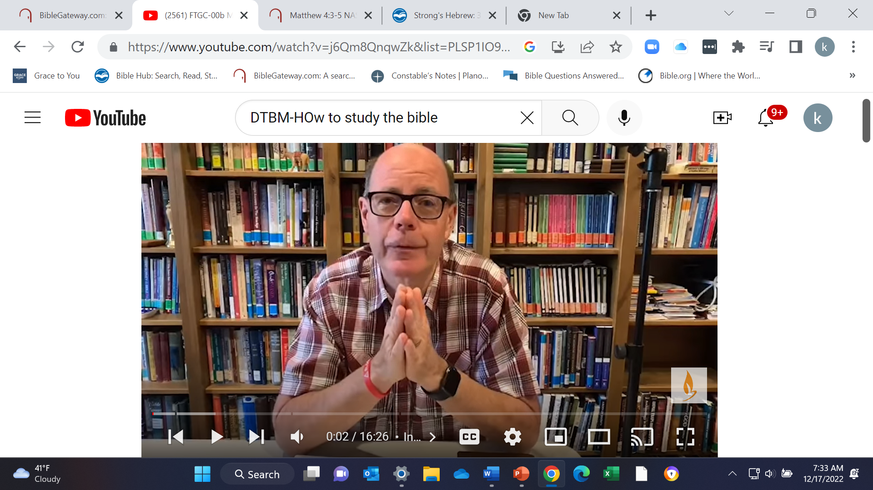
Discover the Book Ministries- Dr. John Barnett. https://www.youtube.com/watch?v=j6Qm8QnqwZk&list=PLSP1IO9h3J7vaPEt28uOpOCGCnDxahyNJ&index=2

Slide 25
Session 2
WiFi
North Shore Church
Password: Revelation

Slide 26
    A. Become a detective. Discover the following:
    Who- Who was the author of the book.?
    To whom is it written?
    Are there any specific individuals described in the passage? If so make a note.
    (Sources): Introduction in your Study Bible, or another online-
    Introduction to the book in printed Commentaries-
    i.e. The Bible Knowledge Commentary, or Dr. Constable’s Notes; Bible Hub.com https://www.Biblehub.com
    John MacArthur’s Introduction to the book, and online sources like https://www.gotquestions.org/

Slide 27
Become a detective. Discover the following:
When- was it written.-
When did the events happen?
(Sources): Introduction to your Study Bible, or Life Application Chronological Study Bible, as examples. Also refer to Online sources: https://BibleHub.com., Bible timelines; Life Application Study Bible.

Slide 28
Become a detective. Discover the following:
  Where- Where did the message take place?
    Where was the author when it was written?
    Where did the audience live?
    Did the author have help? If so who were they and what was their relationship?
    What is the geography of the area where the audience resides?
(sources)- Bible Maps and Charts: https://www.BibleHub.com https://www.Ploughboy.org etc.) which is an app for I phone or I Pad. (The I Pad app has better detail). Introductions to the book from your Study Bible, other commentaries in print or online- Dr. Constable’s Notes, John MacArthur Introductions to the book from www.gracetoyou.org or the I phone app.

Slide 29
Become a detective. Discover the following:
  What…is going on in the text and behind the scenes [context]*
  *To better understand the importance of studying the Bible in Context see: https://www.gotquestions.org/context-Bible.html
    The article referenced has been printed for you in the syllabus provided.
    What was the language being spoken?
    What was the culture of the audience and the government of the land? Learn as much as you can about the Jewish culture, the factions of people within the culture, including the Greek and Roman Influence.
    What is the history of the area?
    What challenges does the author and his audience face?
    Try to discern the theme in your notes of the section through your study.
    (sources)- In commentaries: Life Application Chronological Bible, Intro to the book in your favorite study Bible;

Slide 30
B. Interpretation and Evaluation
What does the Bible Say And What Does It Mean?
Follow these principles:
  a. Take a passage, explore the notes in your study Bible, seek out the meaning of the words in the context of the verse-
  (sources) BibleHub.com- The Interlinear Bible by verse, and the Englishman’s Concordance. Look up the word and discern its meaning from the original language.)
  b. What is the Lord saying to you through this passage and how can you apply this to your life?

Slide 31
Four Principles to Follow in Evaluation:
  Literal principle- the Bible should be understood in its literal normal and natural sense- MacArthur. The Bible will interpret itself through the context:
  Near Context: What does the passage mean for this audience?
  Far Context: What does the passage mean in light of the overarching theme of God’s Word?
  Historical Principle- What did the passage mean to the people to whom it was first written?

Slide 32
Four Principles to Follow in Your Evaluation
  C. Grammatical Principle: Following the sentence structure, pronouns, tense of the main verb, etc. will help things become clear.
  (source: Bible Hub- Greek interlinear verse by verse.)
  D. Synthesis Principle: The Bible will not contradict itself. If something seems contradictory, compare it to other scriptures on the topic.
  (sources: Topics in Got Questions.org, Strong’s concordance, Bible definitions of words in context- Bible Hub Greek interlinear, Gateway Bible- verse look up and explore cross-references at bottom of the verse, notes from your study Bible.)

Slide 33
C. Application and Correlation:
How can I use what I have learned to improve my “walk with the Lord”?
What must I do or what must I change to walk more closely with the Lord?
Make sure that what I’ve learned correlates and aligns with the unwavering truth that is taught over and over through the 66 books of God’s revealed Word.
Share with others!

Slide 34
Objective 2
To teach you the process of “expository” or a “word for word", "verse by verse” study of God’s Word, in “context” according to the revealed truth of the Bible

Slide 35
Step 1.
Putting Concepts into Practice
Accessing your Tools:
  Study Bible
  Printed or Online Commentaries
  Online Resources:- each has a wealth of information
  https://www.Biblegateway.com/
  https://Biblehub.com/
    Greek Interlinear Bible- Verse by verse
    Englishman's Concordance
  https://planoBiblechapel.org/constable-notes/
  https://www.gotquestions.org/

Slide 36
Following The Process of Understanding the Passage
Possible steps that you can follow (Overview):
Pray for guidance
  Access the Bible section for your study.
  Make notes as you study.
  Follow the Bible Study Basics-“who, what, when, and where” of the passage, chapter, or book.
  Apply the 4 Principles, Literal, Historical, Grammatical, Synthesis/”Alignment without contradiction;”

Slide 37
Following The Process of Understanding the Passage
Possible steps that you can follow continued:
  Research the passage or verse in the Greek. www.Biblehub.com.
  Look up cross-references and “word search” to the passage or verse.
  Look at parallel translations for the passage or verse. www.biblegateway.com or www.biblehub.com
  Review commentaries you trust.
  What does the revealed truth of the whole of scripture say about your conclusion?
  Application: What did you learn from the passage?

Slide 38
Step 2.
Access the Passage
Example Acts 2:37-42 Go To: (https://Biblegateway.com)
³⁷ Now when they heard this, they were ^{[a]}pierced to the heart, and said to Peter and the rest of the apostles, “^{[b]}Brothers, ^{(A)}what are we to do?”
³⁸ Peter said to them, “^{(B)}Repent, and each of you be ^{(C)}baptized in the name of Jesus Christ for the forgiveness of your sins, and you will receive the gift of the Holy Spirit. ³⁹ For ^{(D)}the promise is for you and your children and for all who are ^{(E)}far away, as many as the Lord our God will call to Himself.”

Slide 39
⁴⁰ And with many other words he solemnly ^{(F)}testified and kept on urging them, saying, “^{[c]}Be saved from this ^{(G)}perverse generation!”
⁴¹ So then, those who had received his word were baptized; and that day there were added about three thousand ^{[d](H)}souls.
⁴² They were ^{(I)}continually devoting themselves to the apostles’ teaching and to fellowship, to ^{(J)}the breaking of bread and ^{(K)}to ^{[e]}prayer.

Slide 40
Footnotes to Acts 2:37-42 “Biblegateway.org”
Acts 2:37 Lit Men, brothers
Acts 2:40 Or Escape
Acts 2:41 I.e., persons
Acts 2:42 Lit the prayers

Slide 41
Cross references for Acts 2: 37-42 “Gateway Bible
Acts 2:37 : Luke 3:10, 12, 14
Acts 2:38 : Mark 1:15; Luke 24:47; Acts 3:19; 5:31; 20:21
Acts 2:38 : Mark 16:16; Acts 8:12, 16; 22:16
Acts 2:39 : Is 44:3; 54:13; 57:19; Joel 2:32; Rom 9:4; Eph 2:12
Acts 2:39 : Eph 2:13, 17
Acts 2:40 : Luke 16:28
Acts 2:40 : Deut 32:5; Matt 17:17; Phil 2:15
Acts 2:41 : Acts 3:23; 7:14; 27:37; Rom 13:1; 1 Pet 3:20; Rev 16:3
Acts 2:42 : Acts 1:14
Acts 2:42 : Luke 24:30; Acts 2:46; 20:7; 1 Cor 10:16
Acts 2:42 : Acts 1:14

Slide 42
Analyze Acts 2:38- Examine the meaning of the verse: See Bible Hub.org/ Greek Interlinear of verse 38 of chapter 2.
Examination.
What is Acts 2:38 about? Read Acts 1 and 2
What Does this passage relate to Chapters 1 and 2? What is it saying?
What does it mean?
What is the (immediate or “near”), and the (whole of revealed scripture or “far”) context of the verse or passage?
When did the concept of Baptism/ ceremonial cleansing begin in the O.T. for the Jews? Try a word search. An easy way to research cleansing or baptism is https://gotquestions.org

Slide 43
Using www.Got Questions.org
Topical Questions in “a short answer format”

Slide 44
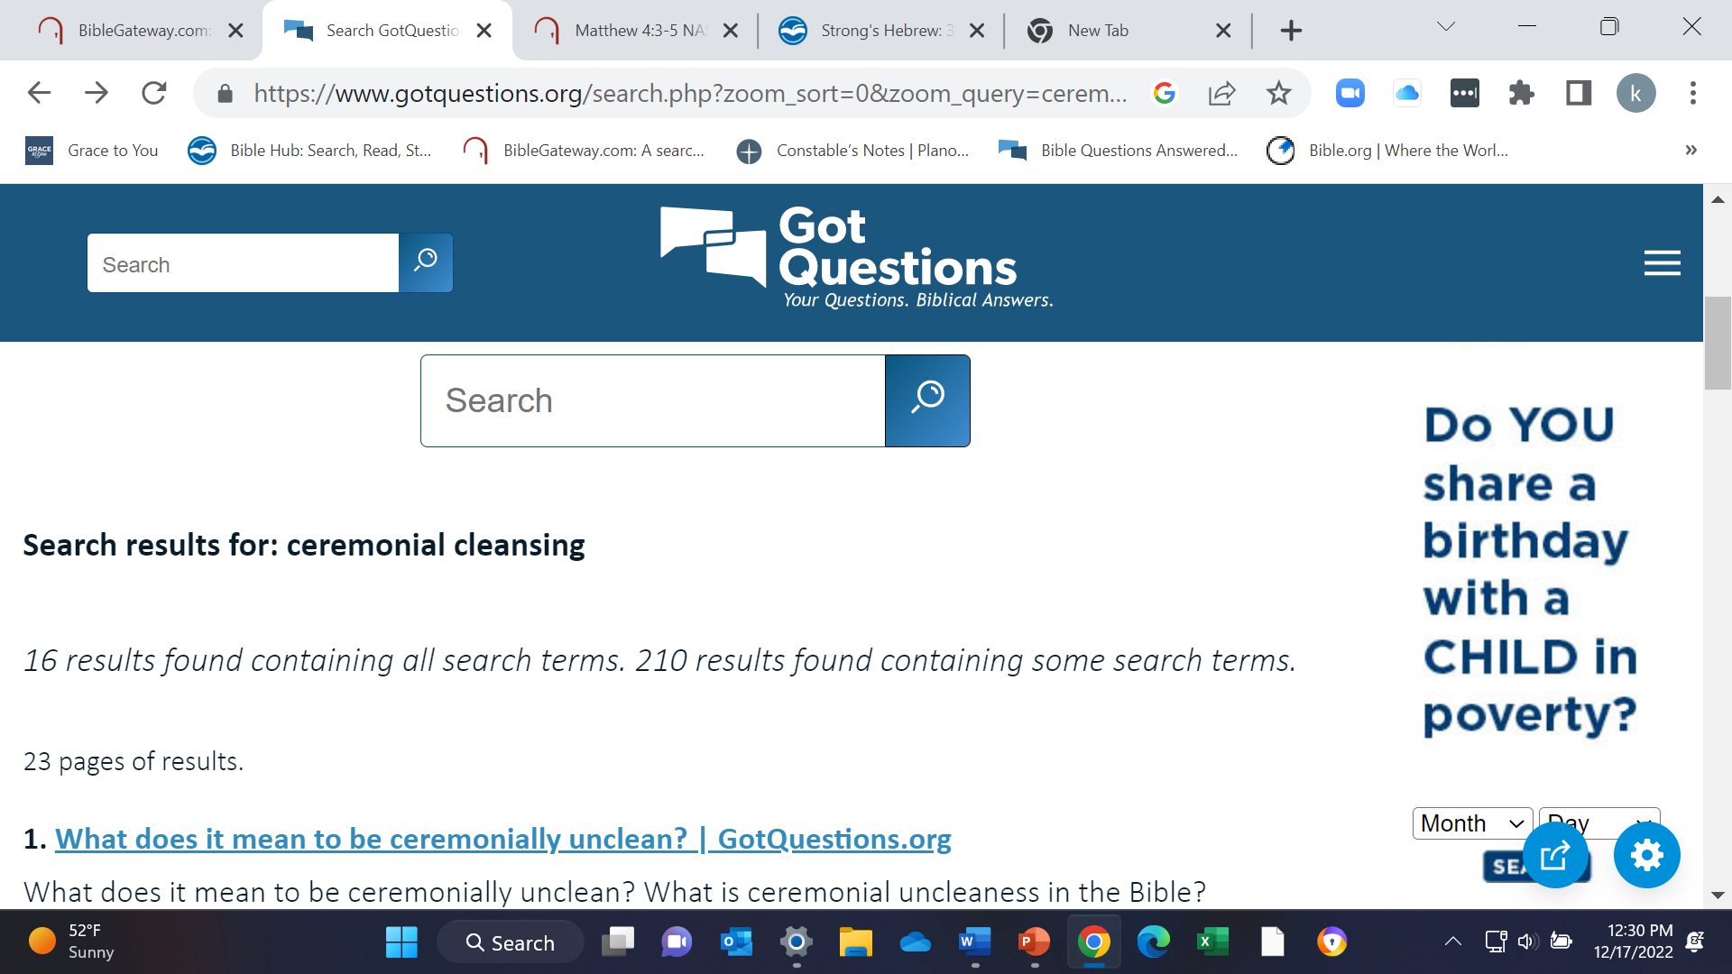



Slide 45
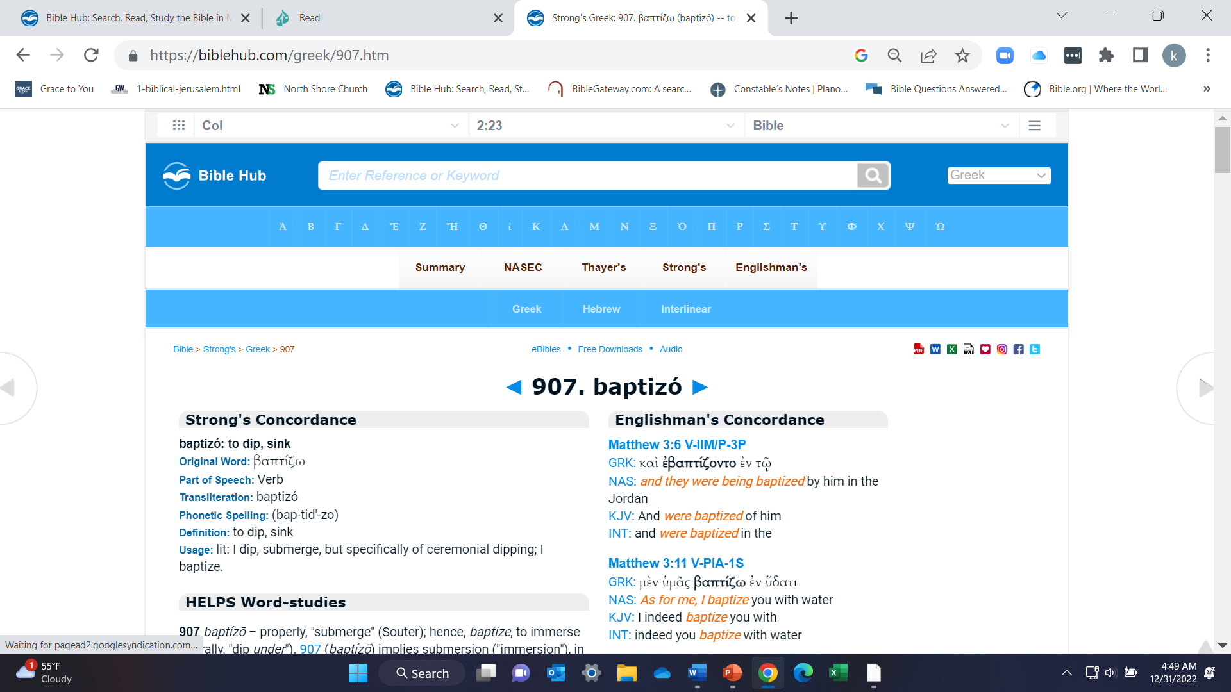
Next, click on the “Strong’s number 907 over the word “baptizo”

Slide 46
  What was the purpose of Baptism/ “cleansing” for the Jews in their faith? (Leviticus: 14-16)
  What is the context (historical- “near” and “far”) of the verse, in the culture of the people?
  Where was baptism performed in this case Acts 2, and other incidents in the gospels? Example John: 1; Matthew 3:
  Who were those who needed to be baptized in the Jewish culture?
  Who baptized people in the Jewish religion? Contrast that understanding with the meaning of Baptism after the resurrection.
  Then take a Look at the meaning of the words in Bible Hub/ interlinear/ Acts 2:38
    https://Biblehub.com/commentaries/acts/2-38.htm
³⁸ Peter said to them,
“^{(A)}Repent, and each of you be ^{(B)}baptized in the name of Jesus Christ for the forgiveness of your sins, and you will receive the gift of the Holy Spirit.
  Look up the verse in Bible Hub/ interlinear/ Acts 2:38
    If so who were they and what was their relationship?

Slide 47
Finding the Greek definition of a word in a verse
Using www.biblehub.com/interlinear
To find the Greek definition of a word or verse

Slide 48
Analysis of the meaning: Investigate (BibleHub/interlinear)
https://Biblehub.com/interlinear/acts/2-38.htm
³⁸ Peter said to them, “^{(A)}Repent, and each of you be ^{(B)}baptized in the name of Jesus Christ for the forgiveness of your sins, and you will receive the gift of the Holy Spirit. NASB
“Repent” Strong’s #3340- to change one’s mind or purpose.
“be baptized”- Strong’s # 907- to dip, “submerge,” but specifically of ceremonial dipping; I baptize.
“For is #519 eis (a preposition) – properly, into (unto) – literally, "motion into which" implying penetration ("unto," "union") to a particular purpose or result.

Slide 49
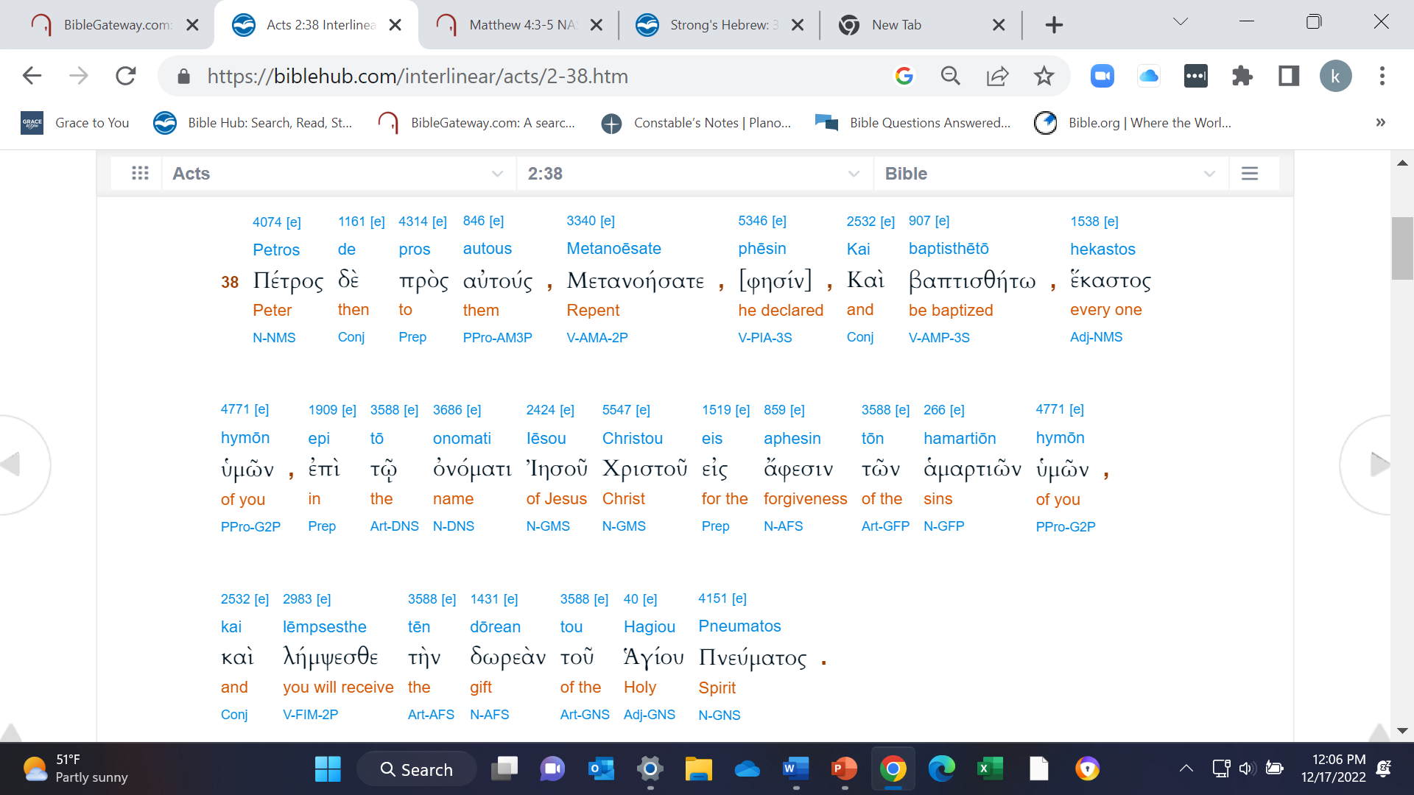


Slide 50
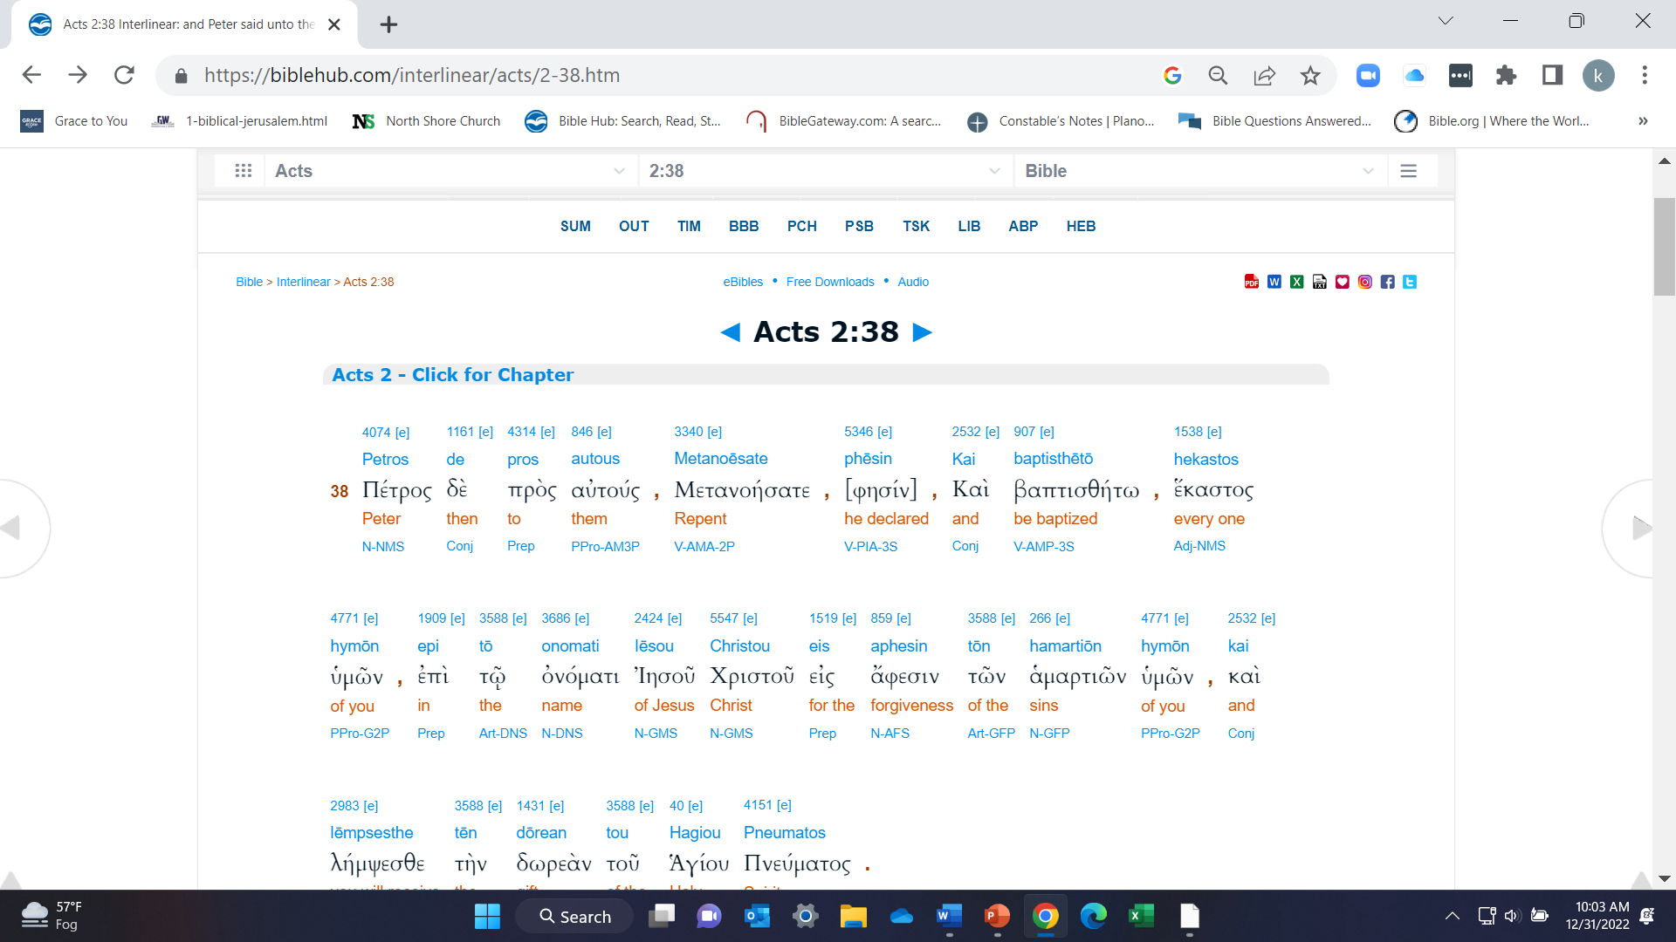

Next Click on “baptized” 907 [e] baptisthētō βαπτισθήτω , be baptized V-AMP-3S-

Slide 51
Cross-referencing a verse
Using www.biblegateway.com to find cross-references or parallel translations for a verse
1. Choose the passage from www.biblegateway.org.
Look for cross-references below the passage
Choose the passage from www.biblehub.com
Look under “Parallel” and they will show up.

Slide 52
Cross-references for Acts 2:38
Acts 3:19 ¹⁹ Therefore ^{(A)}repent and return, so that your sins may be wiped away, in order that ^{(B)}times of refreshing may come from the presence of the Lord;
Acts 4:10 let it be known to all of you and to all the people of Israel, that by the name of Jesus Christ the Nazarene, whom you crucified, whom God raised from the dead—by this name this man stands here before you in good health.
Acts 5:30-31 ^{31 (A)}He is the one whom God exalted ^{[a]}to His right hand as a ^{[b](B)}Prince and a ^{(C)}Savior, to grant ^{(D)}repentance to Israel and forgiveness of sins.

Slide 53
Word Search: “Be Baptized”
Matthew 3:6and they were being baptized by him in the Jordan River, as they confessed their sins.
Matthew 3:13-16The Baptism of Jesus Then Jesus *arrived from Galilee at the Jordan, coming to John to be baptized by him. But John tried to prevent Him, saying, “I have the need to be baptized by You, and yet You are coming to me?” ¹⁵ But Jesus, answering, said to him, “Allow it at this time; for in this way it is fitting for us ^{(A)}to fulfill all righteousness.” Then he *allowed Him.¹⁶After He was baptized, Jesus came up immediately from the water; and behold, the heavens were opened, and he saw the Spirit of God descending as a dove and settling on Him
Mark 1:4-5 ⁴ John the Baptist appeared in the wilderness [a](A)preaching a baptism of repentance for the (B)forgiveness of sins. And all the country of Judea was going out to him, and all the people of Jerusalem; and they were being baptized by him in the Jordan River, confessing their sins.

Slide 54
Handling “problem verses”
Timestamp 50:08-1:01:30

Slide 55
Word Search: “Be Baptized”
Luke 7:29-30 When all the people and the tax collectors heard this, they acknowledged God’s justice, having been baptized with the baptism of John. But the Pharisees and the lawyers rejected God’s purpose for themselves, not having been baptized by John.
Luke 47:45-47 45 Then He (AR)opened their [v]minds to understand the Scriptures, 46 and He said to them, “(AS)So it is written, that the [w]Christ would suffer and (AT)rise from the dead on the third day, 47 and that (AU)repentance [x]for forgiveness of sins would be proclaimed [y]in His name to (AV)all the nations, beginning from Jerusalem.
John 3:23 Now John also was baptizing in Aenon, near Salim, because there was an abundance of water there, and people were coming and being baptized—
Acts 1:5 for John baptized with water, but you will be baptized with the Holy Spirit not many days from now.”
Acts 2:38 Peter said to them, “Repent, and each of you be baptized in the name of Jesus Christ for the forgiveness of your sins, and you will receive the gift of the Holy Spirit.
Mark 16:16 The one who has believed and has been baptized will be saved, but the one who has not believed will be condemned.

Slide 56
Word search: “In the name of Jesus”
Acts: 3:6 But Peter said, “I do not have silver and gold, but what I do have I give to you: In the name of Jesus Christ the Nazarene, walk!”
Acts 4:12 And there is salvation in no one else; for there is no other name under heaven that has been given among mankind by which we must be saved.”
Acts 10:48 And he ordered them to be baptized in the name of Jesus Christ. Then they asked him to stay on for a few days.

Slide 57
“Be Baptized” Parallel Translations
Mark 16:15-16 ¹⁵ NIV He said to them, “Go into all the world and preach the gospel to all creation. ^{(A)} ¹⁶ Whoever believes and is baptized will be saved, but whoever does not believe will be condemned.
KJV¹⁵ And he said unto them, Go ye into all the world, and preach the gospel to every creature. ¹⁶ He that believeth and is baptized shall be saved; but he that believeth not shall be damned.
NKJV^{15 (A)}And He said to them, “Go into all the world ^{(B)}and preach the gospel to every creature. ^{16 ©}He who believes and is baptized will be saved; ^{(D)}but he who does not believe will be condemned,
NLT¹⁵ And He said to them, “^{(A)}Go into all the world and preach the gospel to all creation. ^{16 (B)}The one who has believed and has been baptized will be saved, but the one who has not believed will be condemned.

Slide 58
Acts 2:38 Parallel Translations
New International Version Peter replied, “Repent and be baptized, every one of you, in the name of Jesus Christ for the forgiveness of your sins. And you will receive the gift of the Holy Spirit.
English Standard Version And Peter said to them, “Repent and be baptized every one of you in the name of Jesus Christ for the forgiveness of your sins, and you will receive the gift of the Holy Spirit.
King James Bible Then Peter said unto them, Repent, and be baptized every one of you in the name of Jesus Christ for the remission of sins, and ye shall receive the gift of the Holy Ghost.
New American Standard Bible Peter said to them, “Repent, and each of you be baptized in the name of Jesus Christ for the forgiveness of your sins, and you will receive the gift of the Holy Spirit.
New Living Translation Peter replied, “Each of you must repent of your sins and turn to God, and be baptized in the name of Jesus Christ for the forgiveness of your sins. Then you will receive the gift of the Holy Spirit.

Slide 59
Studying a Commentary that you trust for a passage

Slide 60
Dr. Thomas Constables Notes on Mark 2023 edition. Page 346; Mark 16:16- Commentary
16:16 This is a verse that some people believe teaches the necessity of water baptism for salvation. However, Christian baptism elsewhere in the New Testament is always defined by an outward confession of belief in Jesus Christ.
This verse also regards baptism as such. The second part of the verse clearly teaches that unbelief alone results in condemnation (cf. 9:43- 48),
not belief and failure to undergo baptism. In the first part of the verse, one article governs both participles: "has believed and has been baptized" or "believes and is baptized" (NIV).
This indicates the close relationship between believing and being baptized. However, they are not inseparable (cf. Rom. 3:21-28; 1 Cor. 1:17; Eph.2:8-9).
Baptism is not a condition for salvation, but it is an important step of obedience for a believing disciple.

Slide 61
Using a Concordance to search occurrences of a phrase or word in a text.
    1. Do a phrase or word search in
    www.Biblegateway.com
    Ask a question in www.gotquestions.org

Slide 62
Salvation by Faith Alone
Ephesians 2: 8-9- ⁸ For ^{(A)}by grace you have been saved ^{(B)}through faith; and ^{[a]}this is not of yourselves, it is ^{(C)}the gift of God; ^{9 (D)}not a result of works, so that ^{(E)}no one may boast. ¹⁰ For we are His workmanship, ^{(F)}created in ^{(G)}Christ Jesus for ^{(H)}good works, which God ^{(I)}prepared beforehand so that we would ^{(J)}walk in them.
Acts 16: The Jailer Converted in Philippi: 31-34 ³¹ They said, “^{(BF)}Believe in the Lord Jesus, and you will be saved, you and ^{(BG)}your household.” ³² And they spoke the word of God to him together with all who were in his house. ³³ And he took them ^{(BH)}that very hour of the night and washed their wounds, and immediately he was baptized, he and all his household. ³⁴ And he brought them into his house and set ^{[j]}food before them, and was ^{[k]} overjoyed since he had become a believer in God together with ^{(BI)}his whole household.

Slide 63
Salvation by Faith Alone Continued
Cornelius’ and His Household Acts 10:43-48
^{43 (BM)}All the prophets testify of Him, that through ^{(BN)}His name everyone who believes in Him receives forgiveness of sins.”
⁴⁴ While Peter was still speaking these words, ^{(BO)}the Holy Spirit fell upon all those who were listening to the ^{[ae]}message. ^{45 (BP)}All the ^{[af]}Jewish believers who came with Peter were amazed, because the gift of the Holy Spirit had also been ^{(BQ)}poured out on the Gentiles. ⁴⁶ For they were hearing them ^{(BR)}speaking with tongues and exalting God. Then Peter responded, ⁴⁷ “^{(BS)}Surely no one can refuse the water for these to be baptized, who ^{(BT)}have received the Holy Spirit just as we did, can he?” ⁴⁸ And he ^{(BU)}ordered them to be baptized ^{(BV)}in the name of Jesus Christ.

Slide 64
Salvation by Faith Alone
Romans 3:21 Justification by Faith ²¹ But now apart ^{[a]}from the Law ^{(A)}the righteousness of God has been revealed, being ^{(B)}witnessed by the ^{[b]}Law and the Prophets,
Romans 4:1-8 Justification by Faith What then shall we say that Abraham, ^{[a]}our forefather ^{(A)}according to the flesh, has found? ² For if Abraham was justified ^{[b]}by works, he has something to boast about; but ^{(B)}not ^{[c]}before God.
³ For what does the Scripture say? “^{(C)}Abraham believed God, and it was credited to him as righteousness.”
⁴ Now to the one who ^{(D)}works, the wages are not credited as a favor, but as what is due. ⁵ But to the one who does not work, but ^{(E)}believes in Him who justifies the ungodly, his faith is credited as righteousness, ⁶ just as David also speaks of the blessing of the person to whom God credits righteousness apart from works:
⁷ “^{(F)}Blessed are those whose lawless deeds have been forgiven,
And whose sins have been covered.
^{8 (G)}Blessed is the man whose sin the Lord will not ^{(H)}take into account.”

Slide 65
Review Commentaries: Dr. Constable
Acts 2:38
https://planoBiblechapel.org/constable-notes/ General Site
https://planoBiblechapel.org/tcon/notes/pdf/acts.pdf Specific page for Acts.
  Go to Acts 2:38 page 77 for an explanation
Check out other commentaries- on websites
Dr. John MacArthur notes from I phone app (not available on the website). How to access the notes:
  Copy the notes from your I phone to an email to you
  then copy the text of the email to a Word doc. (.wpd)

Slide 66
Review and Discuss Acts 2:37-42
How did it go?
What did the Lord teach you in your study of the passage?
What tools or tips do you typically use when studying the Bible that might help someone else?
What worked well in studying the passage?
What did you learn about the passage?
What questions do you have?

Slide 67
Objective 3
To give you some tools to use to help you in your study.
“Timestamp 1:01:30- 117:28”

Slide 68
A Crucial Note About Resources Available in Studying the Bible
We will look at some resources next and some will include online resources.
but let’s understand that long before there were online resources, the Lord was able to teach us with His printed Word, through the Holy Spirit.
We let the Holy Spirit guide us in our study and which resources to use.
Online resources are simply another tool in our study toolbox to help in our study. They are not for everyone.
Anything online is also in print. Our goal here is to understand how to use whatever source you are most comfortable with!

Slide 69
Study Bibles are a relatively new edition to the Bible inventory, and they make it easier to study.
The first printed Bible was the Geneva Bible in 1560.
The first Study Bible was the Scofield Study Bible written and Published in 1917 by Oxford University Press

Slide 70

Some Study Resources Available to the Student:
A Good Study Bible(s) One As Accurate A Translation As You Can Find
Ryrie Study Bible- NASB- I use this one.

Slide 71

Some Study Resources Available to the Student:
A Good Study Bible(s) One As Accurate A Translation As You Can Find
The Life Application Study Bible- NIV;

Slide 72

Some Study Resources Available to the Student:
A Good Study Bible(s) One As Accurate A Translation As You Can Find
The Life Application, Chronological Study
Bible, New Living Translation, NLT;

Slide 73
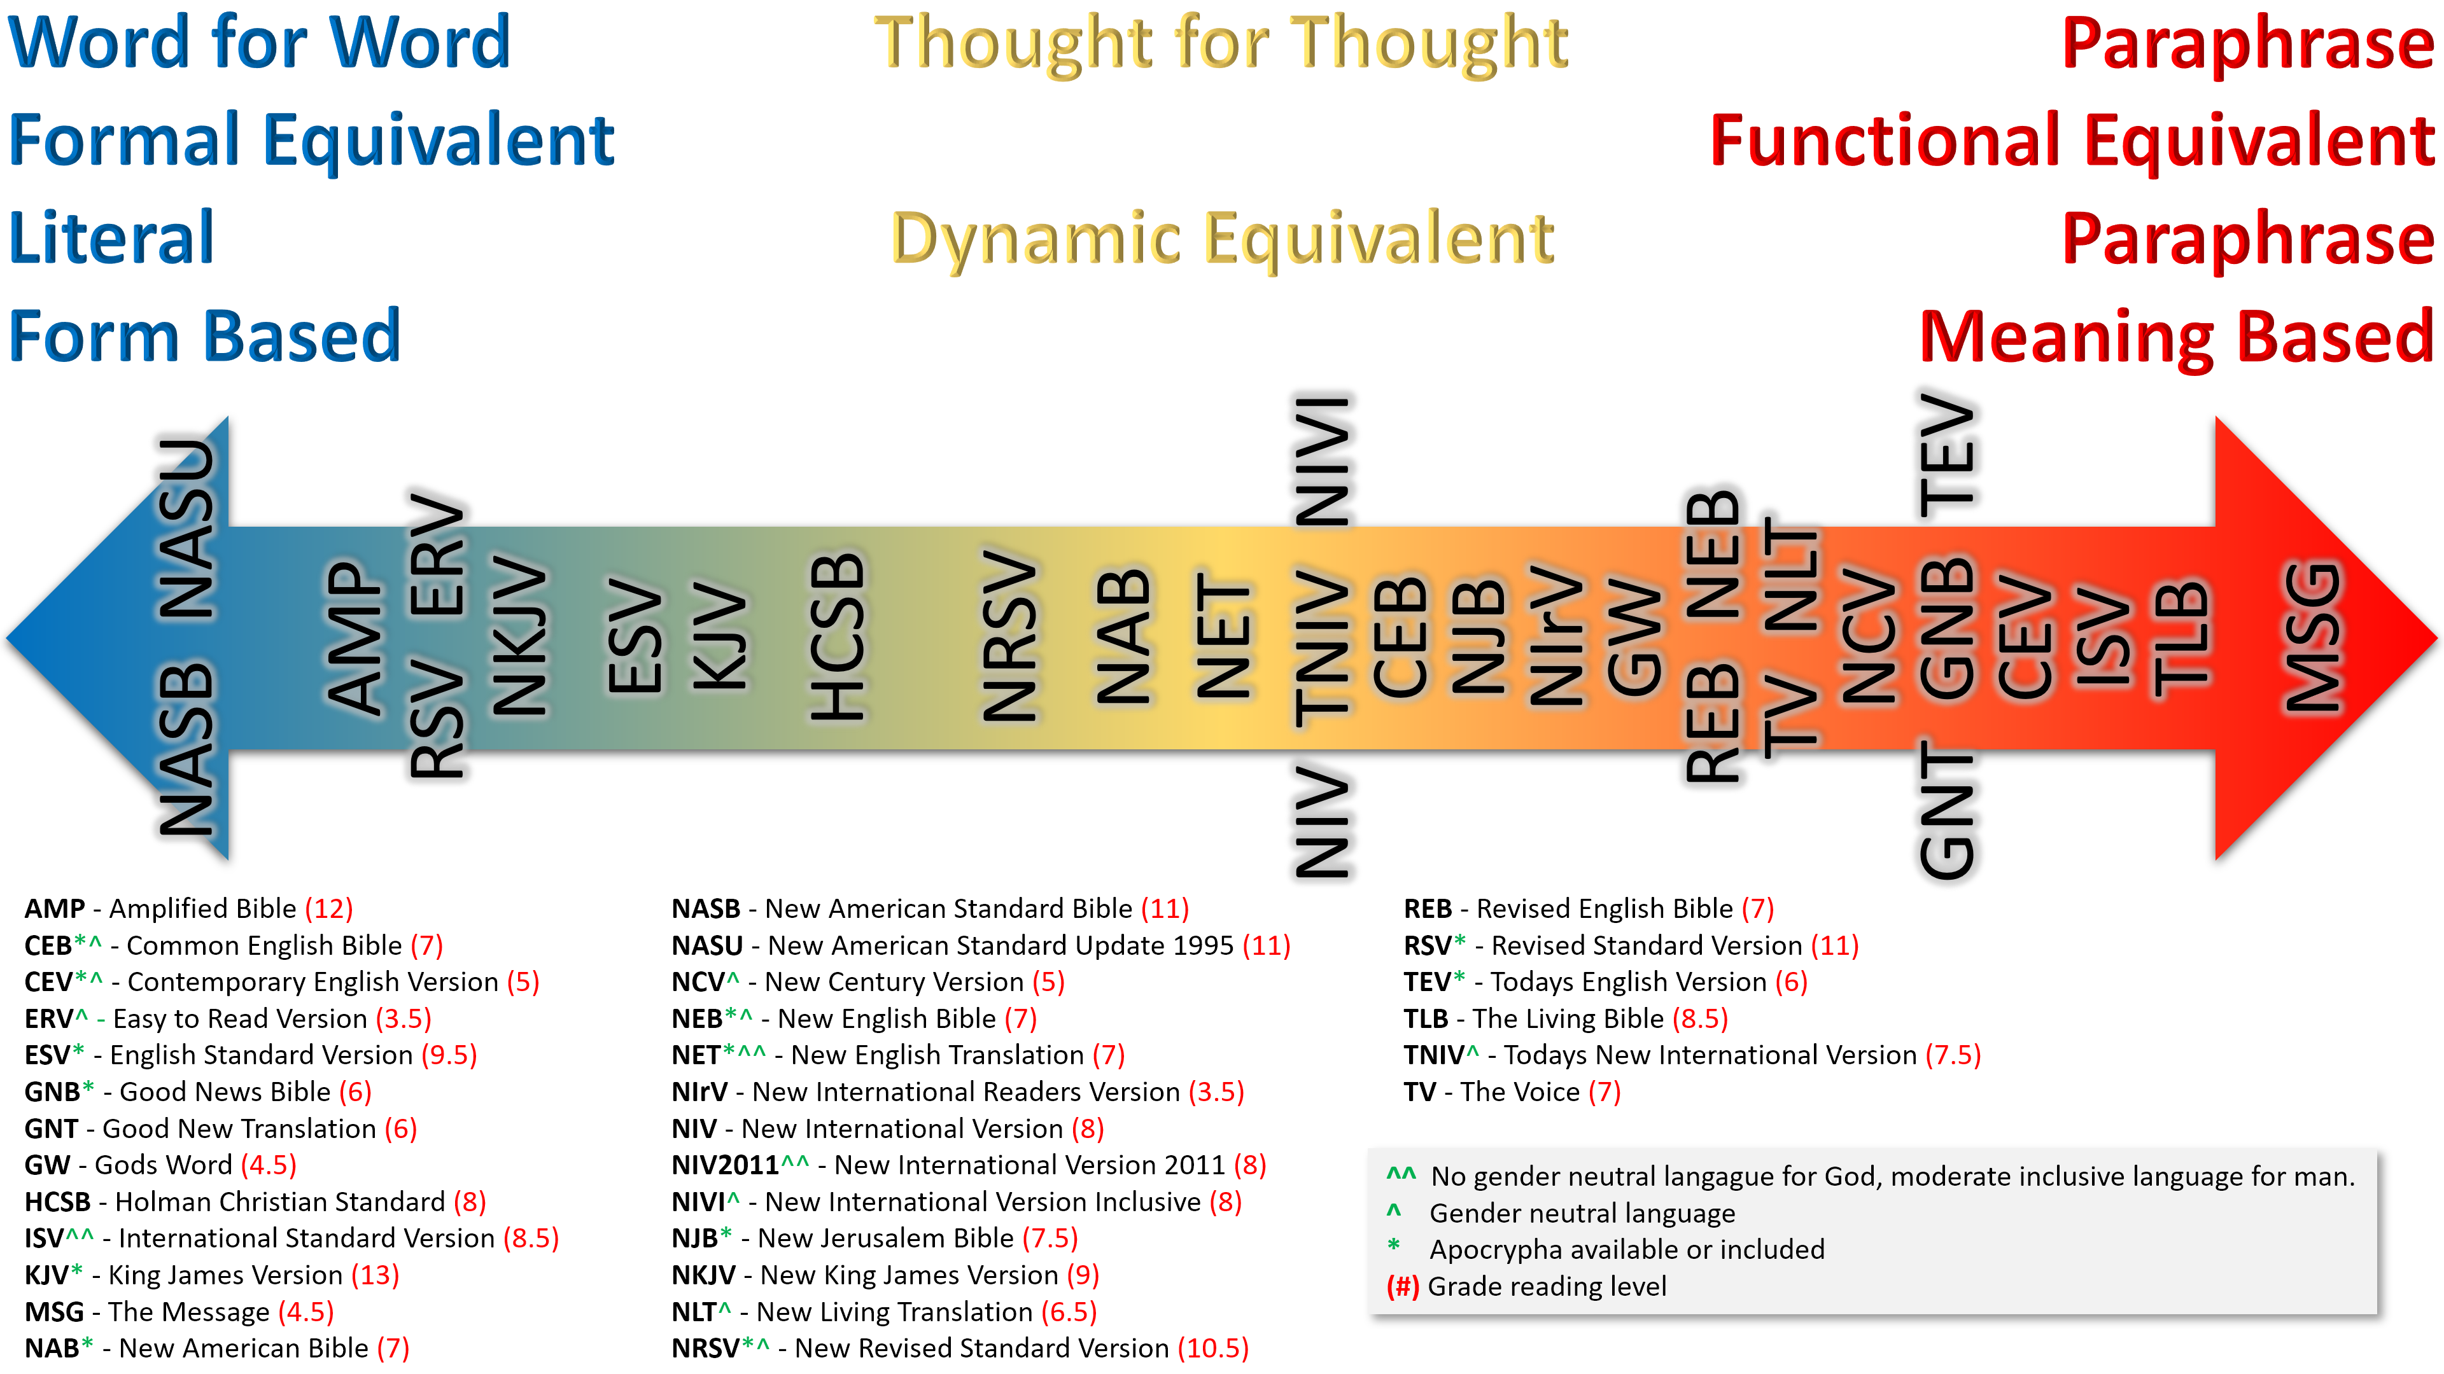

Slide 74
The MacArthur Study Bible, “Also has an App for I phones at the Apple App Store”
Beautiful Bible Stories – Stories from the Old Testament through the Ministry of Jesus.by Rev. Charles P. Roney D.D. ; the John A. Hertel Co. Wichita, KA; 1978 ed. Stories from the beginning through the life of Jesus;
“Printed” Commentaries, Bible Dictionaries, Atlases, Maps, Greek Interlinear Bible, and others.
Access to an Exhaustive Concordance in print
Access to Englishman’s Concordance in Print or online on https://BibleHub.com

Slide 75
Online Resources
Online resources that I typically use:
www.Biblegateway.com
www.BibleHub.com –This has a wealth of information
www.gotquestions.org;
https://Bible.org/book/about-Bibleorg.;
https://www.generationword.com/jerusalem101/1-biblical-jerusalem.html
www.gracetoyou.org –
https://www.ploughboy.org/ website; note: “The I phone app has the map interactive map features- the website does not.;

Slide 76
Online Resources
Online resources that I typically use:
www.Biblegateway.com
Screenshot

Slide 77
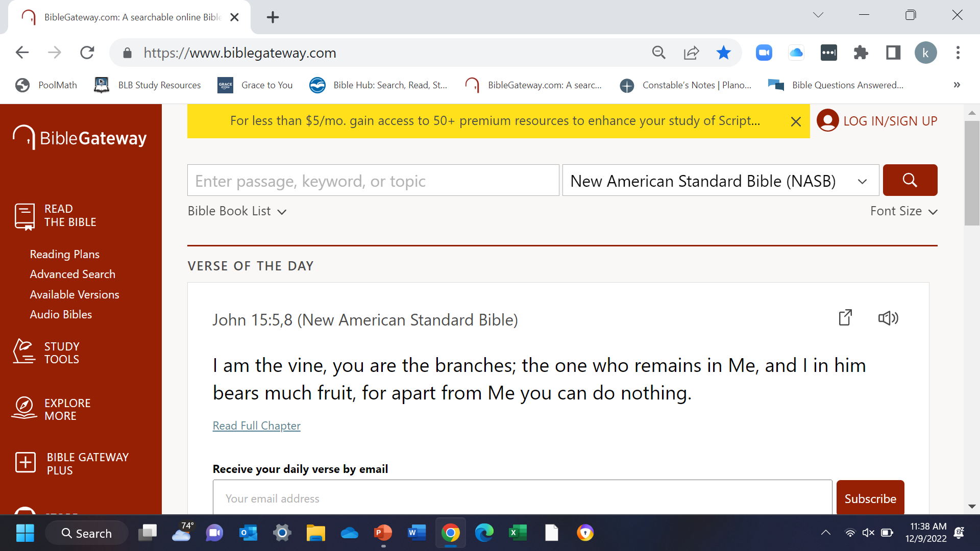

Slide 78
https://www.BibleHub.com

Slide 79
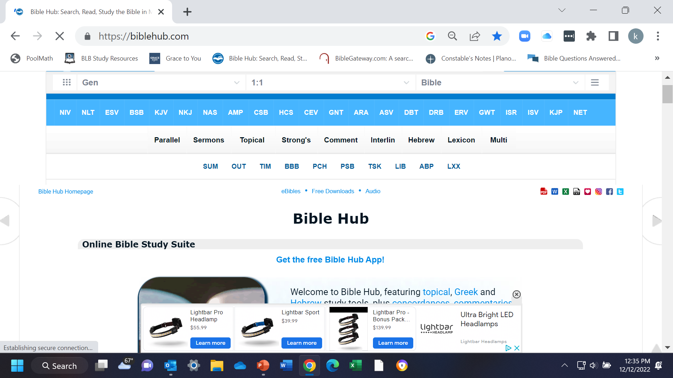

Slide 80
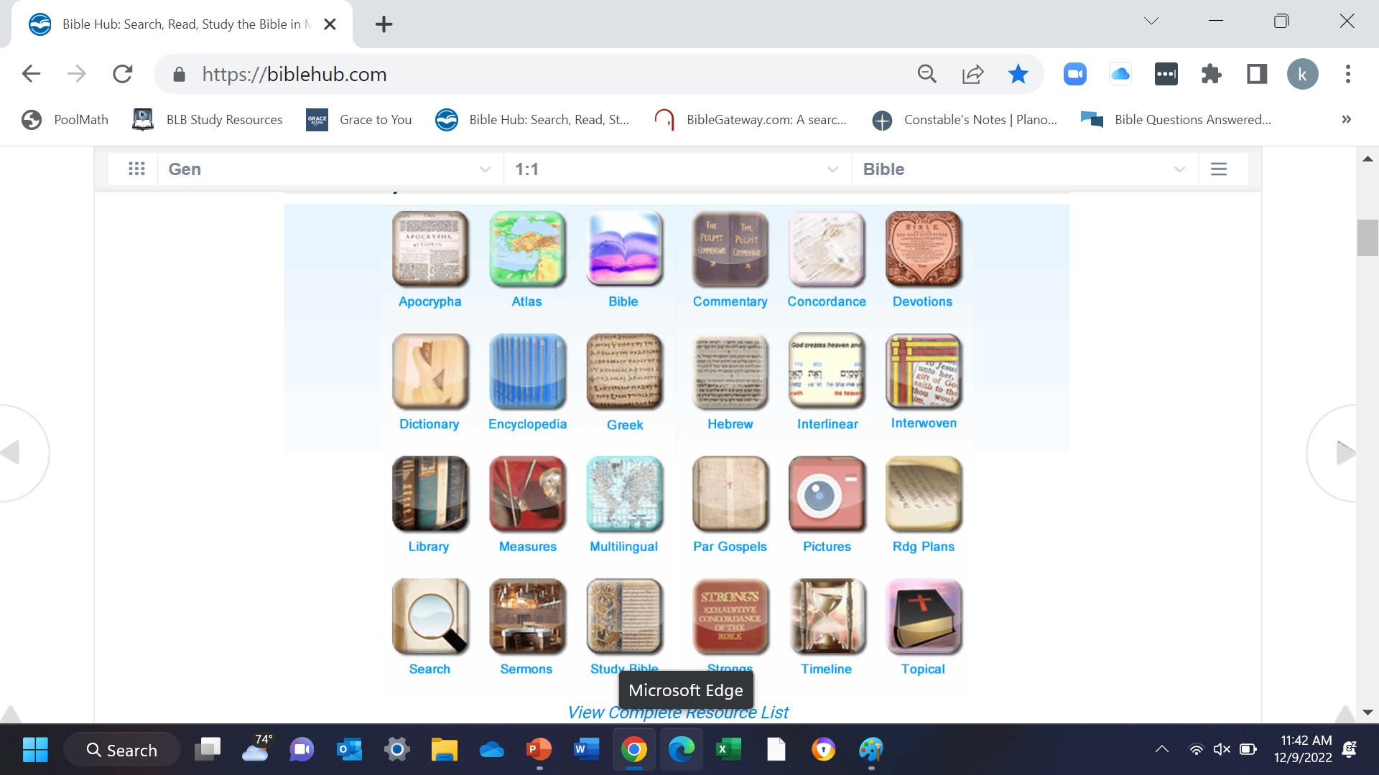

Slide 81
Online Resources
www.gotquestions.org;
This site is the “Cliff Notes of the Bible”.

Slide 82
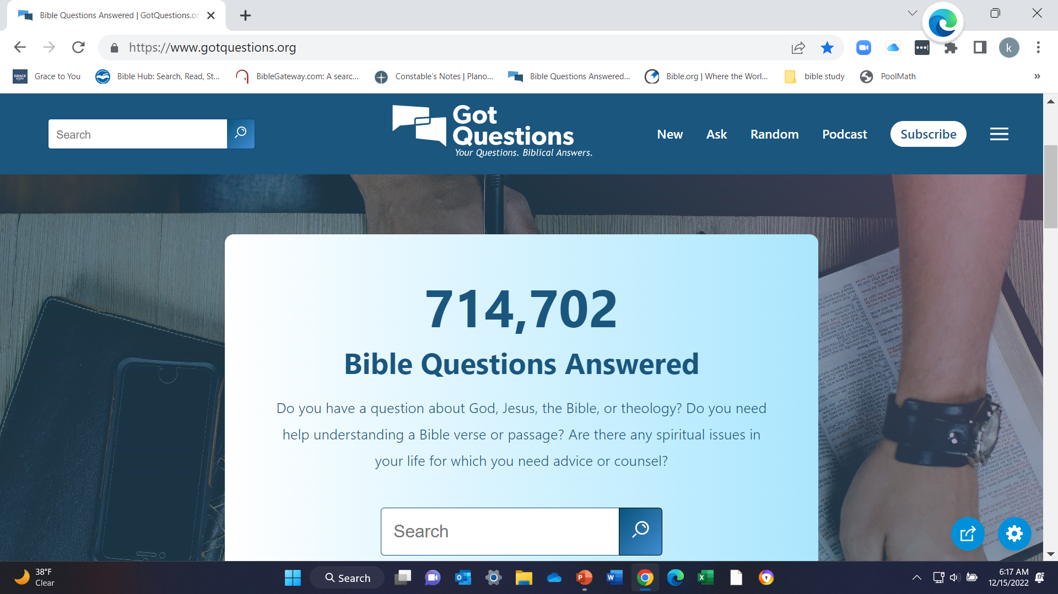

Slide 83
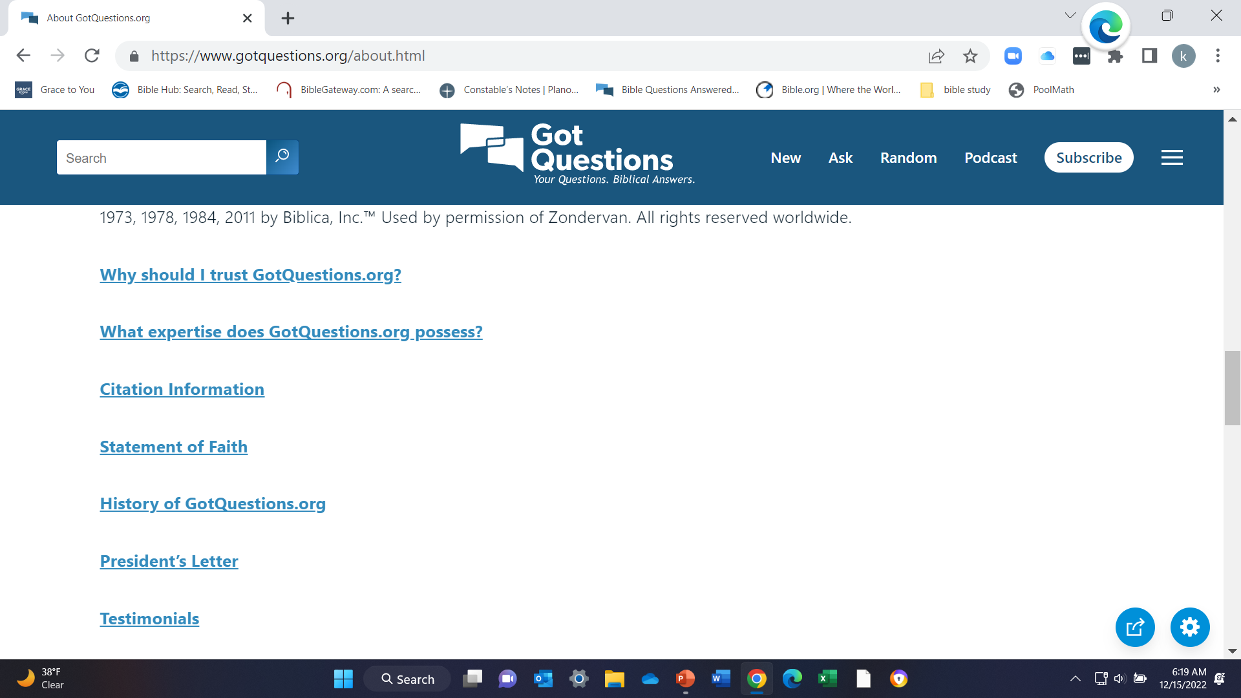

Slide 84
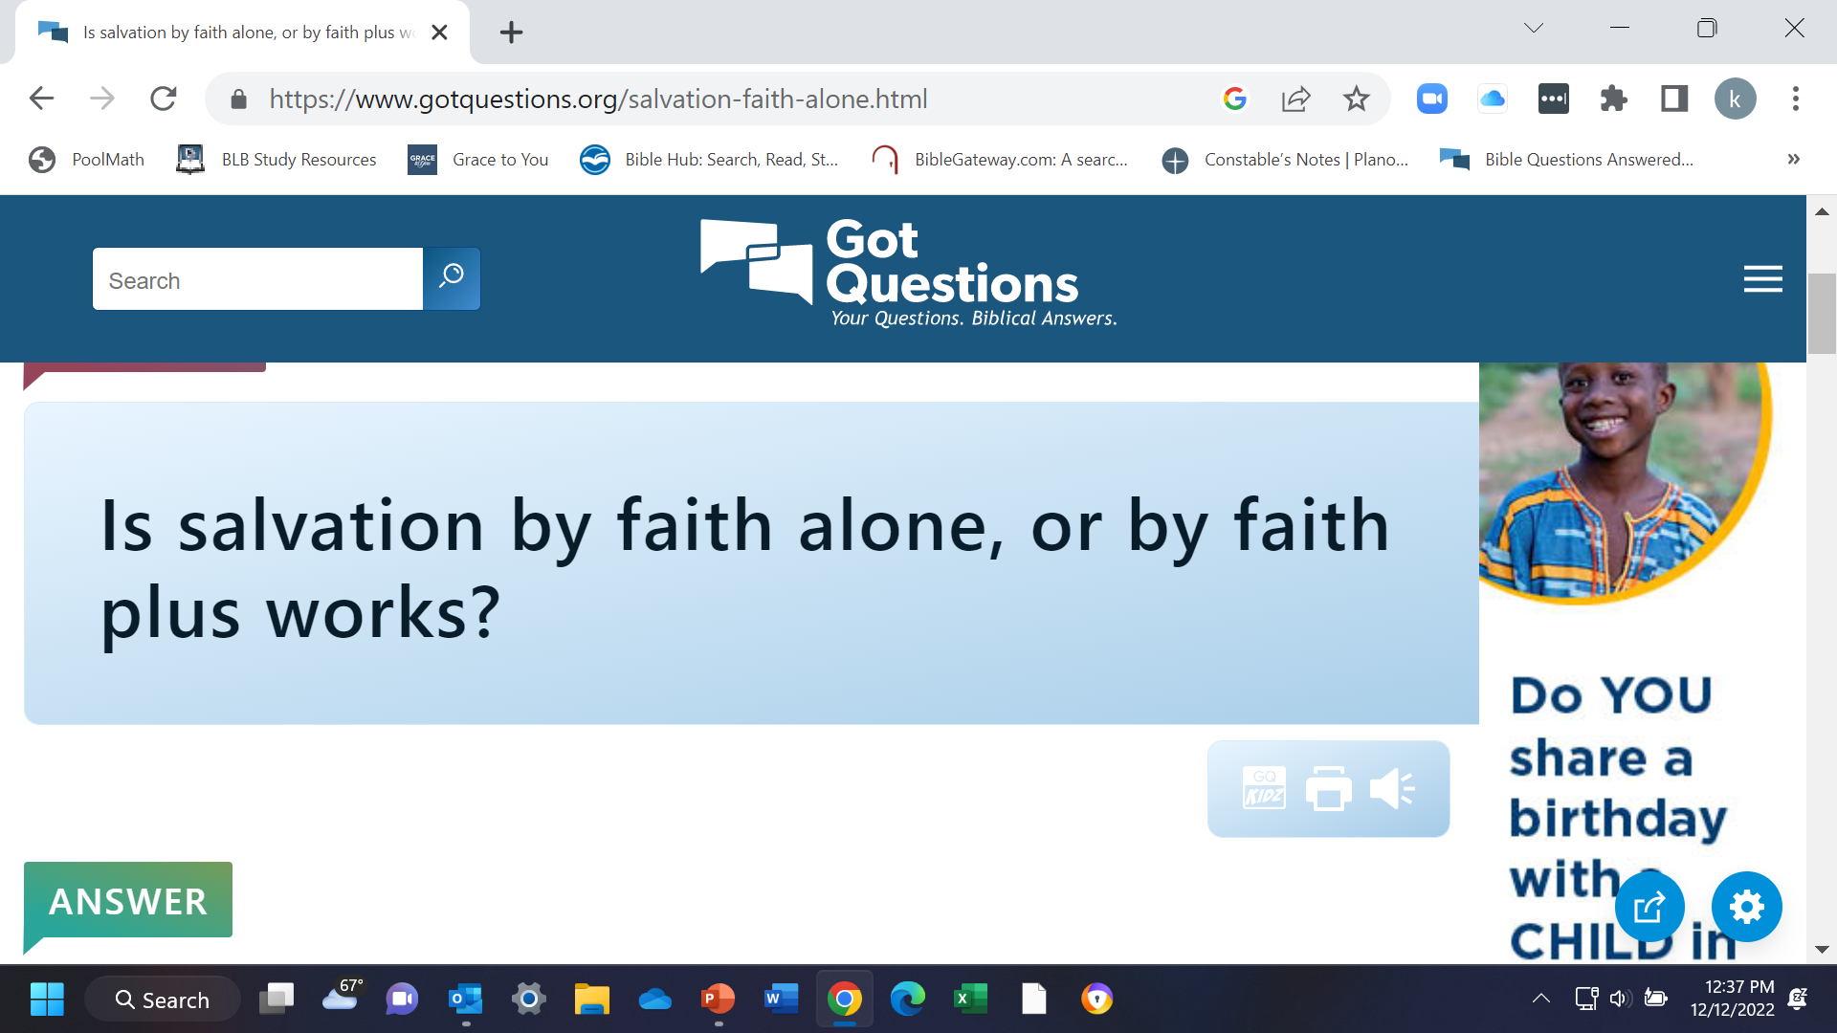

Slide 85
Online Resources
https://Bible.org/book/about-Bible.org

Slide 86
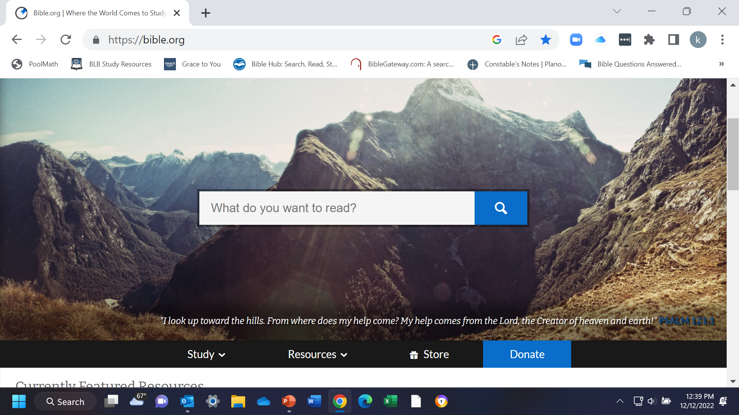

Slide 87
Online Resources
Grace to you. org
www.gracetoyou.org –

Slide 88
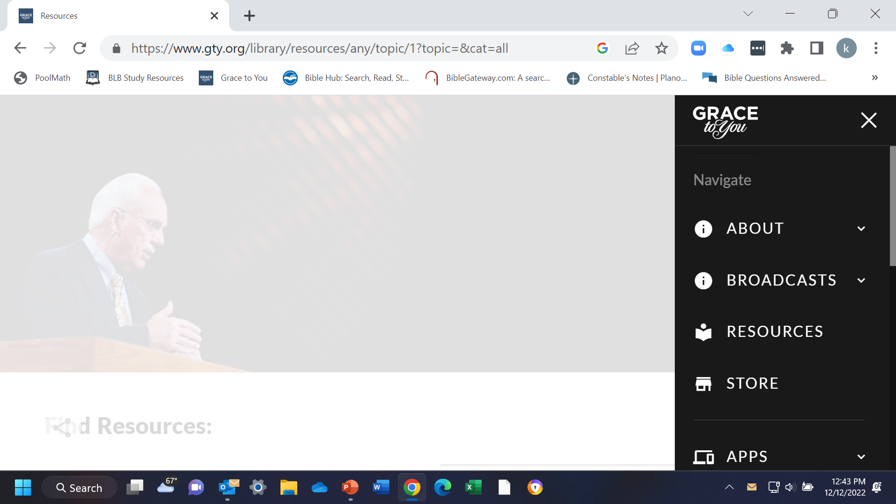

Slide 89
Online Resources
https://www.ploughboy.org/
website; note: “The I phone app has the map interactive map features- the website does not.;

Slide 90
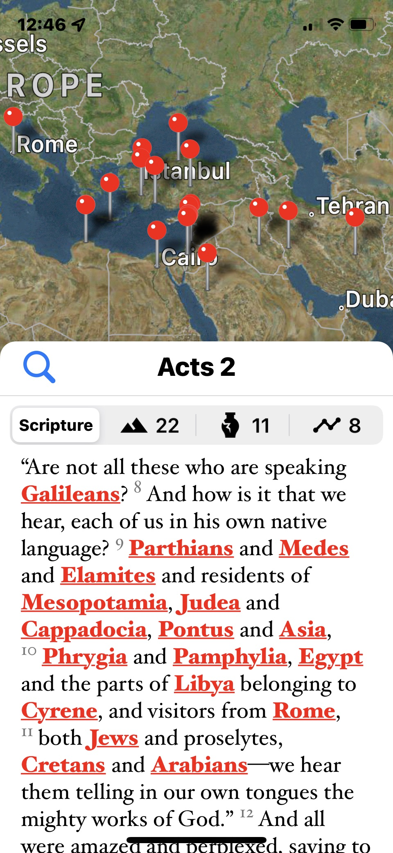

Slide 91
You Tube and Other Websites:
Sermons
https://discoverthebook.org/about-us/- Dr. John Barnett;
Grace to you Ministries, Dr. John MacArthur- https://www.gracetoyou.org/
Many others are out there.
  Explore and examine their content for accuracy to God’s Word.

Slide 92
Online Resources Summary
Online resources that I typically use:
www.Biblegateway.com
www.BibleHub.com
www.gotquestions.org;
https://Bible.org/book/about-Bibleorg.;
www.gracetoyou.org – www.gty.org
https://www.ploughboy.org/ website; note: “The I phone app has the map interactive map features- the website does not.;

Slide 93
I Phone Resources / Applications
  Plano Bible Chapel- Dr. Thomas Constable’s Notes- there is no iOS. app available to my knowledge. https://planoBiblechapel.org/constable-notes/but it can be downloaded onto favorites in your phone library;
Bible gateway app;
Bible hub app;
ploughboy app, - in the App store as “Bible Map”
gotquestions.org, app;
John MacArthur Study Bible with Notes app,; Grace to you Ministries, Dr. John MacArthur- https://www.gracetoyou.org/

Slide 94
Other Online Resources:
Maps, Pictures, Explanations
https://www.generationword.com/jerusalem101/1-biblical-jerusalem.html

Slide 95
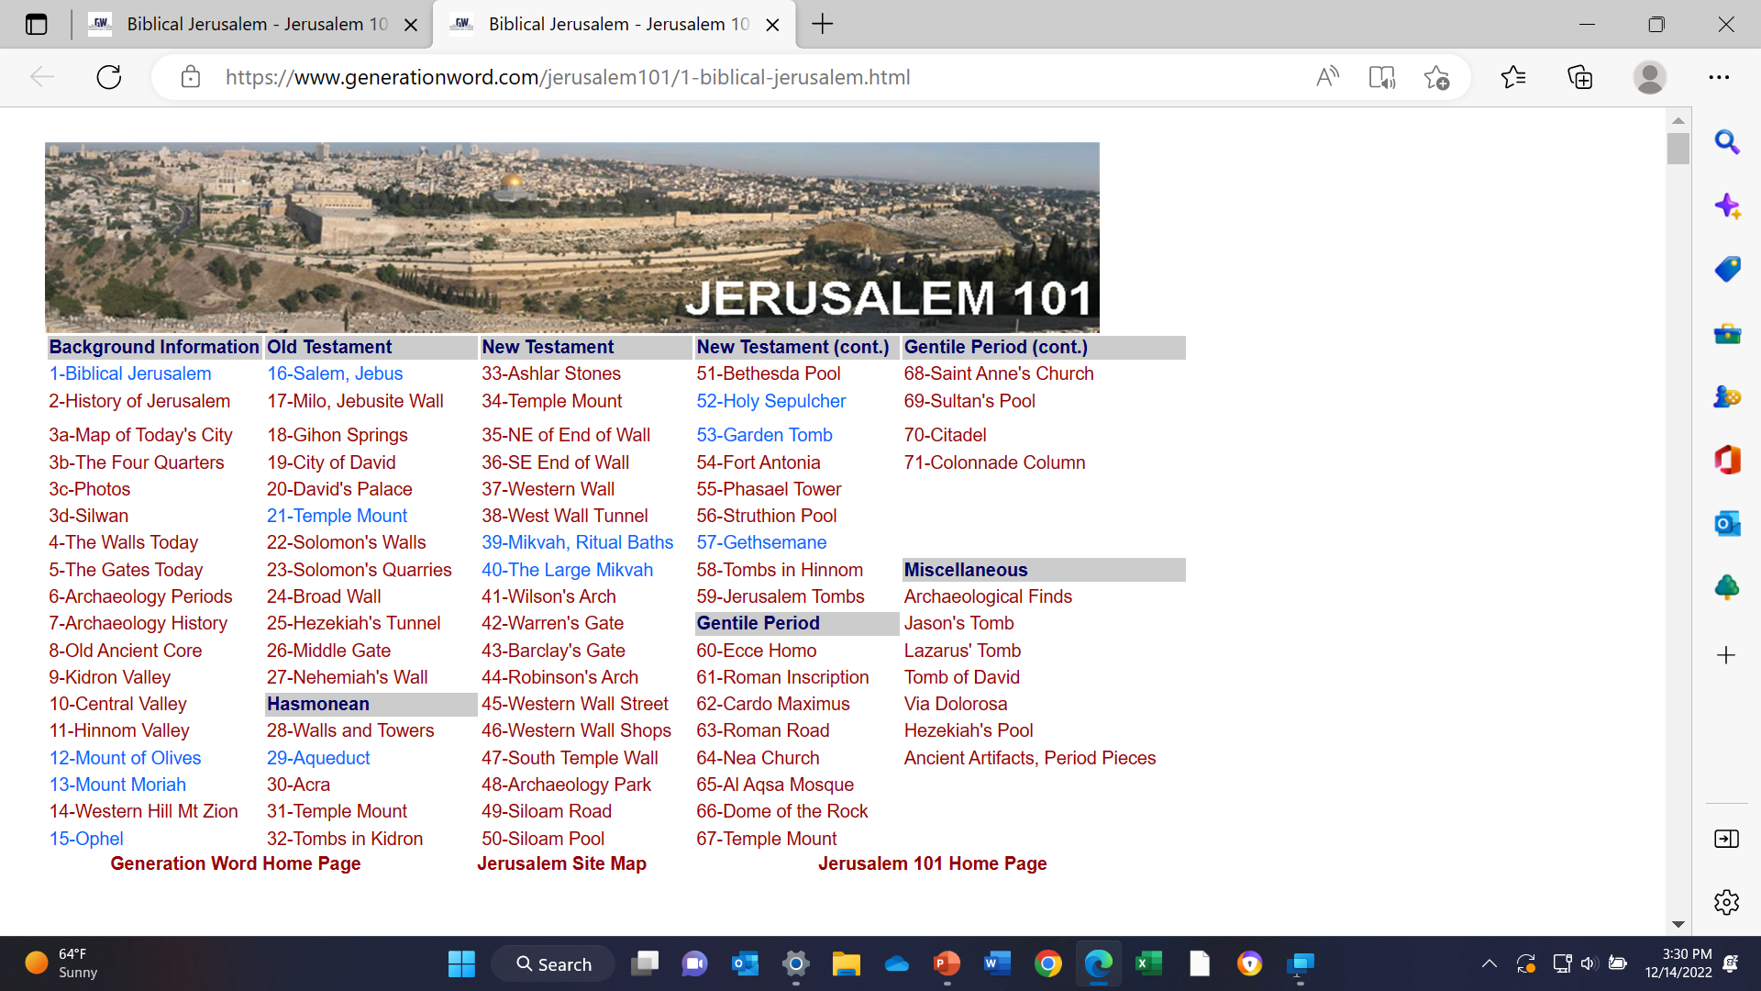

Slide 96
Other Online Resources
Ancient Israel-
https://www.generationword.com/Israel/Israel_site_page.htm
Disclaimer- I found this site for maps and charts of ancient Israel.
The doctrinal content has not been vetted although I have read the introductory material and the statement of faith.

Slide 97
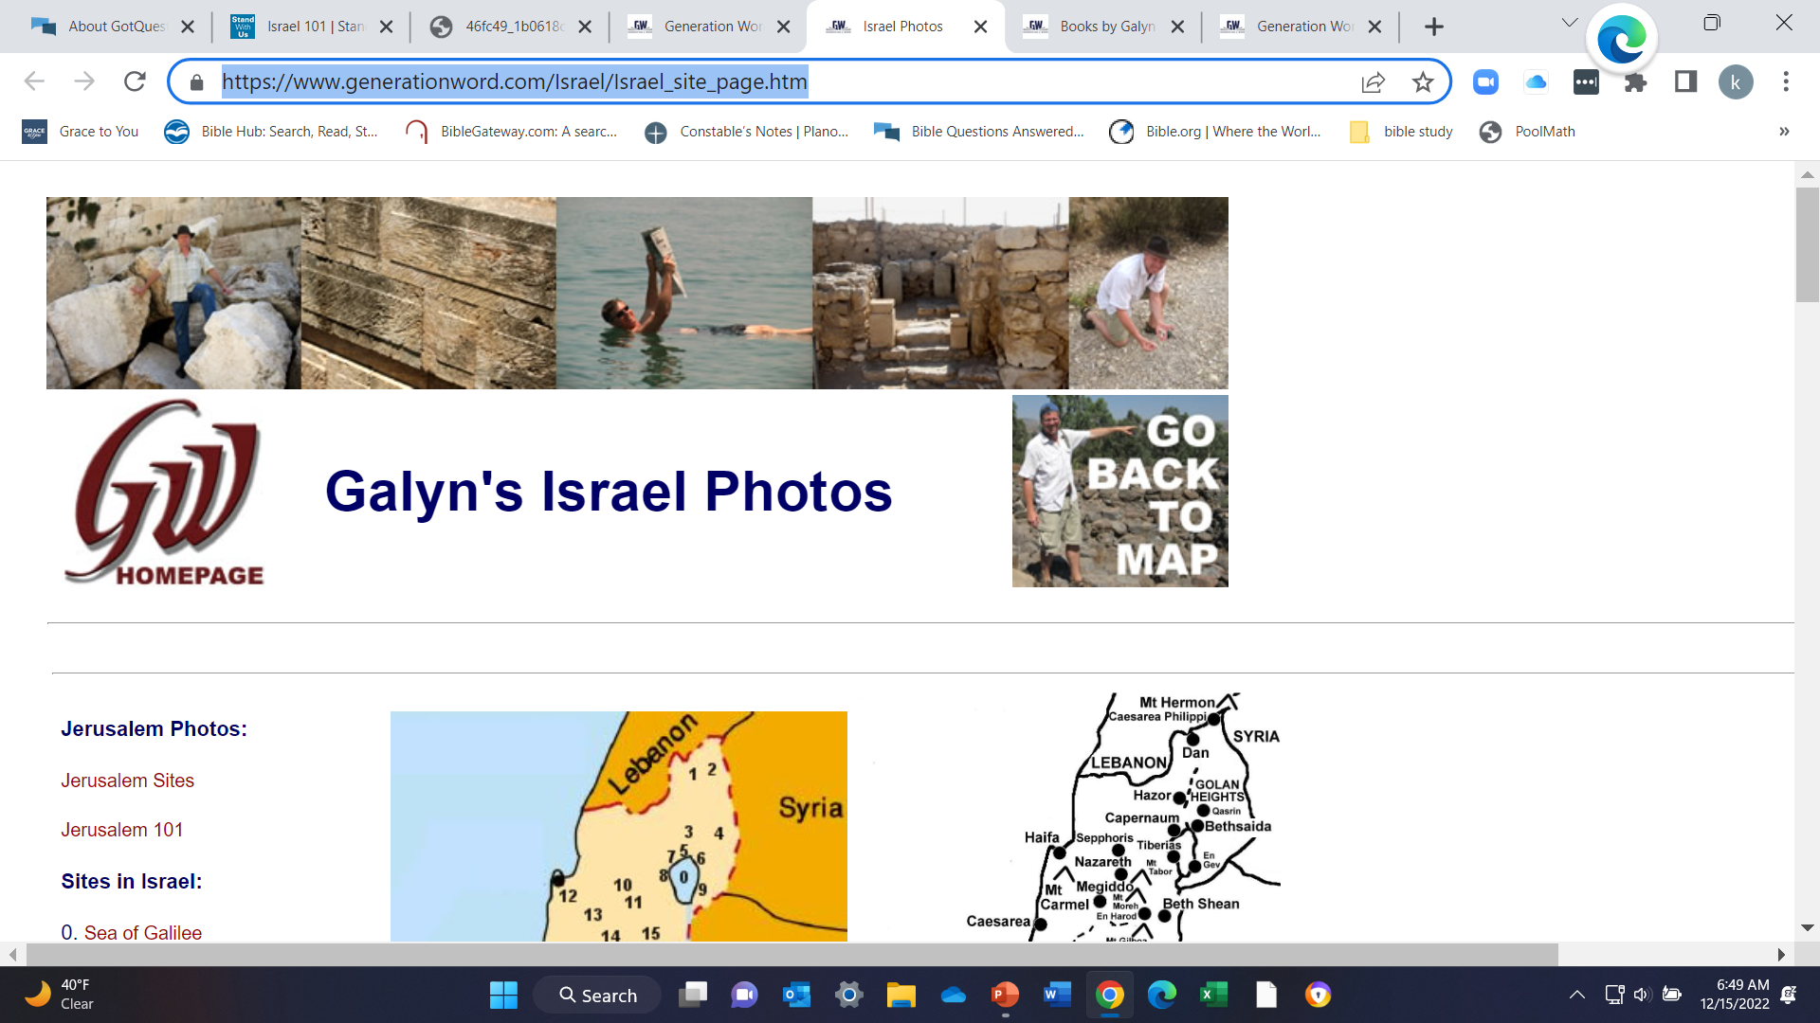

Slide 98
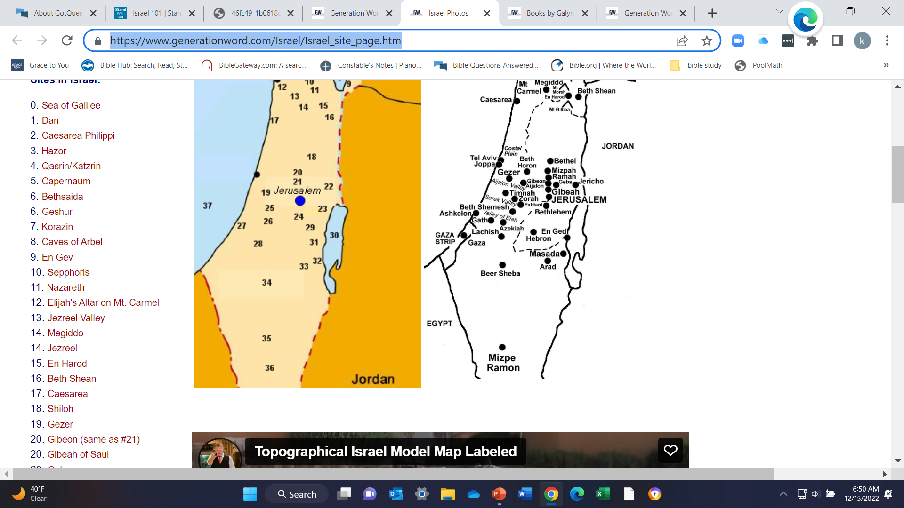

Slide 99
Israel 101- Modern History of Israel
https://www.standwithus.com/israel101

Slide 100
