Slide 1
Biblical Stewardship G.O.D.S.M.O.N.E.Y.
City of Hope Community Church
Taught by: Erica Baird-Nash

Slide 2
G.O.D.S.M.O.N.E.Y.
DAY TWO

Slide 3
DAY TWO AGENDA
DEBT
SAVINGS
Budgeting
RECAP

Slide 4

Why & What Summary
Money is clearly important to God so it should be to us.
God owns it all.
We are managers (not owners). We must manage “our” money for the glory of God.
We are blessed TO BE A BLESSING
It is a Heart Issue
God desires Obedience
If we are Faithful…HE will prosper us…

Slide 5




Biblical Giving
Offerings & Alms are on top of the Tithe
Giving is a form of worship. Deuteronomy 16:16b “…and they shall not appear before the Lord empty-handed.”
Tithe – our moral duty - our first fruits – 10% of all your earnings – to YOUR church
Offerings – are an expression of our gratitude to God. In biblical times, people would make sacrifices as an offering to God for his favor. It’s a show of faith and generosity
Alms are money or food given to the poor. The only giving not directly given to God. Your motivation should be from a place of compassion.
Notes:
Tell about when I couldn’t give the tithe and how I got there…
Don’t play games or lie to God
First fruits
% of the church that tithes
Tell about when I couldn’t give the tithe and how I got there…
Gross or Net and tithe on taxes
Don’t play games or lie to God
First fruits
Just because you don’t see giving doesn’t mean people not giving…but God sees giving
None givers usually the ones who need help – God not required to protect you

Slide 6
Budgeting Key Take-a-ways
Add up every dollar coming in…
Add up every dollar going out…net zero budget
Track all spending
Use envelopes method if spend too much on a regular basis
Avoid credit cards until you have mastered yourself
If single get a Christian, disciplined accountability partner
If married, you must discuss and agree on the budget TOGETHER
If married - no lying or sneak spending
Stay diligent
Put fun AND tithes in your budget
Your emergency Fund is for REAL emergencies
Don’t Give Up
Notes:
Envelop method is so you see your money going out if you get in trouble on credit cards
If one is digging you out of the whole and the other steady pouring in…you will never win.
It is not about controlling each other – it is working together to win tomorrow.
You have to budget in fun AND savings

Slide 7
Debt free living
Debt – something, typically money, that is owed or due.
Free – Not under the control or in the power of another; able to act or do as one wishes.
Financial Freedom – having control over your own finances, where your income is yours to save, spend and invest without the burden of debt payments and interest.
Benefits:
Reduced Stress
Increased Savings
Life Flexibility

Slide 8
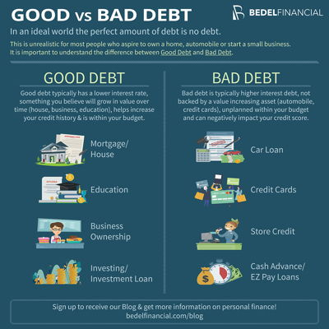
Understanding the difference
Good Debt is an investment
Bad debt has higher interest rates and is not deductible
No debt is your best position but is not always realistic
Debt should be in your budget
Major purchases can be planned for in advance - YIELD
Requires extreme discipline or can worsen your situation
Good debt can provide some tax breaks
Notes:
My mom’s quote on lying to yourself
Speak to the yielding

Slide 9
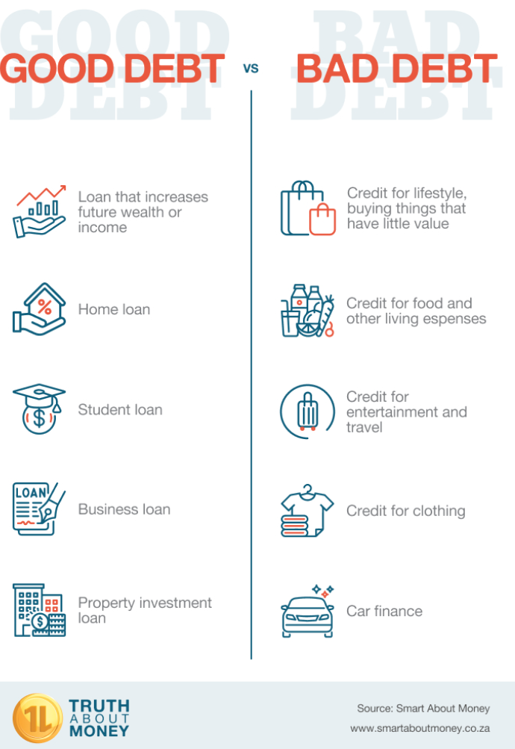
Understanding Debt…
Food for thought: You will never be debt free if you live a lifestyle of instant gratification
Notes:
Use example of children getting bad grades
Do not take advice of a fool
If you are single – discuss debt levels of future spouse

Slide 10
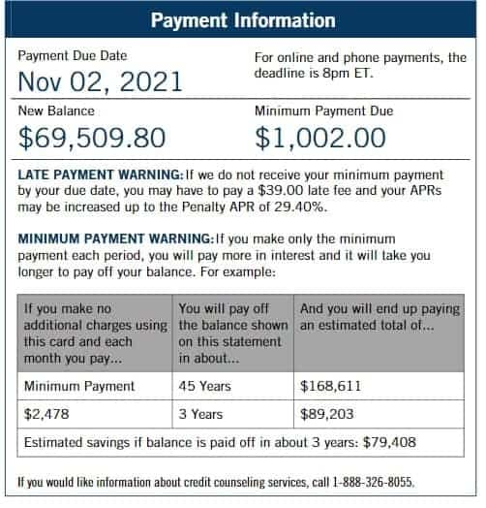
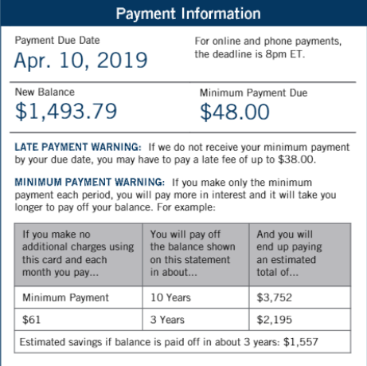
Debt costs more than intended…
Notes:
Scripture – steal, kill and destroy – he is stealing your investments for tomorrow, killing your future and can destroy your now and your relationships…

Slide 11
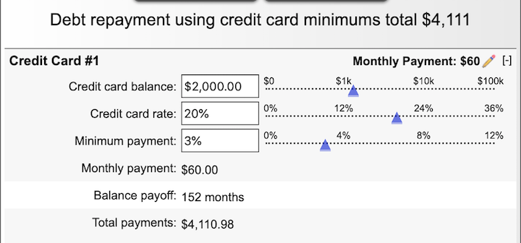
Debt costs more than intended…
12.666 years to pay $2000
$2110.98 extra or 2.06X the money
Notes:
Scripture – steal, kill and destroy – he is stealing your investments for tomorrow, killing your future and can destroy your now and your relationships…

Slide 12
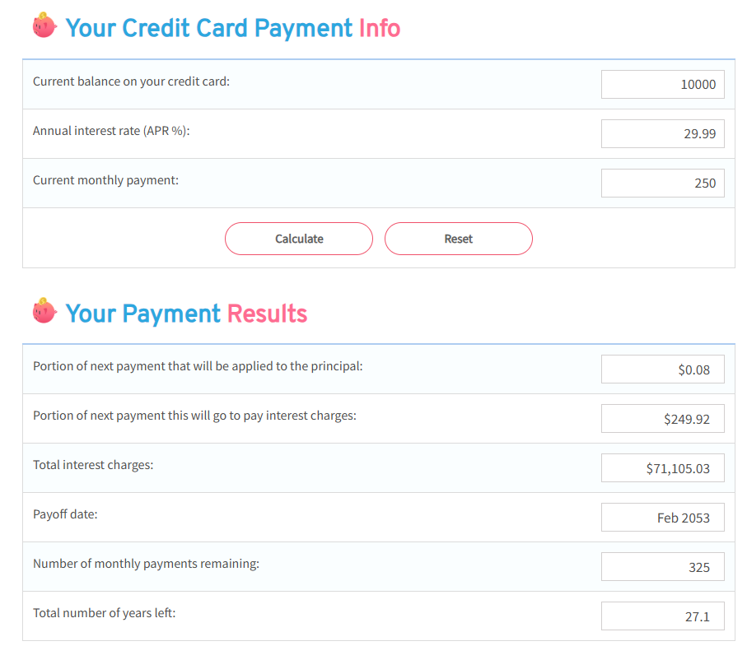
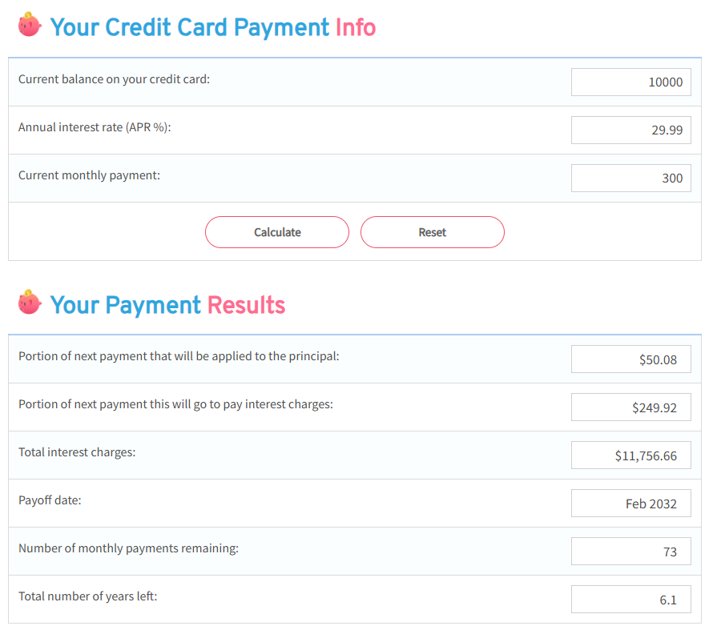
Debt costs more than intended…
Notes:
Scripture – steal, kill and destroy – he is stealing your investments for tomorrow, killing your future and can destroy your now and your relationships…

Slide 13
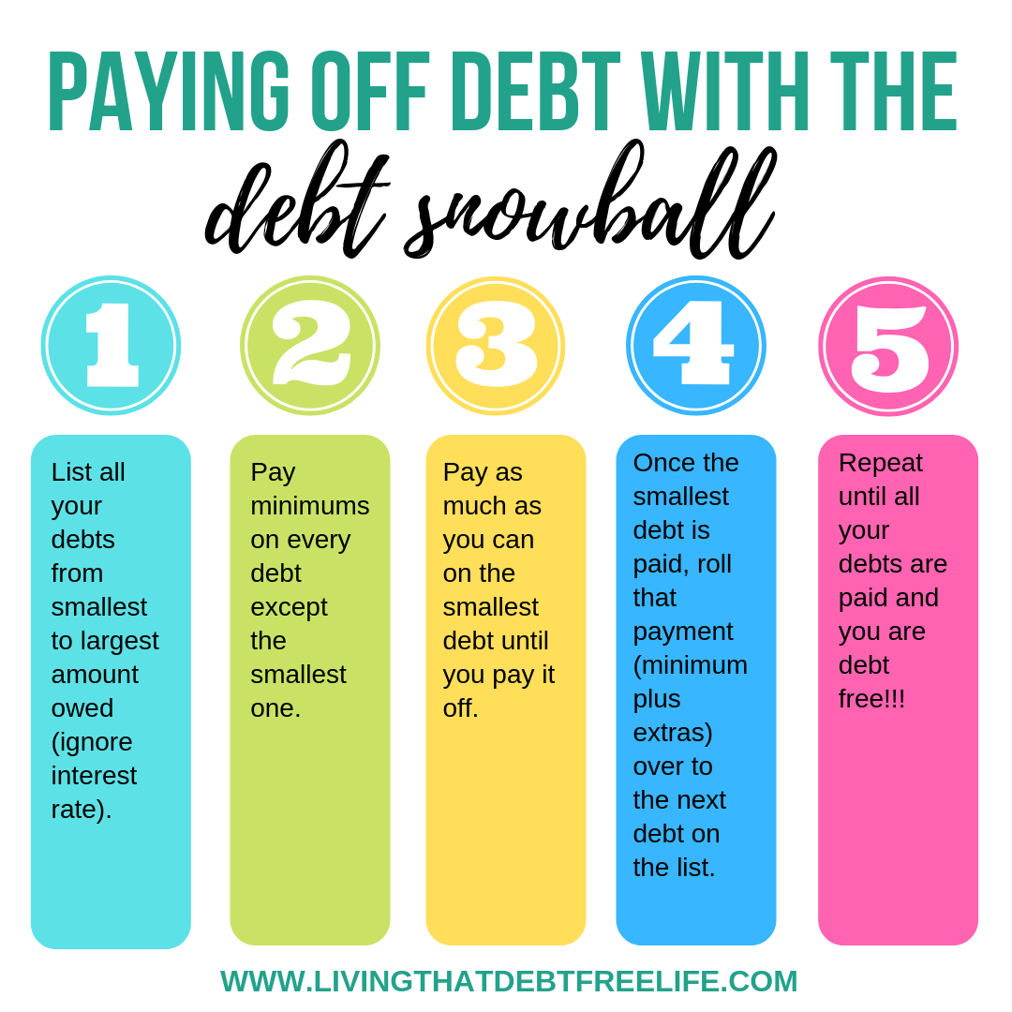
Debt pay off example…

Slide 14
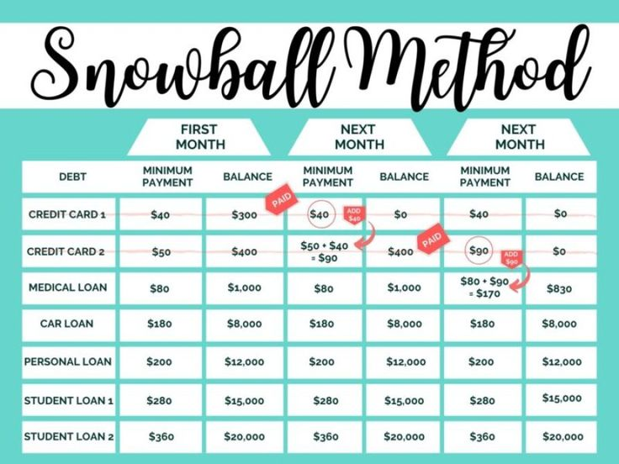
Debt pay off example…
Food for thought: Is 2-5 years spent paying debt off worth being out of bondage for the rest of your life?

Slide 15
Debt Avoidance: Biblical Verification
It’s a
Heart
Issue
Proverbs 22:7 “If you borrow with interest, you’ll end up serving the interests of your creditors, for the rich rule over the poor and the borrower is the slave to the lender.”
Proverbs 37:21 “The wicked borrow and pay not again [for they may be unable], but the [uncompromisingly] righteous deal kindly and give [for they are able].”
Deuteronomy 28:12 “The Lord will open for you his rich storehouse, the heavens, to give the rain of your land in its season and to bless all your undertakings. You will lend to many nations, but you will not borrow.”
Proverbs 11:15 “There’s danger in putting up security for a stranger’s debt; it’s safer to not guarantee another person’s debt.”
Notes:
Abel gave of his first and his best…Cain was selfish and gave what he had left over and didn’t want…
Only place the bible says you can test God…Jesus when tempted by the devil. Test not the lord your god (Matt 4:7), The lord can not be tempted (James 1:13) Duet 6:16 Do not put the Lord your God to the test
Jesus himself receives them.
God is watching us…

Slide 16

Debt Take-a-ways
Only thing fast about Debt is getting in it
Minimum payment will keep you paying the bank for years
Stop spending everything you have then borrowing for things you really don’t need
It is not designed for you to win (remember 2 – 10 times original cost)
The borrower IS the slave to the lender
You can NOT use the cards while you are paying them off
If single – screen partner – unequally yoked can be long-term danger
Do NOT take the advice of a fool – if their debt bad…enuf said!
DEBT is spending TOMORROW’S prosperity TODAY
Notes:
Stop putting off tomorrow…most people in the room needed to start yesterday
No is full sentence – say it to yourself and others
Use my tithe example on paying off debt and tithe commitment

Slide 17
Benefits of Savings:
1
Improved Financial Security
Peace of Mind
2
3
Work choices
4
Greater Flexibility
5
A sense of accomplishment
Reduced stress
6
7
A safety net
Better interest rates
8
9
Legacy for future generations
Ready for retirement
10

Slide 18




Types of Savings
Retirement
Planning for your tomorrow, Securing your future
401K
IRA
Stocks
Certificates
Emergency Savings
appliance Failure, major car expense, deductible for insurance, unexpected travel (Funeral or illness)
$2000 - $8000
Short Term Needs
school Clothing, Car Insurance, car maintenance, Home Maintenance, appliances, Furniture, Medical (FSA), Etc.
Important events/ Long Term Needs
Car, Prom, wedding, funeral, vacation, family reunion, Christmas, Birthdays
Notes:
Tell about when I couldn’t give the tithe and how I got there…
Don’t play games or lie to God
First fruits

Slide 19
Types of Savings
10-15% of your net income
5-10% of your net income
Retirement 10-15% of your net income
401K (Pre-tax – company Match)
IRA (can be pre or post Tax)
Stocks (Risky but if have Extra)
Mutual Funds – Risky but safer than Stock
Emergency Savings (Semi-Liquid) $2000 - $8000
Separate account
Money Market (low Interest)
Short Term Needs -
Savings Accounts
Money Market
Certificate
Important events/ Long Term Needs
Savings accounts
Money Market
Certificate
Notes:
Tell about when I couldn’t give the tithe and how I got there…
Don’t play games or lie to God
First fruits

Slide 20

Pack your lunch
Eat out less
Only order water out
Shop with a list (not on list – don’t buy)
Save change or dollars
Automatic withdrawal (don’t see / don’t cry)
Buy in bulk / Gas cheaper at Costco and Sam’s also
Buy everything in cash – NO Credit card usage
Turn off lights and close doors
Increase deductibles (once have emergency fund)
Shop insurance
Only purchase on sale
YIELD – wait 48 hours on purchases

Slide 21
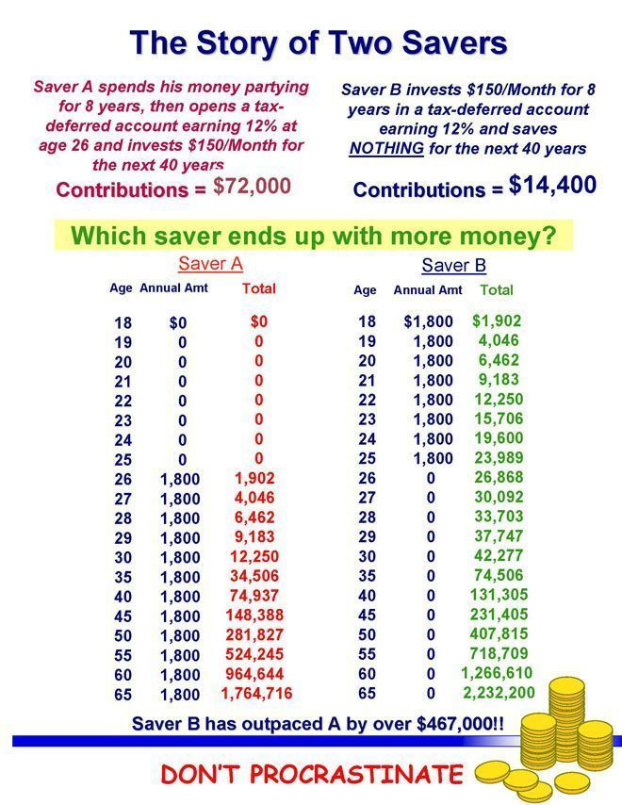
The Power of Compounding Interest is the secret…

Slide 22
How to pick a financial planner
Work With a Fiduciary Financial Advisor
A fiduciary financial advisor is a professional bound by legal and ethical standards who always acts in your best interest.
1. Your Interests Come First
Fiduciaries are required to prioritize your financial needs above their own. Their recommendations are based solely on what benefits you—not what earns them the most commission or fees.
2. Transparency is Guaranteed
Fiduciaries must disclose any potential conflicts of interest. This ensures that you fully understand how their advice aligns with your goals, creating a foundation of trust.
3. Should be able to provide comprehensive financial planning. Example:
Retirement planning
Tax strategies or refer you
Debt repayment plans
Insurance recommendations for your family’s protection
Estate planning and wealth transfer strategies

Slide 23
How to pick a financial planner
Continued:
Research Their Credentials:
Look for certifications like Certified Financial Planner (CFP) or Registered Investment Advisor (RIA).
Ask Key Questions (It is YOUR money):
Are you a fiduciary?
How are you compensated? (Fee-only advisors often have fewer conflicts of interest.)
Can you provide references or success stories?

Slide 24

Savings: Biblical Verification
It’s a
Heart
Issue
Proverbs 21:20 TLB “The wise man saves for the future, but the foolish man spends whatever he gets.”
Matthew 25:27-29 “why didn’t you deposit my money in the bank? At least I could have gotten some interest on it. Then he ordered, “Take the money from this servant and give it to the one with ten bags of silver. To those who use well what they are given, even more will be given, and they will have abundance. But from those who have nothing, even what little they have will be taken away.
Genesis 41:35-36 “Have them gather all the food produced in the good years that are just ahead and bring it to Pharaoh’s storehouses. Store it away, and guard it so there will be food in the cities. That way there will be enough to eat when the seven years of famine come to the land of Egypt. Otherwise, this famine will destroy the land.”
Proverbs 6:6,8 “Take a lesson from the ants, you lazybones. Learn from their ways and become wise!...they labor hard all summer, gathering food for the winter.”
Notes:
Summer is while you are younger and able, winter is when you are retired and can no longer work…

Slide 25

Savings Take-a-ways
YOU NEED to save!!
Short & Long-term Items are NOT an Emergency
NEVER touch your retirement money
You should save 10-20% of your net income
If married – one digging and one savings = same place long-term – the digger will win!
If single – this is the best gift you can give YOU and your future partner
Retirement = 10-15% Other savings = 5-10%
You have to be an investor in life and not a gambler - the wise man is going to prosper and the fool is going to make a mess from their life
Notes:
Stop putting off tomorrow…most people in the room needed to start yesterday
No is full sentence – say it to yourself and others
Use my tithe example on paying off debt and tithe commitment

Slide 26
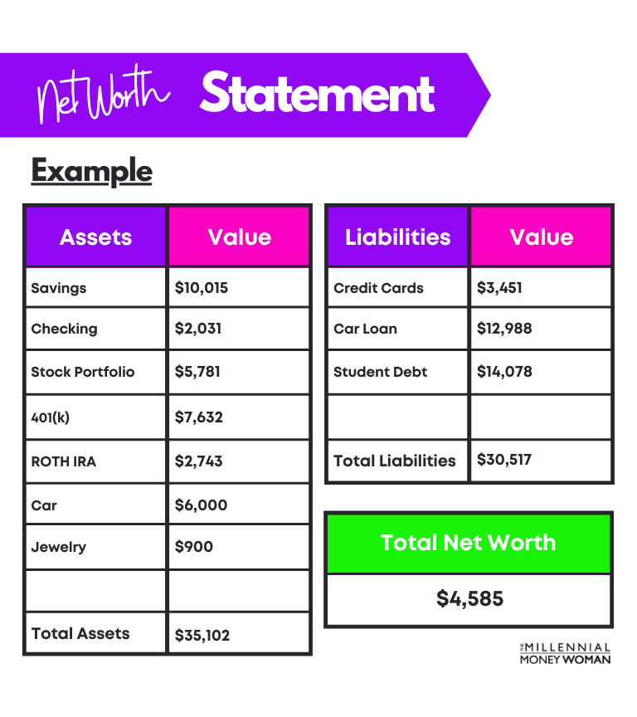
Equity = What you own
Net Worth
=
What you OWN
–
What you OWE
Notes:
Stop putting off tomorrow…most people in the room needed to start yesterday
No is full sentence – say it to yourself and others
Add black vs. white financial facts

Slide 27
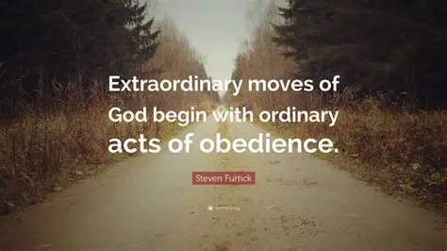
Things I have learned
Generosity protects you from greed
Giving is a need IF you want to be blessed
There are two tests when you have money - how you behave when you have a lot and when you don’t have enough…
Instant gratification is foolish
Borrowing money is spending tomorrow’s prosperity today
You can’t expect money you don’t respect money
Beware of deceptive marketing
Give…save…spend…in that order
2 Options – spend less or make more. Period.
Spend God’s money like you want your children to spend “yours.”

Slide 28
Take-a-ways
Spend Cash (Envelop method)
Avoid Credit Cards (Disciplined)
Pay Credit Card off Monthly
Start yesterday
It is work. Discipline is not easy.
No is a full sentence.
It works IF YOU work it!
Notes:
Stop putting off tomorrow…most people in the room needed to start yesterday
No is full sentence – say it to yourself and others
Use my tithe example on paying off debt and tithe commitment

Slide 29

In Conclusion
Giving and Budgeting are critical
Pay God. Pay Yourself. Live on the rest.
Avoid unnecessary debt
YOU MUST stay the course
You need accountability
Pray and remain committed
FULL steward – it is the whole – not pieces that get the victory
Notes:
You have to have both
Stop putting off tomorrow…most people in the room needed to start yesterday
No is full sentence – say it to yourself and others

Slide 30
G - Giving
O - Obedient
D - Debt
S - Savings
M - Manage it
O - Offerings
N - Net worth
E - Equity
Y - Yield

Slide 31

Questions

