Slide 1

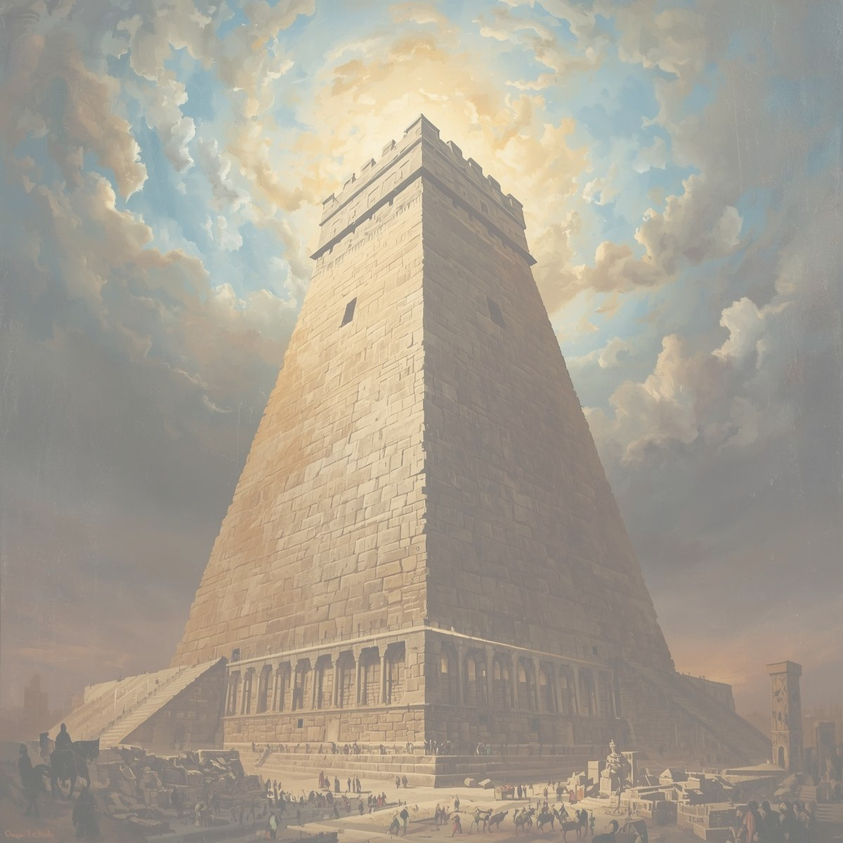
big beginnings with a big god
The tall tower that tumbled
the tower of babel
Unit 1
week 5

Slide 2

focus scripture
“The Lord scattered them over the face of the whole earth.” – Genesis 11:9

Slide 3
After Noah’s family started over, many new people were born. The world grew and people began to settle in a place called Babylonia. They all spoke the same language and worked together to build a great city. But something went wrong with their hearts.

Slide 4
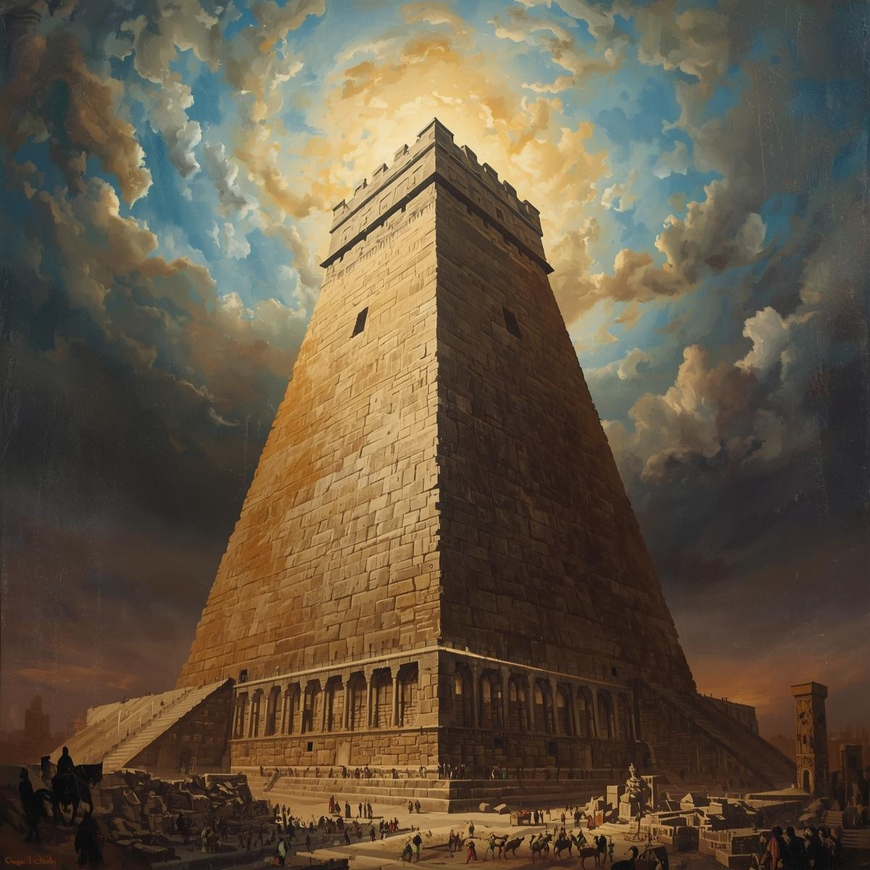
The people decided to build a tower that reached all the way to heaven. Not because they wanted to honor Father God, but because they wanted to show off how great they were. They said, “Let’s make a name for ourselves!” They were filled with pride and forgot all about Father God.

Slide 5
Father God saw what they were doing. He knew that if they continued building without Him, it would lead to more sin and selfishness. So Father God did something amazing. He confused their language!

Slide 6
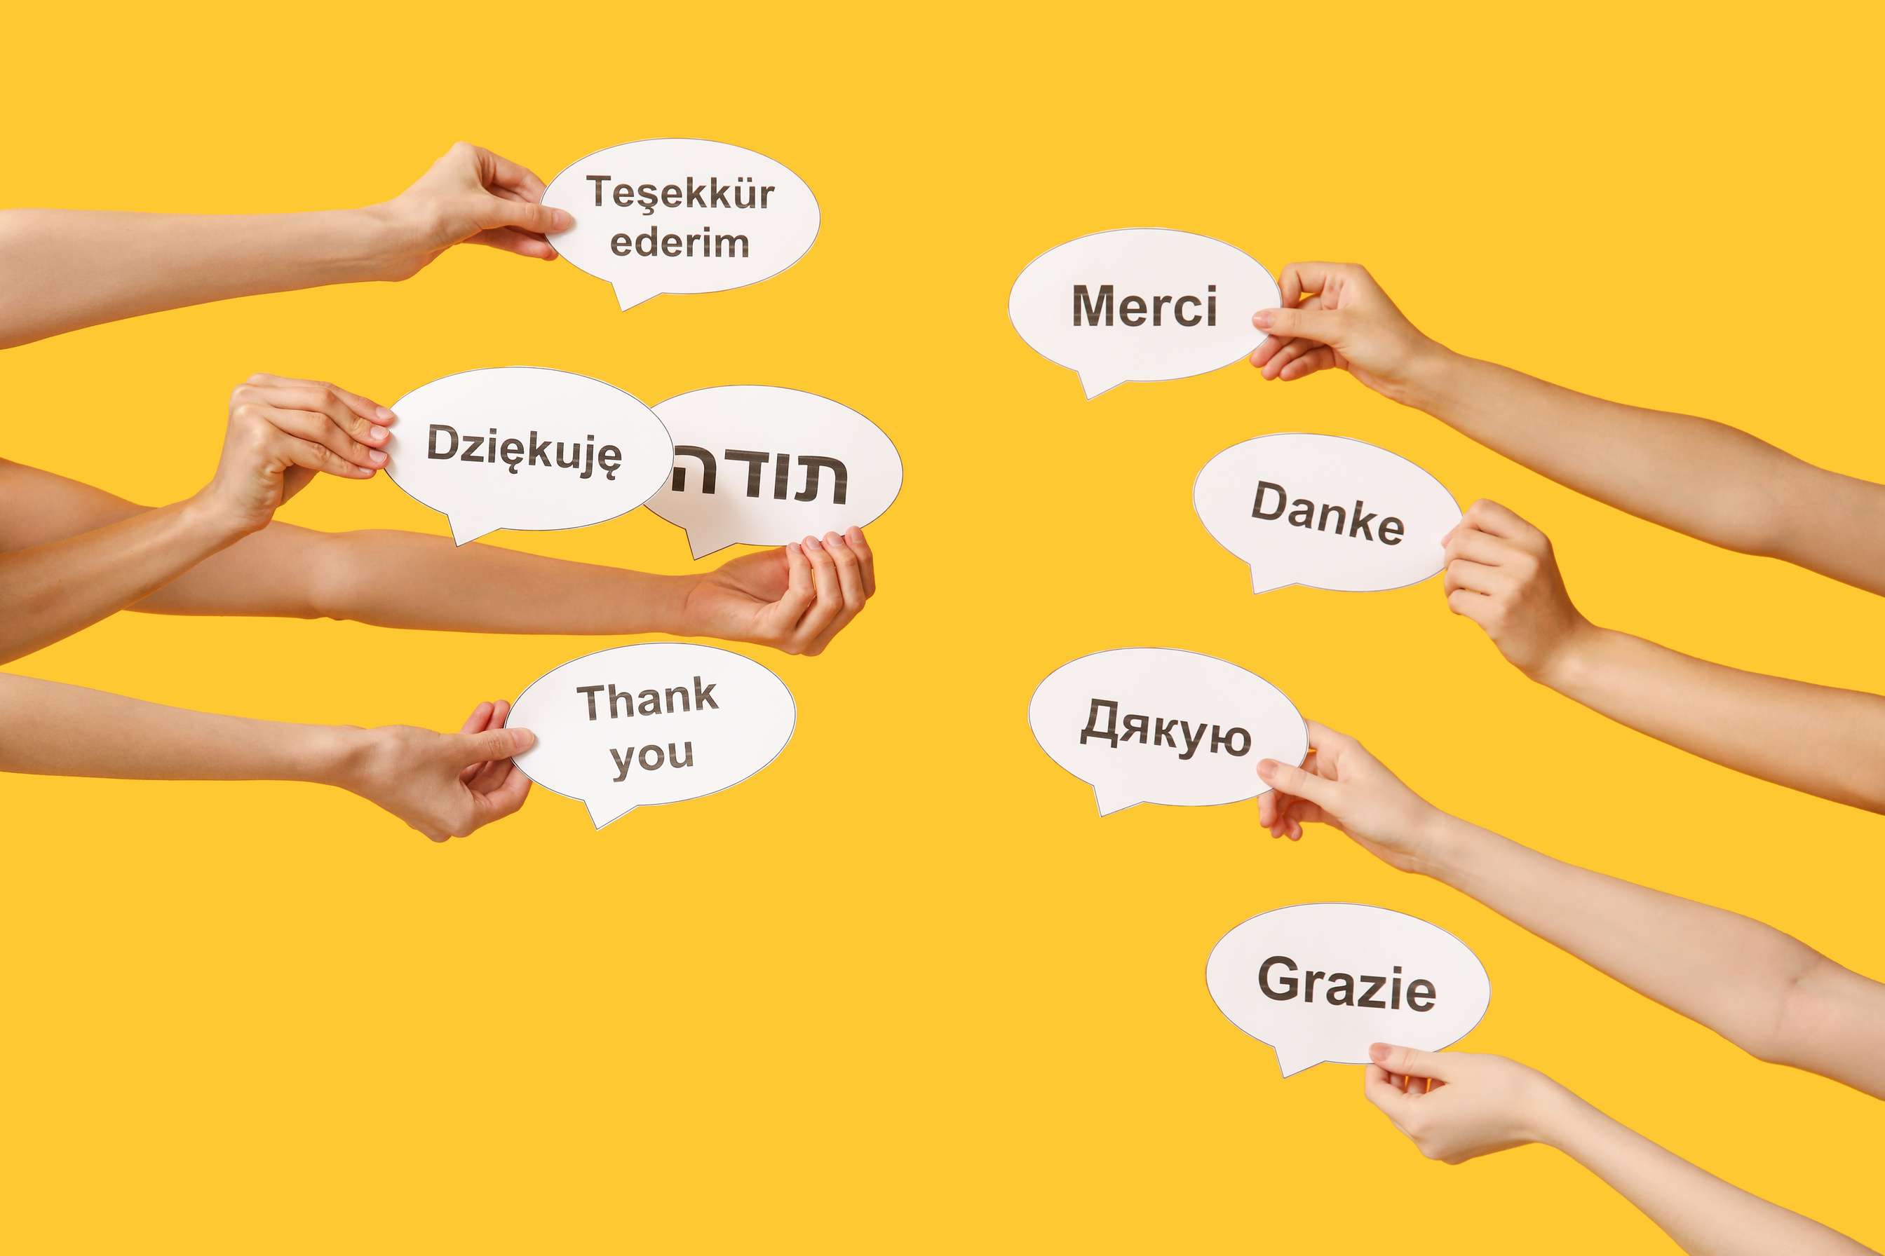
Suddenly, people couldn’t understand each other. Some spoke one language, others another. It was chaos! They had to stop building the tower and spread out all over the world.

Slide 7
This story teaches us that when we try to live without Father God or try to make ourselves the center, things fall apart. But when we put Father God first, He helps us build lives that are strong and full of love.

Slide 8


Slide 9
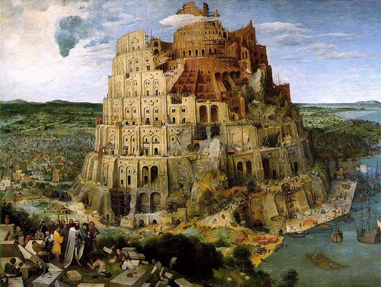
activity
use your imagination to draw several different parts of the story.
o the LORD dispersed them from there over the face of all the earth, and they left off building the city. (Genesis 11:8 ESV)

Slide 10
Let’s remember
Pride brings confusion, but Father God brings peace and unity when we follow Him.

Slide 11
discussion Questions
1. Why did the people want to build the tower?
2. What did Father God do to stop them?
3. What can we learn about putting Father God first in everything we do?

Slide 12
Prayer
Dear Father God, help me to remember that life is not about being famous or proud, but about loving You and others. I don’t want to build things without You in my heart. Teach me to be humble and to work with others in love and kindness. Guide my steps so I always follow Your plan. Amen.

