Slide 1




DEVELOPING A STRONG FAITH
What Is Faith?
Unit 1
Week 5

Slide 2
REMINDERS
1. SAY KIND THINGS & USE KIND WORDS
3.CAMERAS ON
4.RAISE HAND TO UNMUTE
2. BE MINDFUL OF YOUR BACKGROUND NOISE & SURROUNDINGS.
5.PARTICIPATE AND HAVE FUN!

Slide 3




FOCUS SCRIPTURE
Hebrews 11: 1 NIV
Now faith is confidence in what we hope for and assurance about what we do not see.

Slide 4





BELEIVING WHEN WE CAN’T SEE
Hebrews 11:1 defines faith as “confidence in what we hope for and assurance about what we do not see.”
Think about the wind—you can’t see it, but you can feel it moving around you. Faith is like that. We may not see God with our physical eyes, but we experience His presence through His Word, His love, and His work in our lives.

Slide 5


TRUSTING HIM COMPLETELY
Faith isn’t just believing that God exists—it’s trusting Him completely. A strong faith means depending on God in every situation, even when things don’t make sense. When we trust in God, we know that He is always in control and working for our good.

Slide 6





GREAT FAITH
Who do you know has complete faith in God?

Slide 7



STRONG FAITH
Many people in the Bible, like Abraham, Moses, and Daniel, showed great faith in difficult times. They trusted God even when they couldn’t see the outcome. The stronger our faith becomes, the more we learn to rely on God instead of fear or doubt.

Slide 8
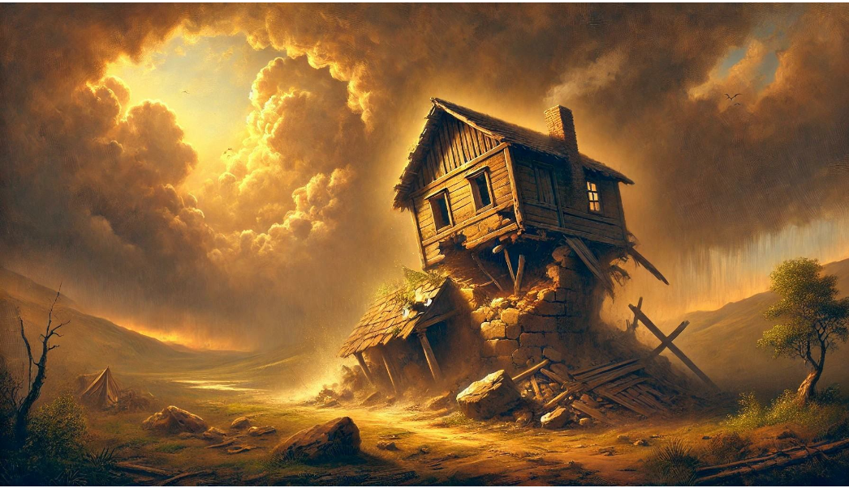


KEY LESSONS
● ​The more we rely on God, the stronger our faith becomes.
● ​Faith is trusting God, even when we don’t see everything clearly.
● ​A strong faith helps us face challenges without fear.

Slide 9


LIFE APPLICATIONS
Faith is like a muscle—it grows when we use it. Think about faith like a work out. It can hurt and take time before we actually see the growth of our muscles but with much constancy in due time it will grow.
Developing Strong Faith:
Spend time with God
Read His Word
Trust Him in every situation

Slide 10

FAITH IN THE UNKNOWN
Faith is not about having all the answers—it’s about trusting God every step of the way.
Ways to Strengthen Your Faith:
✅ Pray daily and talk to God about your struggles.
✅ Read the Bible to understand God’s promises.
✅ Surround yourself with people who encourage your faith.
✅ Remember how God has helped you in the past.

Slide 11


REFLECTIVE QUESTION
1. ​What does having faith in God mean to you?
​2. ​How can you trust God more in your daily life?
​3. ​What is one way you can strengthen your faith this week?

Slide 12


Slide 13
ACTIVITY
CHARADES: ACTING OUT BIBLE CHARACTERS AND STORIES.
OTHERS WILL GUESS WHO THE CHARACTER IS

Slide 14
PRAYER
Dear God,
Help me to develop strong faith in You. Even when life feels uncertain, remind me that You are in control. Teach me to trust You in all things and to grow closer to You every day. Amen.

