Slide 1

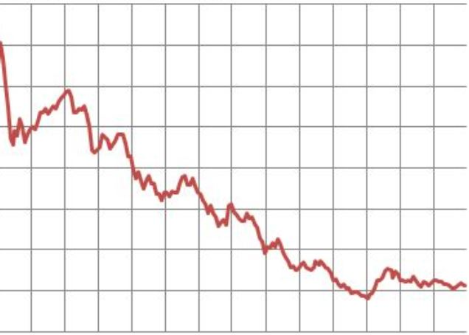

Failing
Upward
God’s Word
Luke 9:37-62
Notes:
Are your classroom colors different than what you see in this template? That’s OK! Click on Design -> Variants (the down arrow) -> Pick the color scheme that works for you!
Feel free to change any “You will…” and “I will…” statements to ensure they align with your classroom procedures and rules!

Slide 2
Growing Discipleship
Thru Failure
Power comes from prayer & dependence on God

Slide 3
Mark 9:23-24
“Jesus said unto him, If thou canst believe, all things are possible to him that believeth. And straightway the father of the child cried out, and said with tears, Lord, I believe; help thou mine unbelief.”

Slide 4
Growing Discipleship
Thru Failure
Power comes from prayer & dependence on God

Slide 5
Matthew 17:21
“Howbeit this kind goeth not out but by prayer and fasting.”

Slide 6
Ephesians 6:12
“For we wrestle not against flesh & blood, but against principalities, against powers, against the rulers of the darkness of this world, against spiritual wickedness in high places.”

Slide 7
Matthew 17:20-21
“And Jesus said unto them, because of your unbelief: for verily I say unto you, If ye have faith as a grain of mustard seed, ye shall say unto this mountain, remove hence to yonder place; & it shall remove; & nothing shall be impossible unto you. Howbeit this kind goeth not out but by prayer & fasting.”

Slide 8
Growing Discipleship
Thru Failure
Power comes from prayer & dependence on God
Greatness comes from humility & child-like faith

Slide 9
Matthew 18:3-4
“And said, Verily I say unto you, Except ye be converted, and become as little children, ye shall not enter into the kingdom of heaven. Whosoever therefore shall humble himself as this little child, the same is greatest in the kingdom of heaven.”

Slide 10
Growing Discipleship
Thru Failure
Power comes from prayer & dependence on God
Greatness comes from humility & child-like faith
Effectiveness comes from proper application of the Word of God

Slide 11
John 1:17
“For the law was given by Moses, but grace and truth came by Jesus Christ.”

Slide 12
John 3:17
“For God sent not his Son into the world to condemn the world; but that the world through him might be saved.”

Slide 13
Growing Discipleship
Thru Failure
Power comes from prayer & dependence on God
Greatness comes from humility & child-like faith
Effectiveness comes from proper application of the Word of God
Victory comes from commitment & focus on Jesus

Slide 14
Philippians 3:13b-14
“…forgetting those things which are behind, and reaching forth unto those things which are before, I press toward the mark for the prize of the high calling of God in Christ Jesus.”

Slide 15
Ephesians 6:5
“Servants, be obedient to them that are your masters according to the flesh, with fear and trembling, in singleness of your heart, as unto Christ.”

Slide 16
Growing Discipleship
Thru Failure
Power comes from prayer & dependence on God
Greatness comes from humility & child-like faith
Effectiveness comes from proper application of the Word of God
Victory comes from commitment & focus on Jesus

