Slide 1
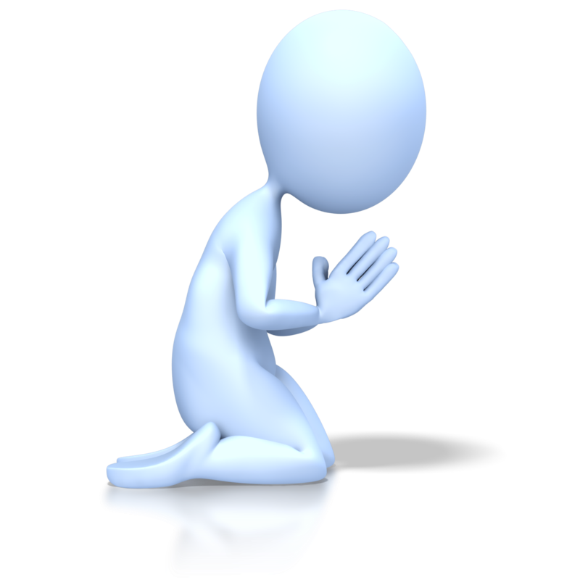


From Work To Worship
God’s Word
Luke 10:25-11:13

Slide 2
From Work To Worship
Check Your Heart:
Is it self-righteous or compassionate?

Slide 3
Romans 3:19-20
“Now we know that what things soever the law saith, it saith to them who are under the law: that every mouth may be stopped, & all the world may become guilty before God. Therefore by the deeds of the law there shall no flesh be justified in His sight: for by the law is the knowledge of sin.”

Slide 4
From Work To Worship
Check Your Heart:
Is it self-righteous or compassionate?
Check Your Ears:
Are they closed or open?
Check Your Spirit:
Is it persistent or sporadic?

Slide 5
Characteristics of Prayer
Adoration | Our Father in Heaven | Father
Adoration | Our Father in Heaven | Father
Authority | Thy Kingdom Come | King
Adoration | Our Father in Heaven | Father
Authority | Thy Kingdom Come | King
Asking | We Need Daily Provision | Friend
Adoration | Our Father in Heaven | Father
Authority | Thy Kingdom Come | King
Asking | We Need Daily Provision | Friend
Cleansing | Forgive us, as we forgive them | Savior
Adoration | Our Father in Heaven | Father
Authority | Thy Kingdom Come | King
Asking | We Need Daily Provision | Friend
Cleansing | Forgive us, as we forgive them | Savior
Cover | Deliver us from evil | Priest

Slide 6
From Work To Worship
Check Your Heart:
Is it self-righteous or compassionate?
Check Your Ears:
Are they closed or open?
Check Your Spirit:
Is it persistent or sporadic?

