Slide 1
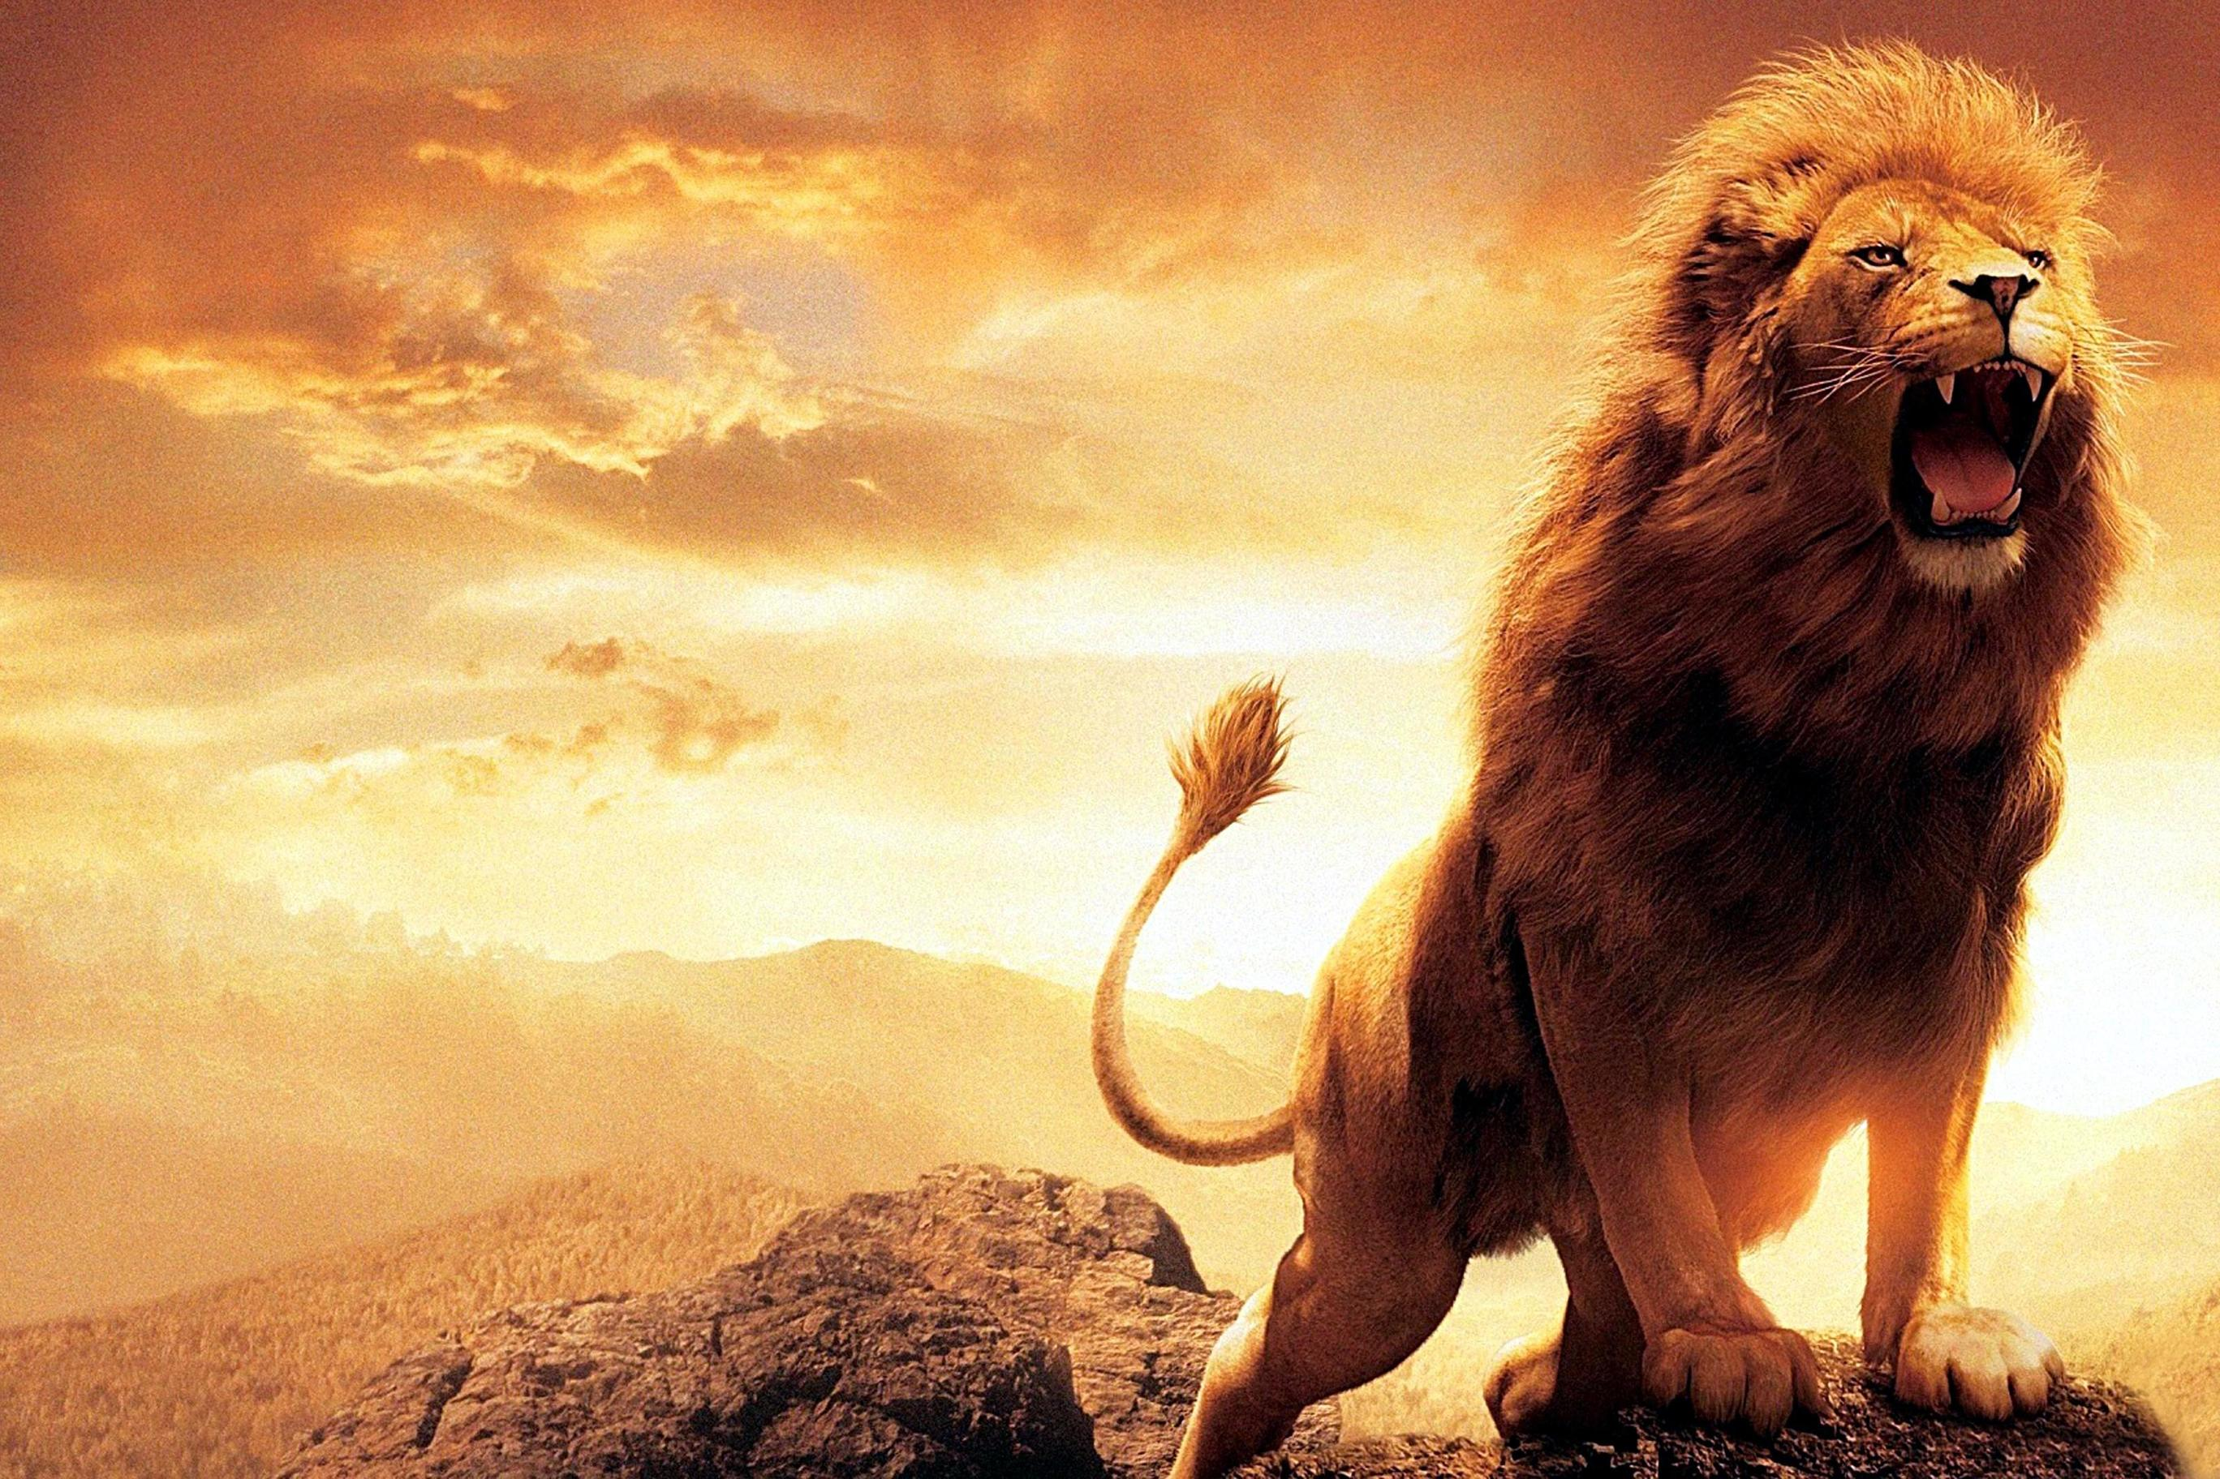

Living In Light Of The Lion’s Return
God’s Word --- Luke 12:35-13:9

Slide 2
Living In Light Of The Lion’s Return
Stay Ready – Reward is coming
Stay Active – Accountability is coming
Stay Washed – War is coming

Slide 3
Luke 3:16
“John answered, saying unto them all, I indeed baptize you with water; but One mightier than I cometh, the latchet of whose shoes I am not worthy to unloose: He shall baptize you with the Holy Ghost and with fire.”

Slide 4
Matthew 20:20-22
“Then came to Him the mother of Zebedee's children w/ her sons, worshipping Him, & desiring a certain thing of Him. He said unto her, What wilt thou? She saith unto Him, Grant that these my two sons may sit, the one on Thy right hand, & the other on the left, in Thy kingdom. But Jesus answered & said, Ye know not what ye ask. Are ye able to drink of the cup that I shall drink of, & to be baptized w/ the baptism that I am baptized with? They say unto him, We are able.”

Slide 5
Luke 2:14
“Glory to God in the highest, and on earth peace, good will toward men.”

Slide 6
Living In Light Of The Lion’s Return
Stay Ready – Reward is coming
Stay Active – Accountability is coming
Stay Washed – War is coming
Stay Repentant – Rescue is coming

