Slide 1
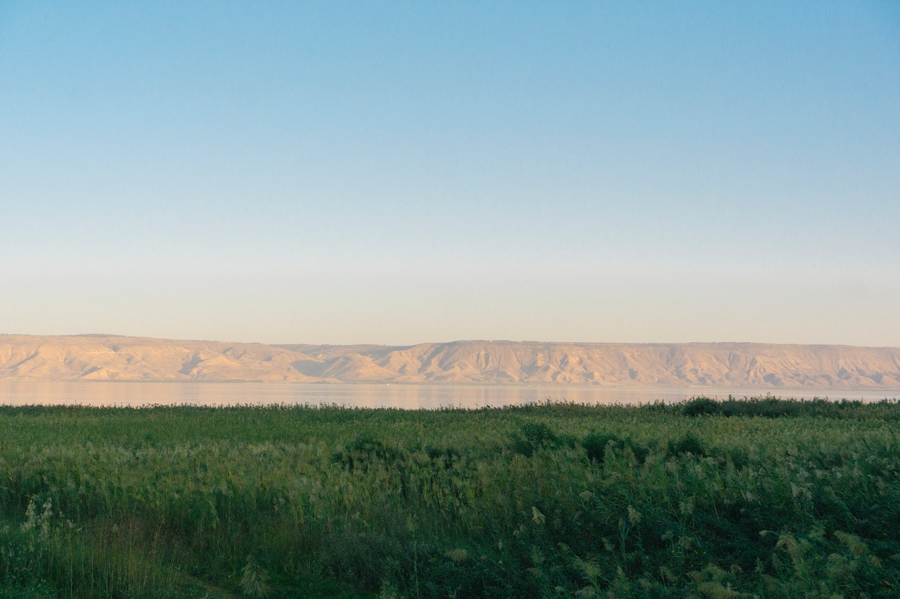
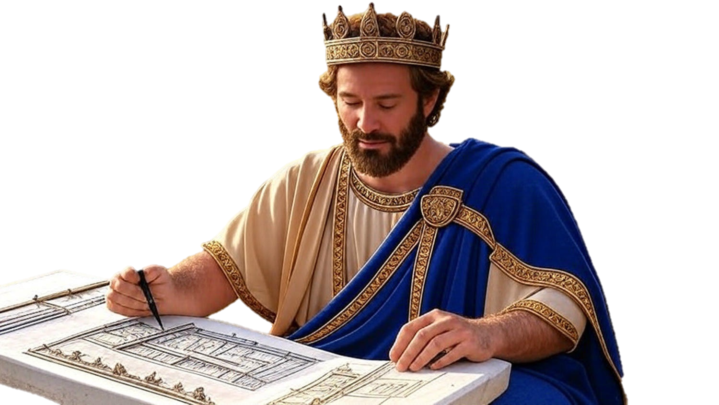

Chapters 34-35
2nd Chronicles
Josiah’s Restoration Spreads

Slide 2
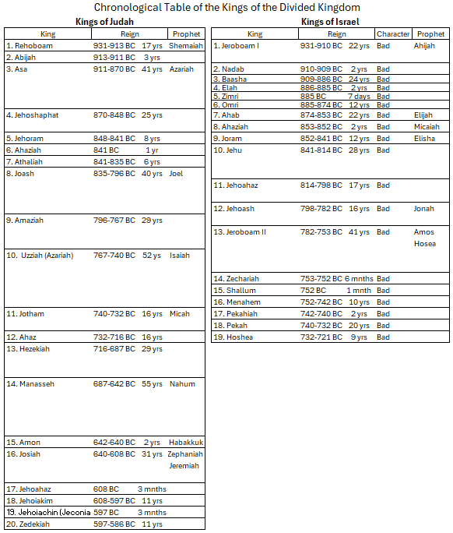

Slide 3
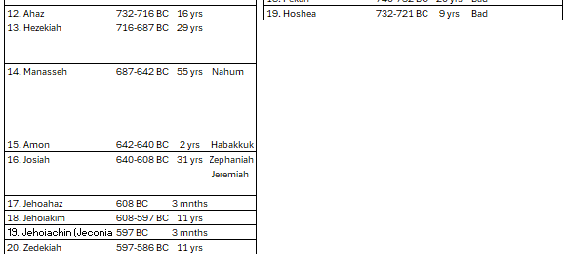

Slide 4
Chapters 34-35
2nd Chronicles
Josiah’s Restoration Spreads

Slide 5
The Steps of Josiah’s Restoration
Follow what little we know
Spread the Word you learn
Call for inner change
Live in victory

