Slide 1
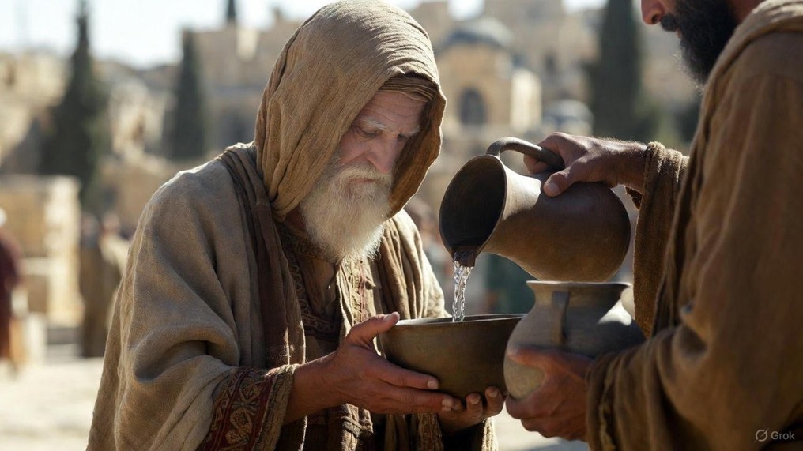

.
Our God Of Light & Life Descended
J
THE
BOOK
of
OHN
Chapter 1:1-18

Slide 2
.
Our God Of Light & Life Descended
The Word of Life Instituted Creation

Slide 3
.
“Who [Jesus] is the image of the invisible God, the firstborn of all creation. For in Him all things were created, both in the heavens & on earth, visible & invisible, whether thrones or dominions or rulers or authorities—all things have been created through Him & for Him.”
Colossians 1:15-16

Slide 4
.
Our God Of Light & Life Descended
The Word of Life Instituted Creation
The Witness of Light Instituted a Decision Point

Slide 5
.
“But ye will receive power, after that the Holy Ghost has come upon you: & you shall be My witnesses both in Jerusalem, & in all Judaea, & in Samaria, & even to the ends of the earth.”
Acts 1:8

Slide 6
.
Our God Of Light & Life Descended
The Word of Life Instituted Creation
The Witness of Light Instituted a Decision Point
The Worthy One of the Law Instituted Grace

Slide 7
.
“God, having spoken long ago to the fathers in the prophets in many portions & in many ways, in these last days spoke to us in His Son, whom He appointed heir of all things, through whom also He made the worlds, who is the radiance of His glory & the exact representation of His nature, & upholds all things by the word of His power.”
Hebrews 1:1-3a

Slide 8
.
Our God Of Light & Life Descended
The Word of Life Instituted Creation
The Witness of Light Instituted a Decision Point
The Worthy One of the Law Instituted Grace

Slide 9
.
“Gracious is Yahweh, & righteous; & our God is compassionate.”
Psalm 116:5

Slide 10
.
“Surely His salvation is near to those who fear Him, that glory may dwell in our land. Lovingkindness & truth have met together; Righteousness & peace have kissed each other. Truth springs up from the earth, & righteousness looks down from heaven.”
Psalm 85:9-11

Slide 11
.
Our God Of Light & Life Descended
The Word of Life Instituted Creation
The Witness of Light Instituted a Decision Point
The Worthy One of the Law Instituted Grace

Slide 12
.
Our God Of Light & Life Descended
The Word of Life Instituted Creation
The Witness of Light Instituted a Decision Point
The Worthy One of the Law Instituted Grace
“Your word is a lamp to my feet And a light to my path.”
Psalm 119:105

