Slide 1
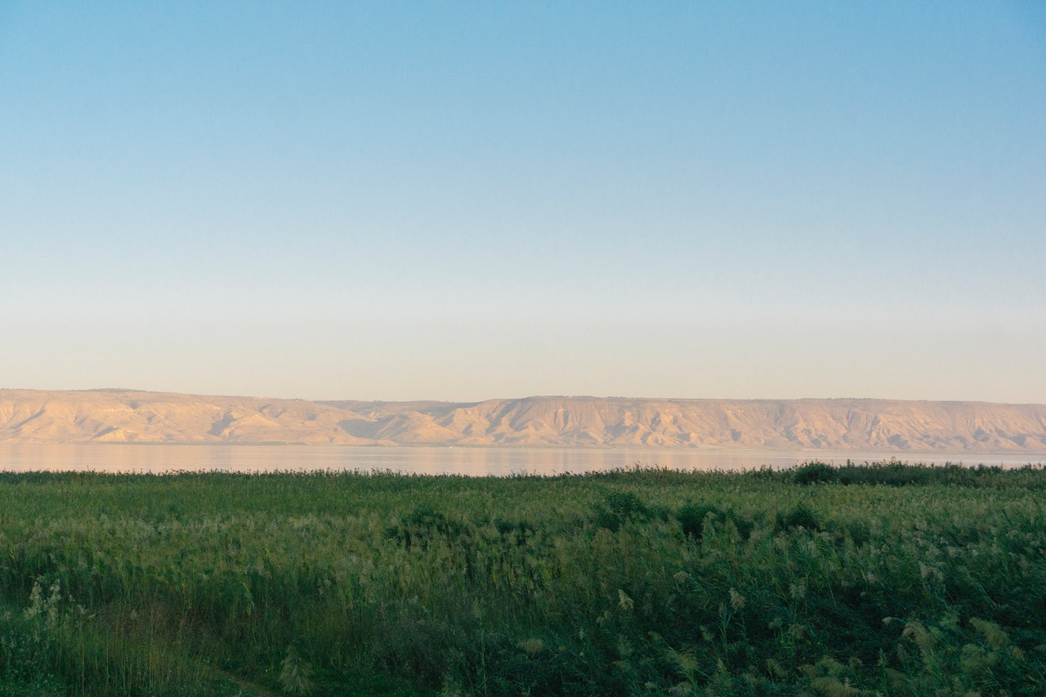
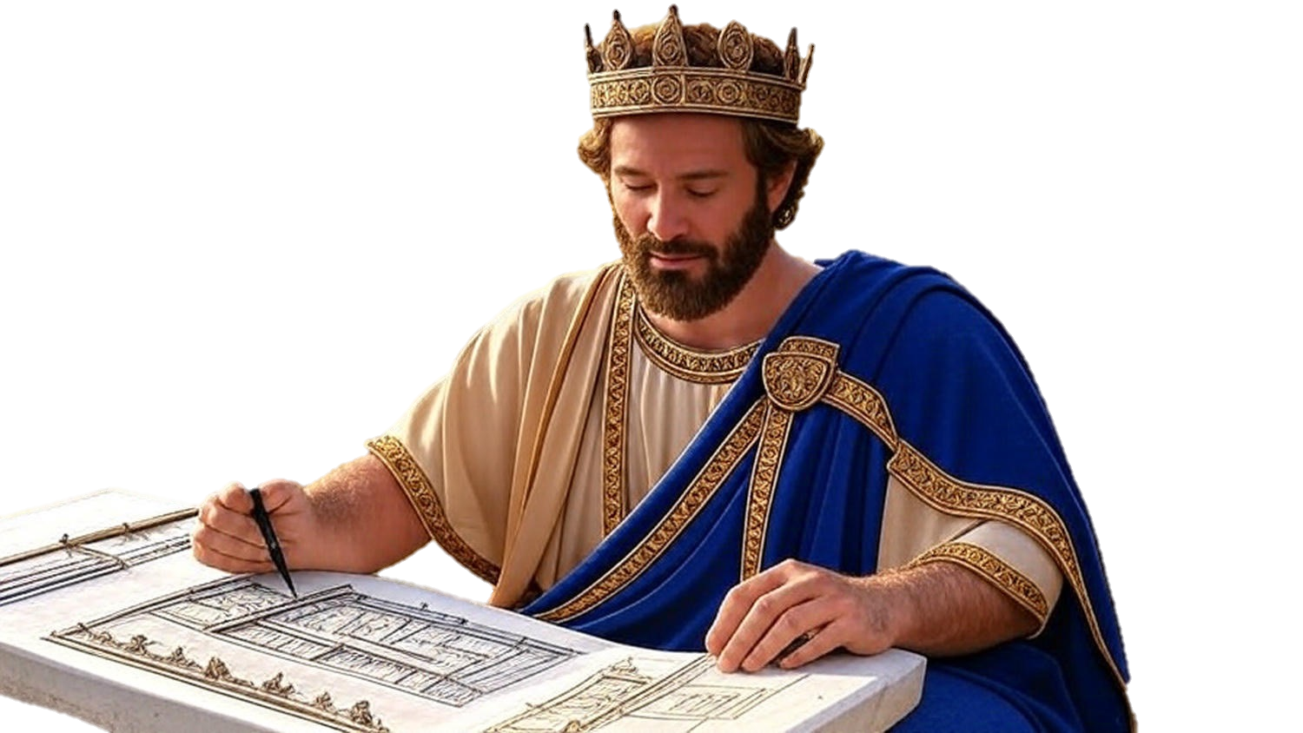

Chapters 36
2nd Chronicles
22.5 Years Of Reality Shock

Slide 2
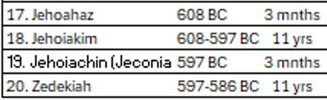
Judah’s Final Kings
Josiah
Joahaz
Jehoiakim
Zedekiah
Jehoiachin
1
2
4
3

Slide 3
Jeremiah 7:3-4
“Thus says Yahweh of hosts, the God of Israel, “Make your ways & your deeds good, & I will let you dwell in this place. “Do not trust in lying words, saying, ‘This is the temple of Yahweh, the temple of Yahweh, the temple of Yahweh.’”

Slide 4
Chapters 36
2nd Chronicles
22.5 Years Of Reality Shock

Slide 5
Key people for the final 22.5 years
Joahaz: Shows that exile is worse than death

Slide 6
Jeremiah 22:10-12
“Do not weep for the dead or console him, but weep continually for the one who goes away, for he will never return or see the land of his birth. For thus says Yahweh in regard to Shallum the son of Josiah, king of Judah… “He will never return there; but in the place where they took him away into exile, there he will die & not see this land again.”

Slide 7
Key people for the final 22.5 years
Joahaz: Shows that exile is worse than death
Jehoiakim: Shows that oscillating between two wrongs is futile

Slide 8
Daniel 1:1-2
“In the third year of the reign of Jehoiakim king of Judah, Nebuchadnezzar king of Babylon came to Jerusalem & besieged it. So the Lord gave Jehoiakim king of Judah into his hand, along with some of the vessels of the house of God; & he brought them to the land of Shinar, to the house of his god, & he brought the vessels into the treasury of his god.”

Slide 9
Jeremiah 22:17
“But your eyes and your heart are set on nothing except your own greedy gain and on shedding innocent blood and on doing oppression and extortion.”

Slide 10
Key people for the final 22.5 years
Joahaz: Shows that exile is worse than death
Jehoiakim: Shows that oscillating between two wrongs is futile
Jehoiachin: Shows one cursed of God & departed

Slide 11
Jeremiah 22:28-30
“Is this man Coniah a despised, shattered jar? Or is he an undesirable vessel? Why have he & his seed been hurled out & cast into a land that they had not known? “O land, land, land, Hear the word of Yahweh! “Thus says Yahweh, ‘Write this man down childless, a man who will not succeed in his days; for no man of his seed will succeed sitting on the throne of David or ruling again in Judah.’”

Slide 12
Key people for the final 22.5 years
Joahaz: Shows that exile is worse than death
Jehoiakim: Shows that oscillating between two wrongs is futile
Jehoiachin: Shows one cursed of God & departed
Zedekiah: Shows one blinded & deported

Slide 13
Ezekiel 12:13
“I will also spread My net over him, & he will be caught in My snare. And I will bring him to Babylon in the land of the Chaldeans; yet he will not see it, though he will die there.”

Slide 14
Key people for the final 22.5 years
Joahaz: Shows that exile is worse than death
Jehoiakim: Shows that oscillating between two wrongs is futile
Jehoiachin: Shows one cursed of God & departed
Zedekiah: Shows one blinded & deported
Nebuchadrezzar: Used of God for destruction
Cyrus: Used of God for restoration

