Slide 1
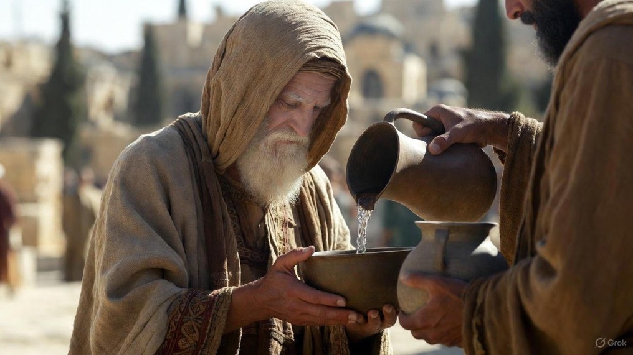

.
Witnessing The Gospel
J
THE
BOOK
of
OHN
Chapter 1:19-51

Slide 2
.
Witnessing The Gospel In Action
Repent: Let the prideful be brought low & the humiliated by brought up to level

Slide 3
.
“And he will turn many of the sons of Israel back to the Lord their God. “And he will go before Him in the spirit & power of Elijah, to turn the hearts of the fathers back to the children, & the disobedient to the attitude of the righteous, to make ready a people prepared for the Lord.”
Luke 1:16-17

Slide 4
.
“His disciples asked Him, saying, “Why then do the scribes say that Elijah must come first?” He answered & said, “Elijah is coming & will restore all things; but I say to you that Elijah already came, & they did not recognize him, but did to him whatever they wished. So also the Son of Man is going to suffer at their hands.”
Matthew 17:10-12

Slide 5
.
“Yahweh your God will raise up for you a prophet like me [Moses] from among you, from your brothers; you shall listen to him.”
Deuteronomy 18:15

Slide 6
.
“Moses said, ‘the Lord God will raise up for you a prophet like me from your brothers; to Him you shall listen to everything He says to you.”
Acts 3:22

Slide 7
.
Witnessing The Gospel In Action
Repent: Let the prideful be brought low & the humiliated by brought up to level

Slide 8
.
“As for me, I baptize you with water for repentance, but He who is coming after me is mightier than I, and I am not fit to remove His sandals; He will baptize you with the Holy Spirit and fire.”
Matthew 3:11

Slide 9
.
Witnessing The Gospel In Action
Repent: Let the prideful be brought low & the humiliated by brought up to level
(Believe) Behold the Lamb: Receive Jesus as our sacrifice & God

Slide 10
.
“And after being baptized, Jesus came up immediately from the water; & behold, the heavens were opened, & he saw the Spirit of God descending like a dove & coming upon Him, & behold, there was a voice out of the heavens saying, ‘This is My beloved Son, in whom I am well-pleased.’”
Matthew 3:16-17

Slide 11
.
Witnessing The Gospel In Action
Repent: Let the prideful be brought low & the humiliated by brought up to level
(Believe) Behold the Lamb: Receive Jesus as our sacrifice & God
Invite Others To Come & See: We need firsthand information about Jesus

