Slide 1
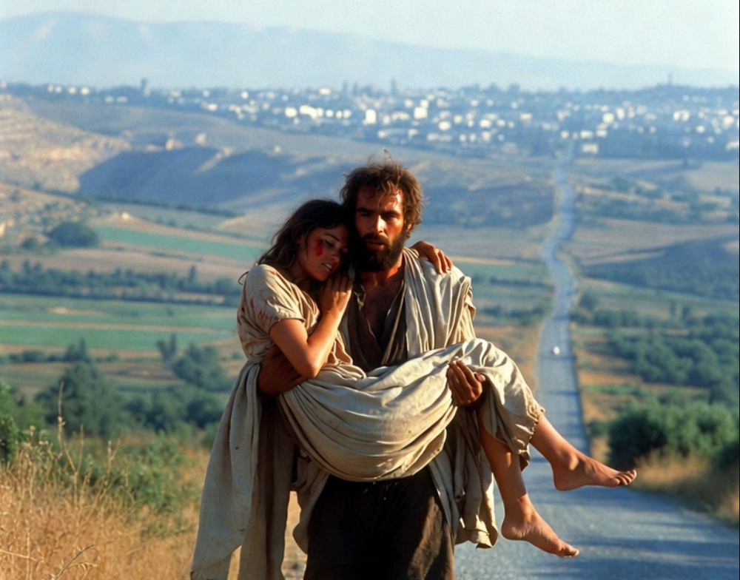

.
God’s Response To Betrayal
THE BOOK OF
HOSEA
CHAPTERS 1-3

Slide 2
.
4 Conditions of Israel & God’s Response
Disposition: Their names speak of their sinful nature

Slide 3
.
“Thomas answered and said to Him, My Lord and my God! Jesus said to him, Because you have seen Me, have you believed? Blessed are those who did not see, and yet believed.”
John 20:28-29

Slide 4
.
4 Conditions of Israel & God’s Response
Disposition: Their names speak of their sinful nature
Dissatisfaction: Their idolatry leads to a painful path

Slide 5
.
“But when he came to himself, he said, ‘How many of my father’s hired men have more than enough bread, but I am dying here with hunger! ‘I will rise up & go to my father, & will say to him, “Father, I have sinned against heaven, & before you.”
Luke 15:17-18

Slide 6
.
4 Conditions of Israel & God’s Response
Disposition: Their names speak of their sinful nature
Dissatisfaction: Their idolatry leads to a painful path
Desertion: God initiates His love to the unfaithful

Slide 7
.
“But seek first His kingdom and His righteousness, and all these things will be added to you.”
Matthew 6:33

Slide 8
.
4 Conditions of Israel & God’s Response
Disposition: Their names speak of their sinful nature
Dissatisfaction: Their idolatry leads to a painful path
Desertion: God initiates His love to the unfaithful
Disinfection: God fulfills His love to the unfaithful

Slide 9
.
“They said to Him, ‘Why then did Moses command to give her a certificate of divorce & send her away?” He said to them, “Because of your hardness of heart Moses permitted you to divorce your wives; but from the beginning it has not been this way.”
Matthew 19:7-8

Slide 10
.
4 Conditions of Israel & God’s Response
Disposition: Their names speak of their sinful nature
Dissatisfaction: Their idolatry leads to a painful path
Desertion: God initiates His love to the unfaithful
Disinfection: God fulfills His love to the unfaithful

