Slide 1
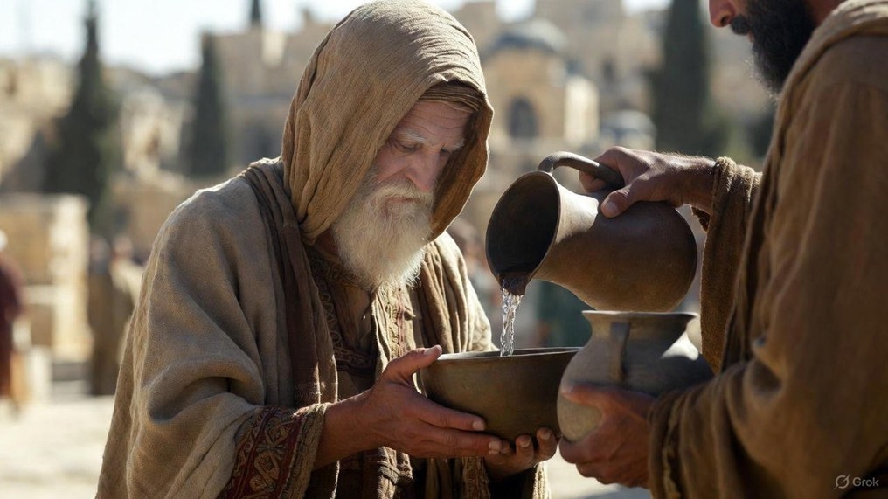

.
Chip Off The Old Rock
J
THE
BOOK
of
OHN
Chapter 2

Slide 2
.
Chip Off The Old R.O.C.K.
Jesus’ Passion In Action
Rooted in His mom’s love: His desire to comfort people
Offering change: His desire to convert unbelievers

Slide 3
.
“Then he said, ‘Go, ask for vessels for yourself, from those outside, from all your neighbors, even empty vessels; do not get a few. And you shall go in & shut the door behind you & your sons, & pour out into all these vessels, & you shall set aside what is full… (cont)
II Kings 4:3-7

Slide 4
.
(cont) …So she went from him & shut the door behind her & her sons; they were bringing the vessels to her & she poured. Now it happened that when the vessels were full, she said to her son, ‘Bring me another vessel’… (cont)
II Kings 4:3-7

Slide 5
.
(cont) …And he said to her, ‘There is not one vessel more.’ And the oil stopped. Then she came & told the man of God. And he said, “Go, sell the oil & pay your debt, & you & your sons can live on the rest.”
II Kings 4:3-7

Slide 6
.
Chip Off The Old R.O.C.K.
Jesus’ Passion In Action
Rooted in His mom’s love: His desire to comfort people
Offering change: His desire to convert unbelievers

Slide 7
.
“Now to Him who is able to do far more abundantly beyond all that we ask or understand, according to the power that works within us.”
Ephesians 3:20

Slide 8
.
Chip Off The Old R.O.C.K.
Jesus’ Passion In Action
Rooted in His mom’s love: His desire to comfort people
Offering change: His desire to convert unbelievers
Consumed with the Father: His desire to confess God

Slide 9
.
“I have become estranged from my brothers & a foreigner to my mother’s sons. For zeal for Your house has consumed Me, & the reproaches of those who reproach You have fallen on Me.”
Psalms 69:8-9

Slide 10
.
Chip Off The Old R.O.C.K.
Jesus’ Passion In Action
Rooted in His mom’s love: His desire to comfort people
Offering change: His desire to convert unbelievers
Consumed with the Father: His desire to confess God
Kneeling at the cross: His desire to change everything

Slide 11
.
“Then some of the scribes & Pharisees answered & said to Him, ‘Teacher, we want to see a sign from You.’ But He answered & said to them, “An evil & adulterous generation eagerly seeks for a sign… (cont)
Matthew 12:38-40

Slide 12
.
(cont) …and yet no sign will be given to it but the sign of Jonah the prophet; for just as Jonah was three days & three nights in the belly of the sea monster, so will the Son of Man be three days & three nights in the heart of the earth.”
Matthew 12:38-40

Slide 13
.
Chip Off The Old R.O.C.K.
Jesus’ Passion In Action
Rooted in His mom’s love: His desire to comfort people
Offering change: His desire to convert unbelievers
Consumed with the Father: His desire to confess God
Kneeling at the cross: His desire to change everything

Slide 14
.
“But Abraham said, ‘They have Moses & the Prophets; let them hear them.’ But he said, ‘No, father Abraham, but if someone goes to them from the dead, they will repent!’ But he said to him, ‘If they do not listen to Moses & the Prophets, they will not be persuaded even if someone rises from the dead.”
Luke 16:29-31

Slide 15
.
Chip Off The Old R.O.C.K.
Jesus’ Passion In Action
Rooted in His mom’s love: His desire to comfort people
Offering change: His desire to convert unbelievers
Consumed with the Father: His desire to confess God
Kneeling at the cross: His desire to change everything

