Slide 1
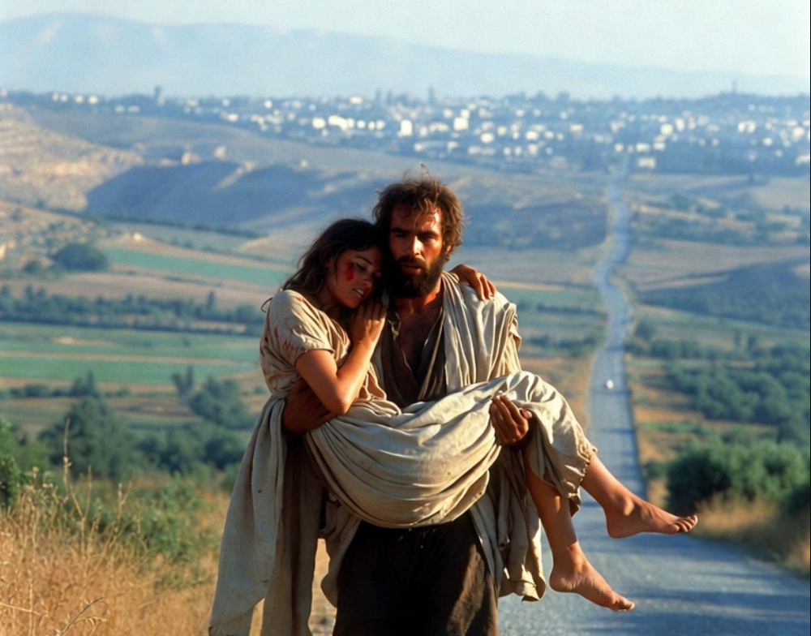

.
To Know The Lord
THE BOOK OF
HOSEA
CHAPTERS 4-7

Slide 2
.
Without Knowing The Lord…
We will be destroyed & impoverished

Slide 3
.
“So that we are no longer to be children, tossed here & there by waves & carried about by every wind of doctrine, by the trickery of men, by craftiness in deceitful scheming, but speaking the truth in love, we are to grow up in all aspects into Him who is the head, that is Christ.”
Ephesians 4:14-15

Slide 4
.
Without Knowing The Lord…
We will be destroyed & impoverished
God removes His presence from us
Our attempt at true worship is passionless, meaningless & deceptive

Slide 5
.
“And this is eternal life, that they may know You, the only true God, and Jesus Christ whom You have sent.”
John 17:3

Slide 6
.
“When the Pharisees saw this, they said to His disciples, ‘Why is your Teacher eating with the tax collectors & sinners?’ But when Jesus heard this, He said, ‘It is not those who are healthy who need a physician, but those who are sick. But go & learn what this means: I desire compassion, & not sacrifice, for I did not come to call the righteous, but sinners.”
Matthew 9:11-13

Slide 7
.
Without Knowing The Lord…
We will be destroyed & impoverished
God removes His presence from us
Our attempt at true worship is passionless, meaningless & deceptive

