Slide 1
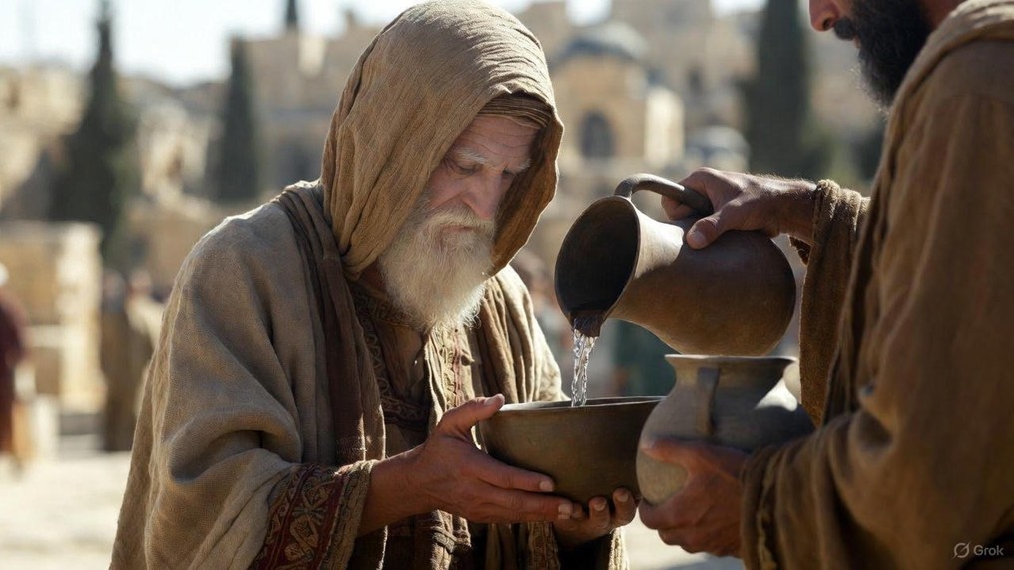

.
An Approach That Saves
J
THE
BOOK
of
OHN
Chapter 3:1-21

Slide 2
.
N.I.C.O. Approaches Jesus with…
Nonresistance To Change

Slide 3
.
“But when the kindness & affection of God our Savior appeared, He saved us, not by works which we did in righteousness, but according to His mercy, through the washing of regeneration & renewing by the Holy Spirit, whom He poured out upon us richly through Jesus Christ our Savior.”
Titus 3:4-6

Slide 4
.
“…behold, w/ the clouds of heaven One like a Son of Man was coming, & He came up to the Ancient of Days... & to Him was given dominion, glory, & a kingdom, that all the peoples, nations, & men of every tongue might serve Him. His dominion is an everlasting dominion which will not be taken away; & His kingdom is one which will not be destroyed.”
Daniel 7:13-14

Slide 5
.
N.I.C.O. Approaches Jesus with…
Nonresistance To Change
Inquisitiveness In The Spirit

Slide 6
.
“So that He might sanctify her, having cleansed her by the washing of water with the word.”
Ephesians 5:26

Slide 7
.
N.I.C.O. Approaches Jesus with…
Nonresistance To Change
Inquisitiveness In The Spirit
Commitment To The Word
Openness In Truth

Slide 8
.
“By this we have known love, that He laid down His life for us; and we ought to lay down our lives for the brothers.”
I John 3:16

Slide 9
.
“Now we know that whatever the Law says, it speaks to those who are in the Law, so that every mouth may be shut & all the world may become accountable to God; because by the works of the Law no flesh will be justified in His sight, for through the Law comes the knowledge of sin.”
Romans 3:19-20

Slide 10
.
N.I.C.O. Approaches Jesus with…
Nonresistance To Change
Inquisitiveness In The Spirit
Commitment To The Word
Openness In Truth

