Slide 1

Lesson 7
The On Going Warfare – The Spirit Against the Flesh
And
Power in Weakness – The Spirit, Present Weakness, and Prayer

Slide 2
Eschatology
(Early Christian twist on the time of the End)
The End
BEGUN
CONSUMATED
Jesus
Resurrection
Jesus
Returns
The Coming Age
The Time of the Spirit
Between the Times
“Already, Not Yet”
The Present Age
The time of “the flesh”

Slide 3
Introduction
The Ongoing Warfare – Spirit Against Flesh
  Power in Weakness
    The Spirit
    Present Weakness
    Prayer
Picture Yourself:
You are a Gentile believer living in Rome. You were raised in a pagan world, a world that is still pagan all around you. You are listening to a letter being read from Paul, a Jew and Roman citizen. He talks about not letting sin reign in my body and the law.
What are you thinking?
Notes:
Read underlined section on p. 127

Slide 4
The Ongoing Warfare – Spirit Against Flesh
“The Spirit – flesh conflict in Paul has to do not with an internal conflict in one’s soul, but with the people of God living the life of the future in a world where the flesh is still very active.”
  Does Paul think we live by a worldly standard?
  To Paul, is there a constant struggle with the flesh?
  Are we different now that we are “infected” with the Spirit?

Slide 5
2 Corinthians 10: 1-6
10 By the humility and gentleness of Christ, I appeal to you—I, Paul, who am “timid” when face to face with you, but “bold” toward you when away! ² I beg you that when I come I may not have to be as bold as I expect to be toward some people who think that we live by the standards of this world. ³ For though we live in the world, we do not wage war as the world does. ⁴ The weapons we fight with are not the weapons of the world. On the contrary, they have divine power to demolish strongholds. ⁵ We demolish arguments and every pretension that sets itself up against the knowledge of God, and we take captive every thought to make it obedient to Christ. ⁶ And we will be ready to punish every act of disobedience, once your obedience is complete.

Slide 6
The Meaning of Flesh
  The meaning of flesh to Paul – “human frailty” and “human fallenness” (morally negative sense)
    Present life is lived “in the flesh” (or as “physical beings”) (see again 2 Cor. 10: 2-4)
    When it is living according to the flesh, we are fallen (i.e., turned to our own way); therefore, utterly hostile to God in every way
    Sometimes referred to as the “sinful nature” – i.e., think self-centered revolting against God
  When flesh is compared to the Spirit it is always in the morally negative sense

Slide 7
2 Corinthians 10: 1-6
10 By the humility and gentleness of Christ, I appeal to you—I, Paul, who am “timid” when face to face with you, but “bold” toward you when away! ² I beg you that when I come I may not have to be as bold as I expect to be toward some people who think that we live by the standards of this world. ³ For though we live in the world, we do not wage war as the world does. ⁴ The weapons we fight with are not the weapons of the world. On the contrary, they have divine power to demolish strongholds. ⁵ We demolish arguments and every pretension that sets itself up against the knowledge of God, and we take captive every thought to make it obedient to Christ. ⁶ And we will be ready to punish every act of disobedience, once your obedience is complete.

Slide 8
The Spirit – Flesh Contrast
  The Spirit changes who we are; we are no longer living as before in the flesh (see Rom. 7: 4-6 and 2 Corinthians 5: 14-17)
  For the flesh,
      The world we live in is the self-centered described in Galatians 5: 19-21 (i.e., the Gentile world was pagan, and this is how people lived); and
      Value and significance are found in power, influence, wealth, and worldly wisdom
  Paul wants the early Christians to recognize the “already, not yet” aspects of life.
Notes:
After first sub-bullet read underlined section on pp. 130-131 (the key points of Romans and 2 Corinthians).
Last, read underlined section on p. 133

Slide 9
The Struggle
  Romans 7: 13-25
    What Paul describes throughout is what it was like to live life under the law – Christian Paul did not consider himself to be under the law.
    The person described never wins.
    There is no mention of the Spirit – Christ and the Spirit are the answer to the “slave to sin”
  Galatians 5: 17 in Context
Paul does not describe Christian life in the Spirit, as one of constant struggle with the flesh – but the struggle does exist between our frail and fallen self and the flesh.

Slide 10
Romans 7: 13-25
¹³ Did that which is good, then, become death to me? By no means! Nevertheless, in order that sin might be recognized as sin, it used what is good to bring about my death, so that through the commandment sin might become utterly sinful.
¹⁴ We know that the law is spiritual; but I am unspiritual, sold as a slave to sin. ¹⁵ I do not understand what I do. For what I want to do I do not do, but what I hate I do. ¹⁶ And if I do what I do not want to do, I agree that the law is good. ¹⁷ As it is, it is no longer I myself who do it, but it is sin living in me. ¹⁸ For I know that good itself does not dwell in me, that is, in my sinful nature. For I have the desire to do what is good, but I cannot carry it out. ¹⁹ For I do not do the good I want to do, but the evil I do not want to do—this I keep on doing. ²⁰ Now if I do what I do not want to do, it is no longer I who do it, but it is sin living in me that does it.

Slide 11
Romans 7: 13-25
²¹ So I find this law at work: Although I want to do good, evil is right there with me. ²² For in my inner being I delight in God’s law; ²³ but I see another law at work in me, waging war against the law of my mind and making me a prisoner of the law of sin at work within me. ²⁴ What a wretched man I am! Who will rescue me from this body that is subject to death? ²⁵ Thanks be to God, who delivers me through Jesus Christ our Lord!
So then, I myself in my mind am a slave to God’s law, but in my sinful nature^{[d]} a slave to the law of sin.

Slide 12
The Struggle
  Romans 7: 13-25
    What describes throughout is what it was like to live life under the law – Christian Paul did not consider himself to be under the law.
    The person described never wins.
    There is no mention of the Spirit – Christ and the Spirit are the answer to being a “slave to sin”
  Galatians 5: 17 in Context
Paul does not describe Christian life in the Spirit, as one of constant struggle with the flesh – but the struggle does exist between our frail and fallen self and the flesh.
Notes:
Read sections from p. 138

Slide 13
Galatians 5: 18 - 21
¹⁶ So I say, walk by the Spirit, and you will not gratify the desires of the flesh. ¹⁷ For the flesh desires what is contrary to the Spirit, and the Spirit what is contrary to the flesh. They are in conflict with each other, so that you are not to do whatever you want. ¹⁸ But if you are led by the Spirit, you are not under the law.
¹⁹ The acts of the flesh are obvious: sexual immorality, impurity and debauchery; ²⁰ idolatry and witchcraft; hatred, discord, jealousy, fits of rage, selfish ambition, dissensions, factions ²¹ and envy; drunkenness, orgies, and the like. I warn you, as I did before, that those who live like this will not inherit the kingdom of God.

Slide 14
Power in Weakness
  Life in the flesh v. life according to the flesh
    The later to Paul means living in sin
    The “already, not yet” conundrum – our cultures view of suffering and pain
  The Spirit, Power, and Weakness
    The Spirit was experienced in Paul’s churches
    Paul steered a course through the radical middle – i.e., “work of the Spirit, not in the wisdom or eloquence of the preacher”
    Lived in faith – why some see miracles and others tortured and put to death in same faith
  Prayer
    Paul prayed regularly and continuously (1 Thess. 5: 16-18)
    Urged praying in and by the Spirit (Eph. 6: 18)
Notes:
Read section on p. 145
Read section on p. 146
Read section on p. 149

Slide 15
Key Points
Paul’s eschatological view shaped his view of the Spirit
The fruits of the Spirit are available corporately and personally (self-control) for our walk with and in the Spirit
The ongoing warfare occurs between the Spirit and the flesh; but is not necessarily a “struggle”
While we may be “weak” in the flesh, prayer in the Spirit is weapon
Picture Yourself:
You are a believer attending West Houston Church of Christ. You are far from perfect, but you know that you are different. You are reading Paul’s letters to the early church and studying the Holy Spirit.
What are you thinking so far?
Notes:
Read from p. 138 as a closing.

Slide 16
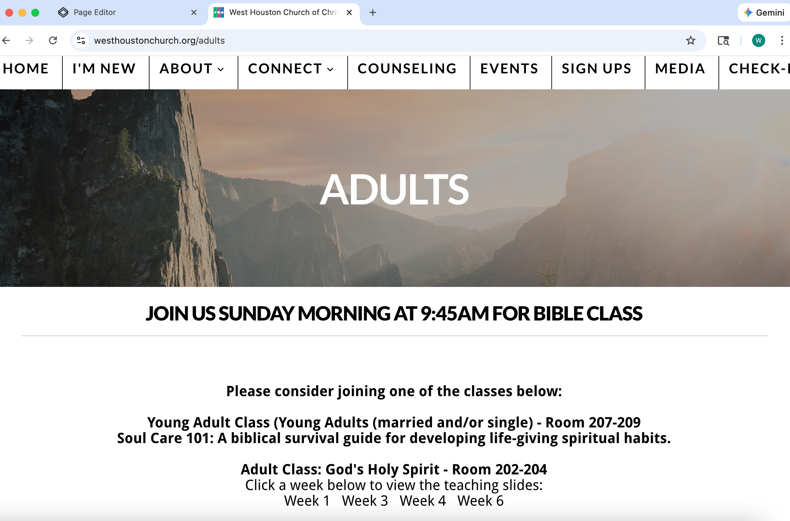
Website -> Connect -> Adults

