Slide 1

Preschool/Nursery theme |  | PARASHA | Yitro “Yitro aka Jethro”
Listening |  | Teachers: . | Yvonna Gamble & Susie Bridges
20 sh'vat 5786 |  | Story: . | Moshe appoints Judges pg. 34
Songs @ 9ish & 12ish | verse @ 9:30ish and 10:30ish | Storytime right after snack 11:30ish | colouring page As they come in & after storytime
Yeshua Loves me Clean up (we encourage you to sing along with worship and liturgy too if you would like) | Mattiyahu 5:23-24 ^{(TLV)} ²³“Therefore if you are presenting your offering upon the altar, and there remember that your brother has something against you, ²⁴leave your offering there before the altar and go. First be reconciled to your brother, and then come and present your offering. | Listening to wise council from Yitro helps Moshe to lead. | Mt. Sinai Trembles
big Idea | big idea | big idea | big idea
Moshe will listen to Yitro. | B'nei Yisreal agrees to obey G-D's commandments. | Our responsibility is to keep G-D's commandments. | G-D's WORD is Truth.
Lesson essential questions #1 | Lesson essential questions #2 | Lesson essential questions #3 | Lesson essential questions #4
What does it mean to listen to G-D? | What does it mean to obey G-D? | What is our responsibility? | What is truth?
vocabulary #1 | vocabulary #2 | vocabulary #3 | vocabulary #4
Listen | Obey | Responsibility | Truth
Hebrew letter of the month OF Sh'vat
This month’s letter of the alef-bet is Dalet. It is the fourth letter of the alef-bet. Say: "dalet". This letteer makes the sound that is similar to the English letter "D". It is written in Talmud that the gimmel is a rich man chasing after a poor man –the dalet 4th letter (dalut means poor) in order to give to him tzedakah (charity). The dalet is indeed said to resemble a person of humility who is bent in a bow. One of the names we call G-D is Dayan ha'Emet or "THE TRUE JUDGE" which begins with the letter dalet. Use your finger to trace the dalet on the next page, and then look at the items that begin with the letter Dalet; can you read the names aloud? Run your finger underneath the letters and remember that Hebrew is read from right to left.

Slide 2
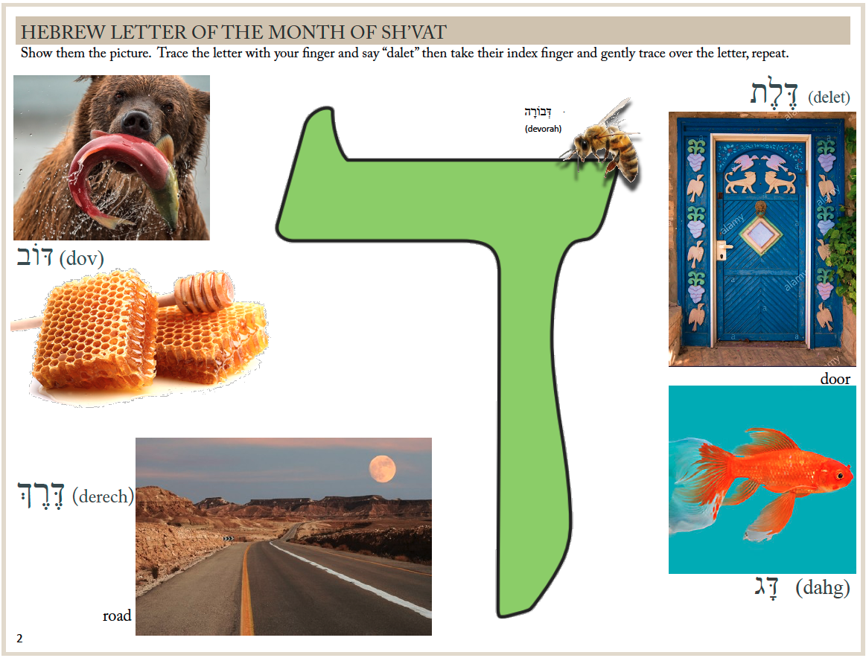
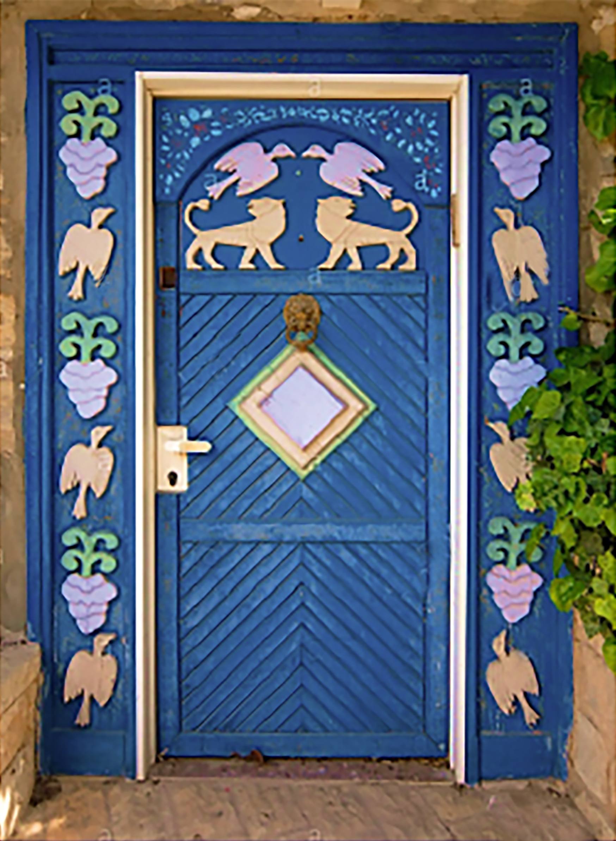
Hebrew letter of the month OF NIssan
Show them the picture. Trace the letter with your finger and say “hey” then take their index finger and gently trace over the letter, repeat.
Hebrew letter of the month OF Tishrei
Show them the picture. Trace the letter with your finger and say “sin” then take their index finger and gently trace over the letter, repeat.
דְּבַשׁ (devash)

Slide 3

Clean up clean up - everybody everywhere.
Clean up clean up - everybody do your share.
Clean up clean up - everybody everywhere.
Clean up clean up - everybody do your share.
REPEAT UNTIL YOU SING IT IN YOUR SLEEP,
or the room is relatively tidy.

Slide 4
Brit Ahm Nursery Policies
This nursery is staffed by volunteers that have submitted to background checks and give up their time to serve.
- they should be treated with kindness.
This nursery is provided for 0-4 year old’s, and for the convenience of nursing mothers.
- other ages are provided for by various other ministries.
This nursery requires that you check your children in and out, and that you pose for a photo with your child.
- This is a safety concern, and we appreciate your cooperation. Be sure to note anything of note; including allergies or concerns.
+Bonus; if you provide your e-mail addy, you get a fun Shabbat memory e-mailed direct to you!
This nursery is cozy and cannot accommodate more than a couple parents at a time.
- we ask that you are mindful, and patient while others check in,
and that you please do not remain longer than needed to situate your child.
This nursery loves to be happy and healthy, and we want your young ones to feel secure.
-Please help them by giving them a bright and cheerful “l’hitra’ot” (see you later) and leaving with confidence.
Children that remain upset, or cry for more than 5 minutes will be returned to their parents.
Please tell us if there is anything we need to know.
-Are there soothers in their nappy bag? An extra set of clothes? Are they having a good/rough day?
Additionally to that end; please do not:
Bring your babies if they are ill with anything communicable (catching)
Sneak out on your children (it makes them untrusting)
Repeatedly come in and go out of the nursery (it confuses them)
Get over-emotional when dropping them off (they intuit your emotions and will feel insecure)
Please see leadership if you have any questions in regard to these written policies, or any other concern.

Slide 5
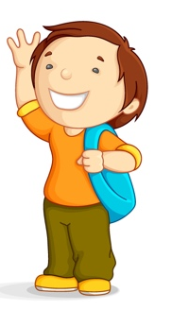

Welcome to Brit Ahm
Although we primarily speak English these are some Hebrew and Yiddish words you might hear around our nursery.
Horim (hor-eem) = it means parents. “this is her first day, her horim are new to Brit Ahm.” Tinoch (tee-no-kch) = it means baby “The tinoch needs a nappy change” Ima (ee-mah) = it means mother. “Elijah you miss your Ima? It’s okay to miss her, she will be back to get you soon.” Abba (ab-bah) = it means father. “Her Abba is such a mensch!” Yeled/Yeladim/Yeldah (yell-ed/yell-a-deem/yell-dah) = it means child / children / little girl. “The yeladim in the nursery had fun today!” Kvetch/Kvetching (ke-vet-ch) = it means to complain. “I am not going to kvetch. I am blessed!” Chitul (kchit-tool) = it means diaper/nappy. “Would you grab me a chitul, size 3 please” L’shon harah (læ -shawn ha-rah) = lit. evil speech. Also gossip, unkindness, or negative speech. “Speak kind words, never l’shon harah, Lydia.”
Bokquer tov (bo-quer toe-v) = it means good morning. “Bokquer tov Eden!” Shalom/Shabbat Shalom (sha-loam / sha-bat sha-loam) = lit. peace. Also hello, goodbye, wholeness, and good Shabbat. “Shabbat Shalom Jacobi!” Kishkes (kish-kahs) = lit. guts/intestines. Also intuition a “gut feeling” “I know that Cate is going to get that scholarship, I feel it in my kishkes.” L’hitraot (læ-hee-trah-oat) = it means “see you later.” (gators and or hippos optional.) “L’hitraot Miss Sadie” Shul (shool) = lit. school Also the synagogue. “I will be back at shul on Tuesday for ladies intercessory prayer.” Mishpacha (mish-pa-kcha) = it means family. “We are so blessed that the Railings are part of our mischpacha” Yeshua (Ye-shua) = lit. salvation Also the Hebrew name of The One called Jesus. “Yeshua loves me this I know….”
Shalom Elijah!
L’hitraot Evie!

Slide 6
Yeshua Loves Me:
is an old lullaby that we sing to our nursery yeladim. You can sing it to your little one to remind them of
The ONE upon whom our hope and our lives rest.
The main purpose of our nursery is to build solid Torah understanding on the foundation that is perfect; our G-D and saviour, rock and redeemer: Yeshua HaMashiach.
Our teaching focus with this age group is to model love, impart courage, and teach self-control so they might grow in power and understanding.
Prayer for Power and Understanding
¹⁴For this reason I bow my knees before the Father—¹⁵from Him every family in heaven and on earth receives its name. ¹⁶I pray that from His glorious riches He would grant you to be strengthened in your inner being with power through His Ruach, ¹⁷so that Messiah may dwell in your hearts through faith. I pray that you, being rooted and grounded in love, ¹⁸may have strength to grasp with all the kedoshim what is the width and length and height and depth, ¹⁹and to know the love of Messiah which surpasses knowledge, so you may be filled up with all the fullness of G-D. ²⁰Now to Him who is able to do far beyond all that we ask or imagine, by means of His power that works in us, ²¹to Him be the glory in the community of believers and in Messiah Yeshua throughout all generations forever and ever! Amen.
~Ephesians 3:14-21 (TLV)

Slide 7
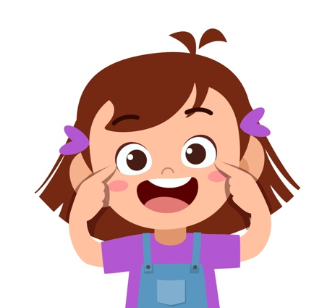
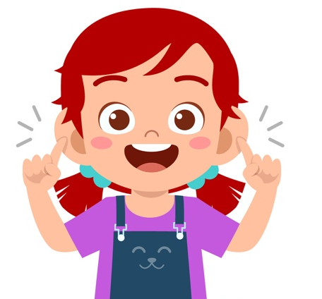
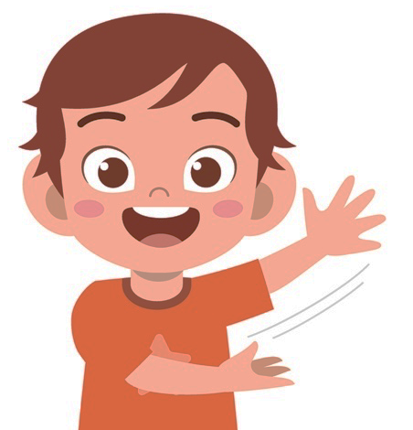
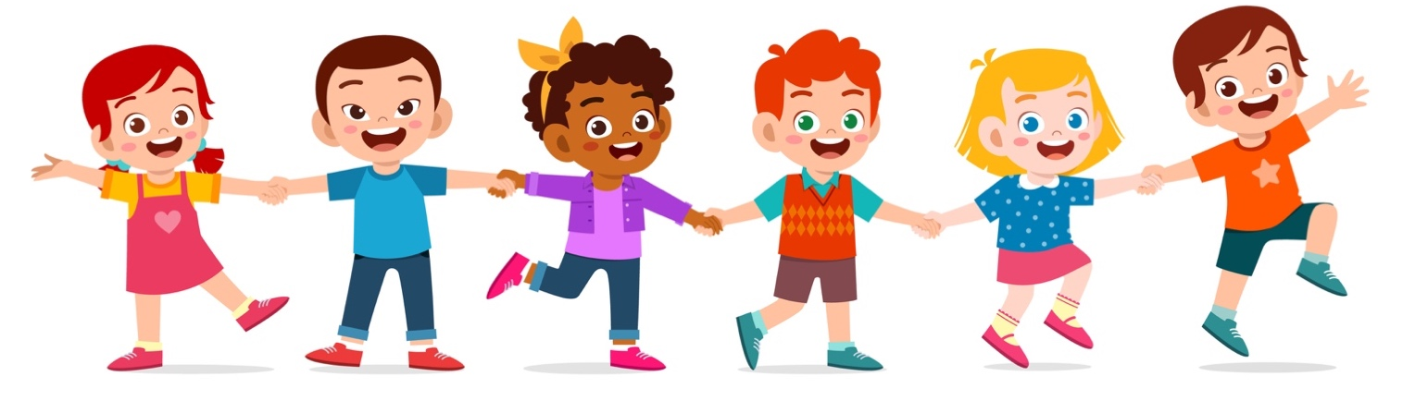
Oh, Be Careful
Oh, be careful little feet where you go
Oh, be careful little feet where you go
Our Abba’s up above
And He's leading us with love
So, be careful little feet where you go
Oh, be careful little mouth what you say
Oh, be careful little mouth what you say
Yeshua is above
And He's speaking out His love
So, be careful little mouth what you say
Oh, be careful little eyes what you see
Oh, be careful little eyes what you see
There's a Father up above
And He's looking down in love
So, be careful little eyes what you see
Oh, be careful little ears what you hear
Oh, be careful little ears what you hear
The Father’s up above
And He's hearing us with love
So, be careful little ears what you hear
Oh, be careful little hands what you do
Oh, be careful little hands what you do
Our Father’s up above and
He's showing us His love
So, be careful little hands
what you do

Slide 8
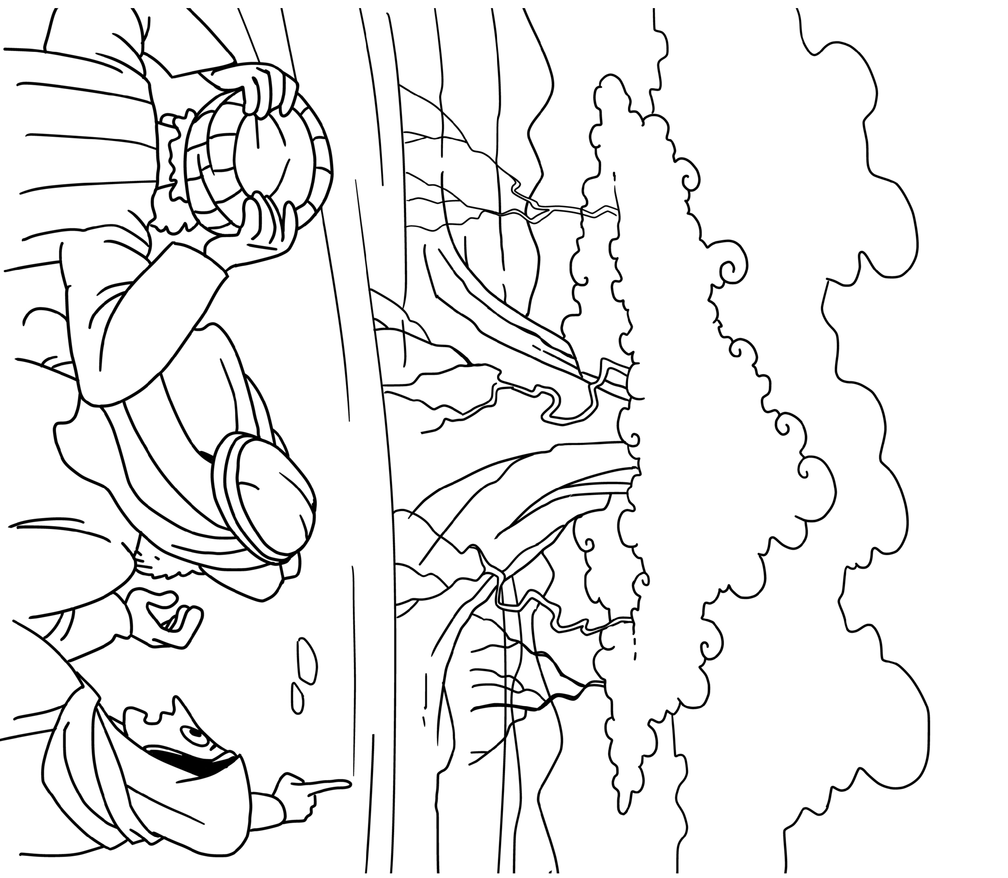
Shemot
Yitro 18:17-20:23

