Slide 1
Last Supper
On the (Thursday) evening before Jesus was arrested
He had His last supper (meal) with His disciples.
The Gospel of Matthew says:

Slide 2

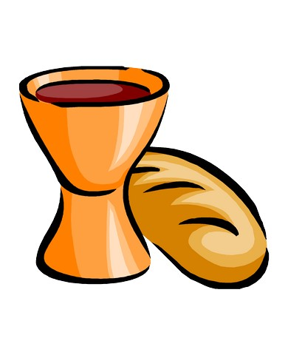
Matthew 26
²⁶While they were eating, Jesus took bread, and when he had given thanks, he broke it and gave it to his disciples, saying, “Take and eat; this is my body.”
²⁷Then he took a cup, and when he had given thanks, he gave it to them, saying, “Drink from it, all of you. ²⁸This is my blood of the covenant, which is poured out for many for the forgiveness of sins. ²⁹I tell you, I will not drink from this fruit of the vine from now on until that day when I drink it new with you in my Father’s kingdom.”
³⁰When they had sung a hymn, they went out to the Mount of Olives.

Slide 3
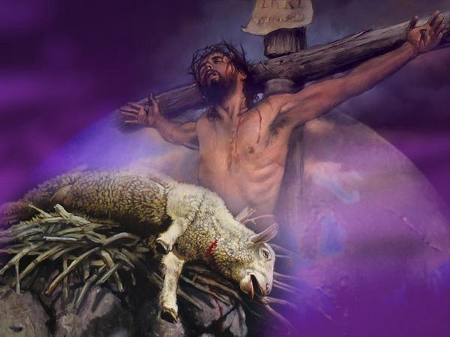
The Gospel of Luke gives the reason why Jesus wanted to have this supper with His followers. He refers to the Passover lamb from the Old Testament.
Luke 22
¹⁴When the hour came, Jesus and his apostles reclined at the table. ¹⁵And he said to them, “I have eagerly desired to eat this Passover with you before I suffer.
¹⁹And he took bread, gave thanks and broke it, and gave it to them, saying, “This is my body given for you; do this in remembrance of me.”
Here Jesus commends all followers to do this. The Christian church calls this communion (being one with Jesus). Taking communion is only for Christians.

Slide 4
Jesus was crucified on a cross on the Friday before Easter.
We call that Good Friday.
Good Friday was not good for Jesus, because He was innocently killed.
Good Friday is good for us, because we were guilty but saved by Jesus’ sacrifice.
Choral from Matthew Passion by JS Bach
Christians go to church on Good Friday to remember Jesus together. And thank Him for all He has done for us. All who have trusted Jesus in their lives are to take the bread and drink the cup in remembrance of Jesus.

Slide 5
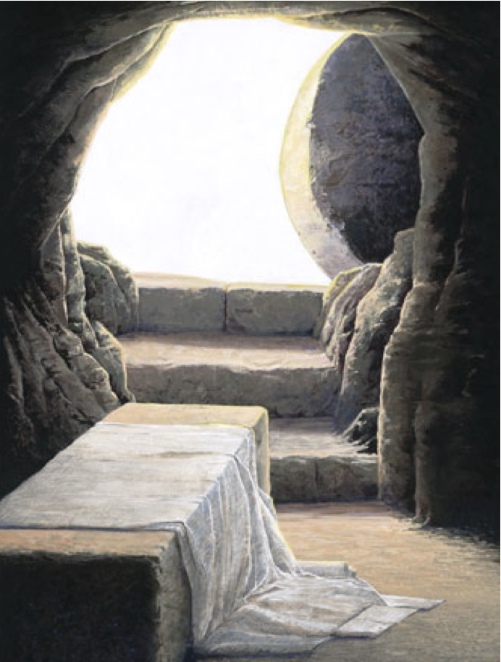
Easter
On the third day Jesus was raised from the dead, which we call resurrection. We celebrate that joyfully on Easter Sunday. Christians then say to each other: “He is risen indeed”.

