Slide 1
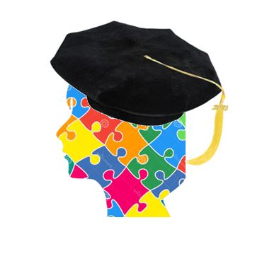

Founder Region Fellowship, Inc.
Solving Puzzles
by Degrees!
Notes:
On behalf of President Vicki, Treasurer Danelle, and Directors: Amelia, Kay, Colleen, Tess, and Cindy, I am so delighted to tell you about the exciting ways you can support Founder Region Fellowship this biennium. February is designated as “Fun for Fellowship” Month to raise awareness and educate our members about our program.
Fellowship’s theme for the 2024-2026 biennium is Solving Puzzles by Degrees!, which was chosen to support Governor Elise’s theme of Putting the Puzzle Together.
Founder Region Fellowship Presentation for Clubs 2024-2026 Biennium

Slide 2
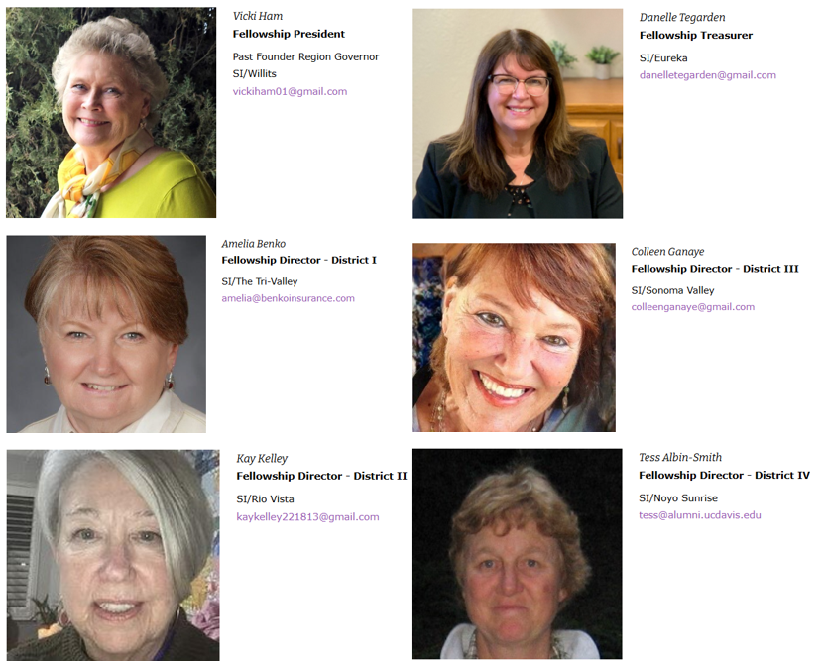
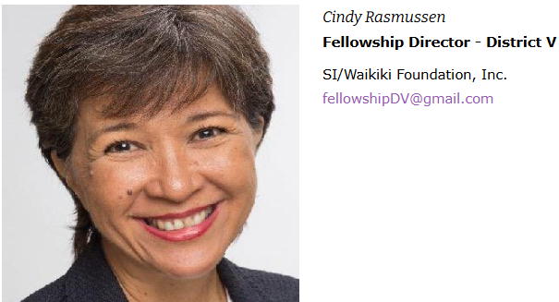
ABOUT US
Notes:
Your Fellowship Board is:
Vicki Ham, S/I Willits, President
Danelle Tegarden, SI/Eureka, Treasurer
Amelia Benko, SI/The Tri-Valley, Fellowship Director, District I
Kay Kelley, SI/Rio Vista, Fellowship Director, District II
Colleen Ganaye, SI/Sonoma Valley, Fellowship Director, District III
Tess Albin-Smith, SI/Noyo Sunrise, Fellowship Director, District IV
Cindy Rasmussen, SI/Waikiki Foundation, Inc., Fellowship Director, District V
Their contact information can be found on the Fellowship website: FounderReigonFellowship.org and in the Founder Region Roster.
Founder Region Fellowship Presentation for Clubs 2024-2026 Biennium

Slide 3

Established in 1948
MISSION STATEMENT:
To advance the Soroptimist mission by awarding grants to outstanding women in the final phase of their doctoral program within Founder Region.
Solving Puzzles by Degrees! Founder Region Fellowship, Inc.
Notes:
Established in 1948, the Fellowship Program is Founder Region's Identifying Project and celebrated the 75th year in 2023.
The Mission is to advance the Soroptimist mission by awarding grants to outstanding women in the final phase of their doctoral program within Founder Region. Fellowship recognizes the value of empowering highly motivated women engaged in academic research in fields such as: science, technology, education, the climate, women's health and all things affecting women and girls' quality of life. These women are doing ground breaking research and breaking down glass ceilings in their male dominated fields. Members in Founder Region have been empowering these women since 1948 and we hope to continue to support our mission for many years to come.

Slide 4
Founder Region Boundaries
10 Northern California Counties: Alameda, Contra Costa, Del Norte, Humboldt, Lake, Marin, Mendocino, Napa, Solano, Sonoma
The State of Hawaii
The U.S. Territory of Guam
The Commonwealth of the Northern Mariana Islands
The Republic of Palau
Notes:
Most service organizations have Identifying Projects that help the organization realize its mission. From Soroptimist International down to the club level, one will find many innovative, heartwarming, and challenging projects to fulfill the Soroptimist mission.
Founder Region is one of 28 regions of Soroptimist International of the Americas (SIA) with our territory encompassing:10 Northern California Counties: Alameda, Contra Costa, Del Norte, Humboldt, Lake, Marin, Mendocino, Napa, Solano, Sonoma
The State of Hawaii
The U.S. Territory of Guam
The Commonwealth of the Northern Mariana Islands
The Republic of Palau
Fellowship is unique to Founder Region and no other region has a program quite like this one.

Slide 5
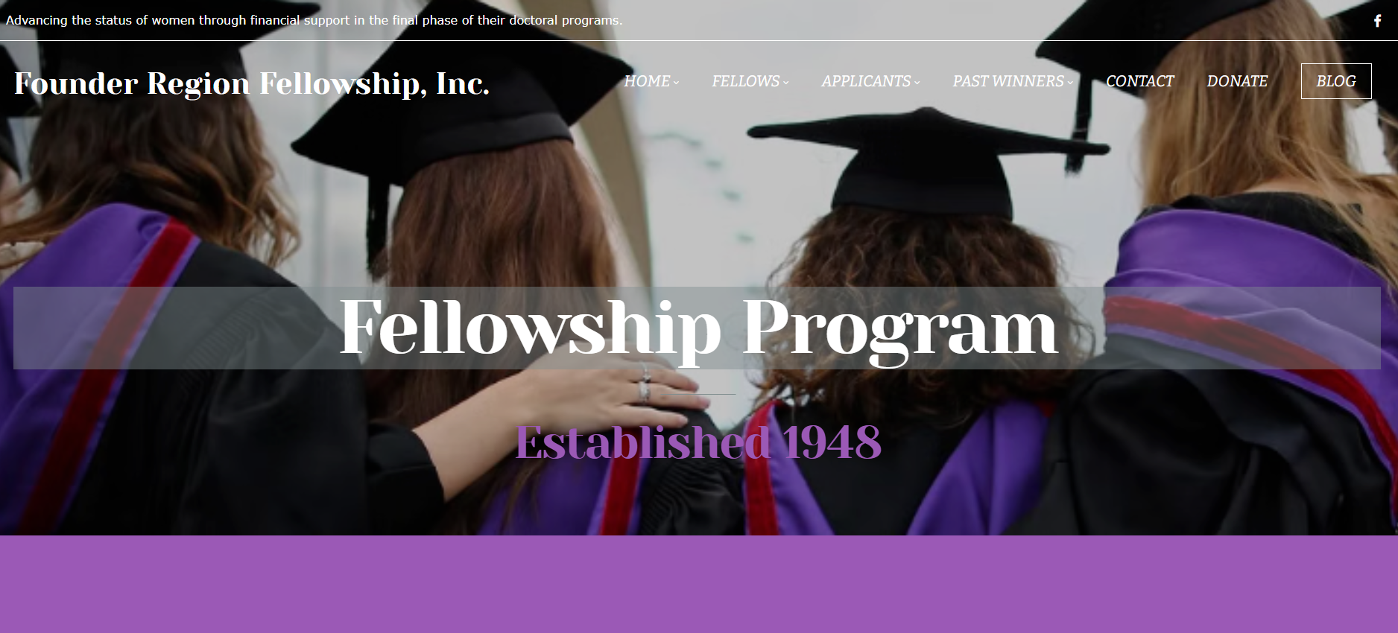
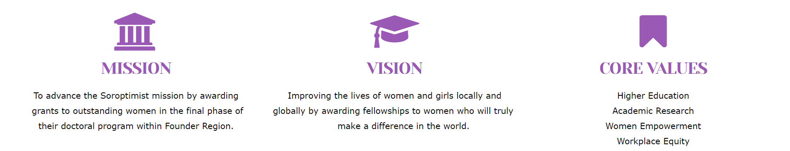
Notes:
Fellowship has recently defined their Vision & Core Values.
The Vision: Improving the lives of women and girls locally and globally by awarding Fellowships to women who will truly make a difference in the world.
The Core Values: to support Higher Education, Academic Research, Women Empowerment and Workplace Equality.

Slide 6
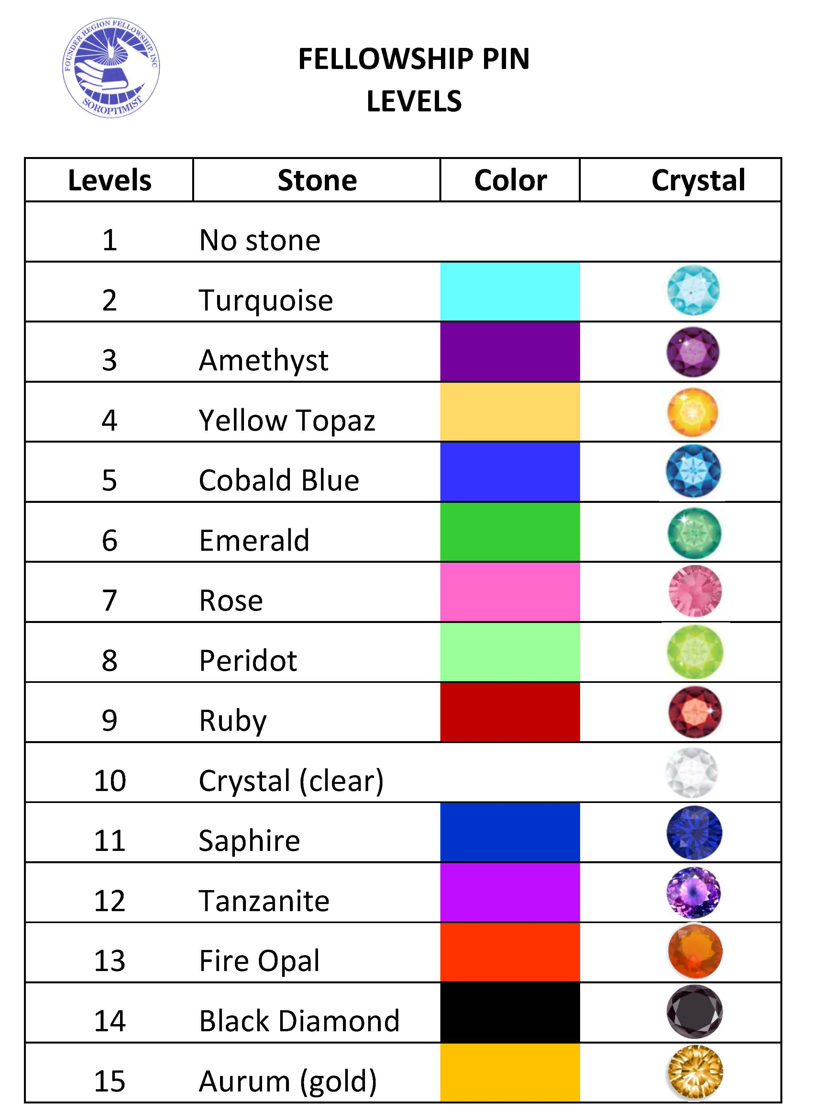
WHAT IS A FELLOW?
A fellow is an equal or a comrade. It is most often used in an academic context: a fellow is often part of an elite group of learned people who work together as peers in the pursuit of knowledge or practice.
Notes:
What is a Fellow?
A Soroptimist “Fellow” is a person or club that is indeed a member of an elite group. Every fellow named represents $1,000 in donations to the Soroptimist Founder Region Fellowship Program, which provides scholarships to some amazing women. Over 750 Soroptimist women have become Fellows since 1948, most of which are active members, and many have multiple fellowships and/or have donated fellowships to other Soroptimist women.
There are currently 15 Fellow levels and each level has its own pin. The pins for Levels 2 through 15 each have their own crystal imbedded in the pin. The levels and crystal colors are listed on the slide. A person (member or not) can become a Fellow by a payment of $1,000 for a level (in one payment or in monthly payments over time) or winning one of numerous opportunity drawings held throughout a biennium as part of Fellowship fundraising .

Slide 7
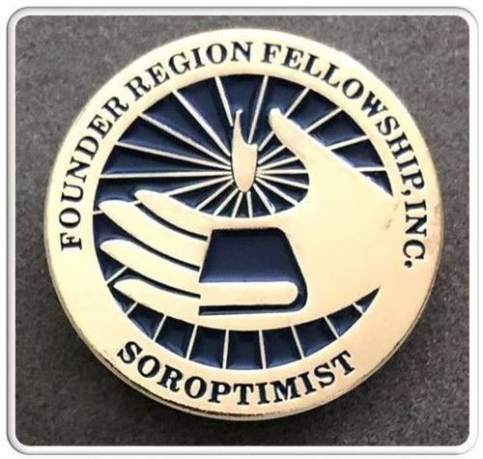
FELLOWSHIP PIN
Fellowship Logo
Lighted Torch
Rays of Light
Book in Hand
1987 Jan Sadler, SI/El Cerrito
Notes:
The Fellowship logo was designed by Jan Sadler of SI/El Cerrito in 1987, and is displayed on the Fellowship pins. The circle is an ancient and universal symbol of unity, wholeness, infinity, the goddess, and female power. The lighted torch is almost always associated with giving light or guidance, as in passing the torch to the next generation. The torch and/or lamp of knowledge generally symbolizes learning or knowledge and in science it is the ‘guiding light of scientific inquiry in an atmosphere of intellectual freedom, truth, and intelligence’. The Olympic torch is a symbol of the harmony and goodwill toward humanity. Sometimes the torch is replaced by a sun on the Fellowship pin. Rays of light symbolize enlightenment and the sharing of knowledge and wisdom in the world. Book in hand is symbolic as Fellowship targets women who are working in fields of great social importance. The design shows a woman’s hand holding a book, symbolizing learning and education. The idea may have its roots in the statue of St. Catherine of Alexandria (who stands holding a book). She has been dubbed the patron saint of libraries and anyone associated with wisdom or teaching.
The first level pin has no stone.

Slide 8
WHO CAN APPLY?
Founder Region’s Identifying Project
Solving Puzzles by Degrees! Founder Region Fellowship, Inc.
Notes:
Grant Requirements
Competition is open to any outstanding graduate woman who is working toward a doctoral degree, preferably in the last year of study but permissibly during the last two years provided she has advanced to candidacy.
International students are encouraged to apply.
Applicant must be enrolled in a graduate school within Founder Region; including the Northern California counties of Alameda, Contra Costa, Del Norte, Humboldt, Lake, Marin, Mendocino, Napa, Solano, Sonoma; the State of Hawaii; the U. S. Territory of Guam; the Commonwealth the Northern Mariana Islands; the Republic of Palau.

Slide 9
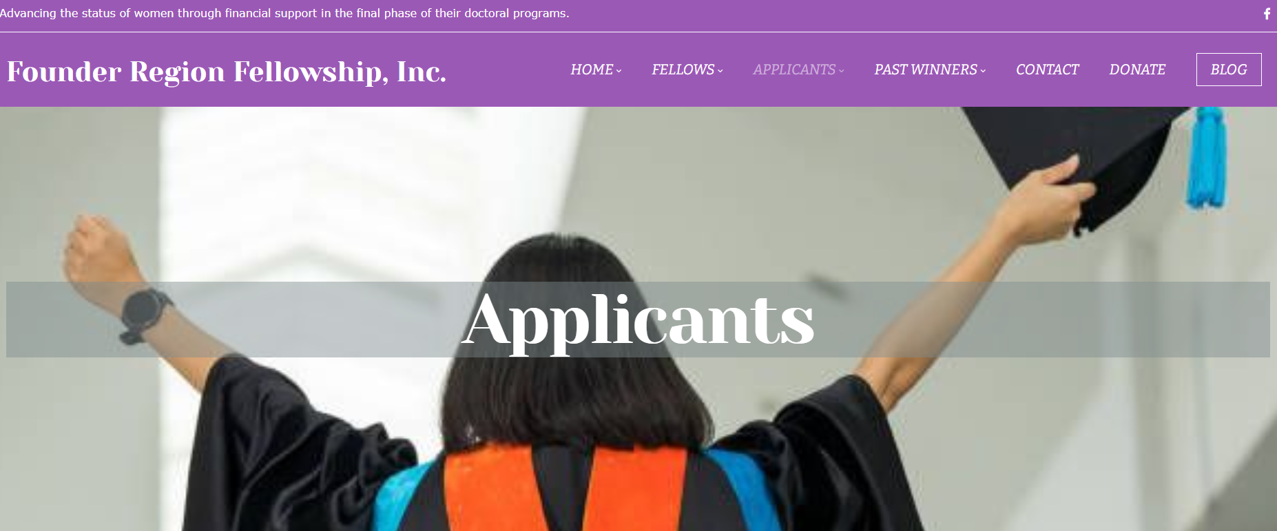
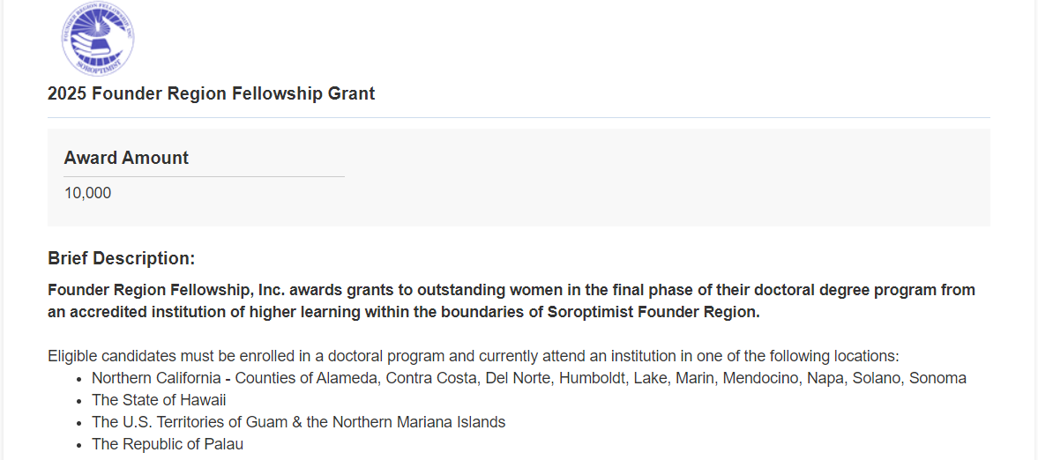
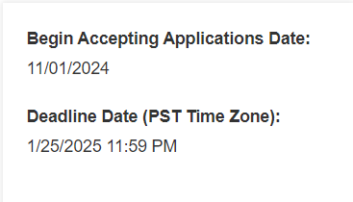

Community Force Scholars United
Notes:
The Fellowship Grant process is now virtual through a free online scholarship portal by Community Force Scholars United. Applicants will complete their applications online, upload required documents, and email recommenders to streamline the process.
The Fellowship board will do their judging through the portal as well to determine finalists for interviews. The process is easy to navigate and we hope to continue to receive many more applications this coming year.
The application window is open from November 20 – January 10 of each year. Applicants are scored and several are selected to be interviewed by the board, which take place in Hawaii and California in March. The winners are then chosen for presentation at conference in May.

Slide 10
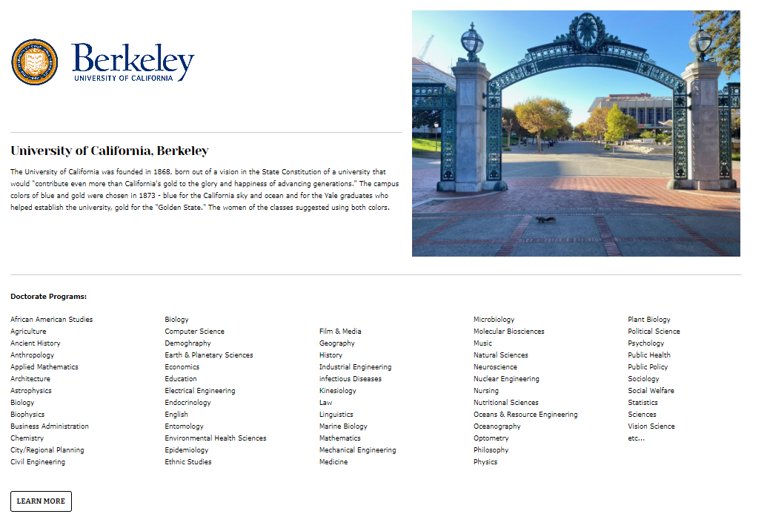
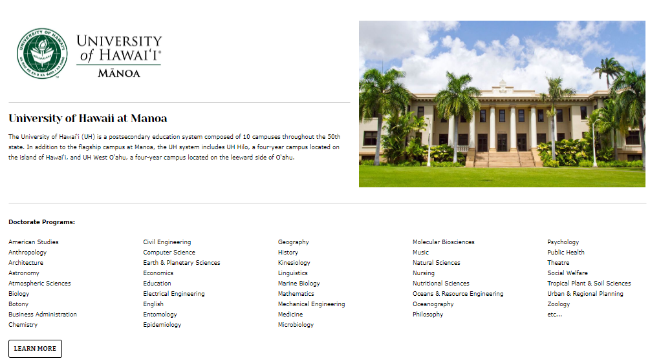
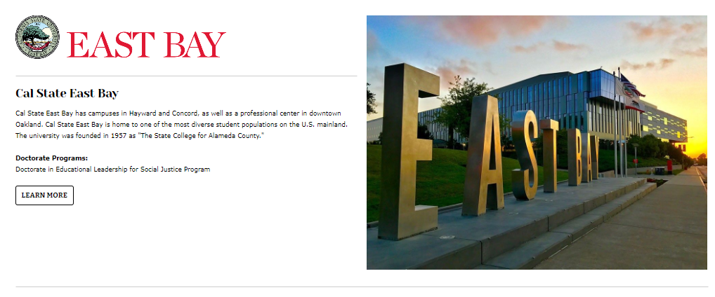
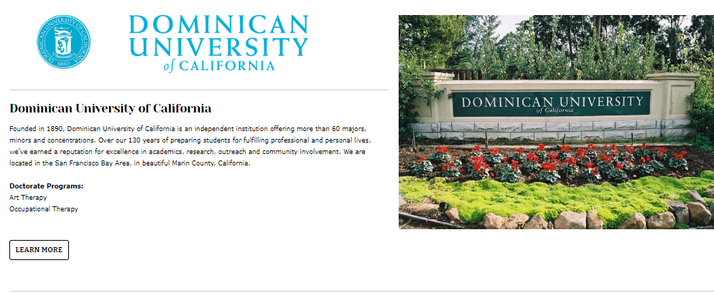
Colleges/Universities
Notes:
Although many of our recipients come from UC Berkeley and University of Hawaii at Manoa, there are actually 16 colleges and universities which offer over 150 doctoral programs in Founder Region.
Recognized Schools in Founder Region who offer doctoral programs Include:
California Sate University, East Bay
Dominican University of California
Graduate Theological Union
Life Chiropractic College West
Mills College
Saint Mary’s College
Samuel Merritt University
San Francisco Theological Seminary – San Anselmo
The Sanville Institute – Berkeley
Saybrook - Oakland
Touro University
UC Berkeley
UC Hawaii, Manoa
The Wright Institute
UMass Global
Chaminade University of Honolulu

Slide 11
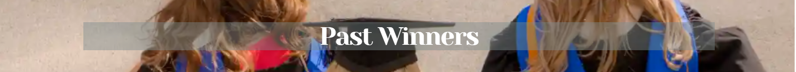
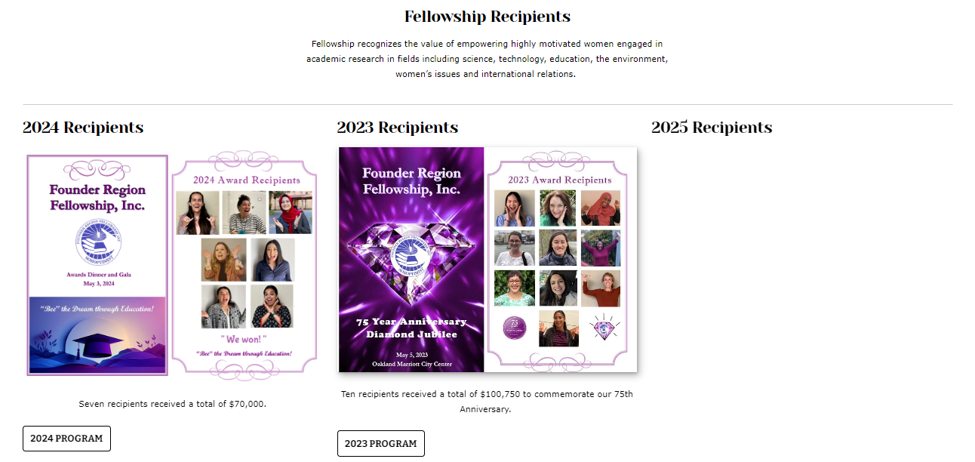
Notes:
Check out the “Past Winners” page on the Founder Region Fellowship website to read about Fellowship recipients and their ground breaking research.
Doctoral Candidates who have been awarded a Fellowship Grant have been in fields such as:
Applied Linguistics
Astronomy
Astrophysics
Biological Oceanography
Botany
Cancer Research
Civil Engineering
Education
Epidemiology
Medicine
Political Science
Tropical Medicine

Slide 12
SUPPORTING FELLOWSHIP
Founder Region’s Identifying Project
Solving Puzzles by Degrees! Founder Region Fellowship, Inc.
Notes:
We know that Fellowship is Founder Region’s identifying project and has been since 1948. Clubs and members continue to support this program wholeheartedly and find value in our mission. We work collaboratively with region leadership to build a strong relationship to ensure our sustainability. Founder Region Fellowship is almost completely supported financially by our members so we want to share with you all the ways you can ensure Fellowship is around for the next 75 years.

Slide 13
CLUB SUPPORT
Club Budget
$1,000/year – name a Fellow
$500/year – name a Fellow every 2 years
In Memory of Donation
In Honor of Donation
milestone anniversaries
special recognition
Solving Puzzles by Degrees! Founder Region Fellowship, Inc.
Notes:
Here are the ways a club can support our mission.
Make Fellowship contributions a line item in your Club Budget so you can name a Fellow annually or bi-annually.
$1,000/year and name a Fellow every year
$500/year and name a Fellow every 2 years
Update your bylaws to make Fellowship your “charity of choice” for memorial contributions for members and their immediate families.
Honor your members with donations to Fellowship for club milestone anniversaries and special recognitions.
The more you talk about and support Fellowship, the more your members will find value in our mission.

Slide 14
MEMBER SUPPORT
$1,000 Donation – Become a Fellow
Sign up for Monthly Giving
minimum $25 pledge
Donate “In Memory/Honor of”
Support Fellowship Basket Drawing
Support Fellowship Sales
Facebook Birthday Fundraiser
Solving Puzzles by Degrees! Founder Region Fellowship, Inc.
Notes:
Our members can support Fellowship in these following ways:
Make a $1,000 Donation to become a Fellow or level up, but if that is not in your budget..
Sign up for Monthly Giving with a minimum $25 pledge. Donate “In Memory/Honor of” – make Fellowship your “Charity of Choice” in memory or in honor of your loved ones.
Support the Fellowship Basket Drawings at the District Meetings by buying chances to win a prize.
Support Fellowship Sales – visit our table
Hold a Birthday Fundraiser on Facebook to solicit donations from family and friends.

Slide 15
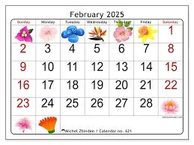
Club Participation
Invite Fellowship Director
Fellowship Presentation
Plan Club Fundraiser
“Fun for Fellowship” Calendar Game
Solving Puzzles by Degrees! Founder Region Fellowship, Inc.
Notes:
Plan now to invite your Fellowship Director to attend your club meeting to talk about Fellowship. First come, first served in reserving a date. Directors will be visiting all clubs throughout the biennium and we look forward to sharing our passion for Fellowship with all your club members.
Plan a Club Fundraiser on your own and donate the proceeds to Fellowship. How about Bunko or Bingo? Plan a social and have some fun while supporting Fellowship.
We have provided you a “Fun for Fellowship” Calendar game that members can refer to every day during February and donate the recommended amount.

Slide 16

THANK YOU
President – Vicki Ham
Fellowship Treasurer – Danelle Tegarden
Fellowship Directors:
District I – Amelia Benko
District II – Kay Kelley
District III – Colleen Ganaye
District IV – Tess Albin-Smith
District V – Cindy Rasmussen
Solving Puzzles by Degrees! Founder Region Fellowship, Inc.
Notes:
The Fellowship board is hard at work to ensure we continue to be valuable, forward thinking, and successful in supporting our Soroptimist mission.
We want to thank you for your continued support and we look forward to a fun and successful biennium celebrating empowering women who will truly make a difference in the world.

